Slide 1
Anti-Bullying Week:
Parent Workshop
Our Lady of the Visitation
13th November 2024

Slide 2
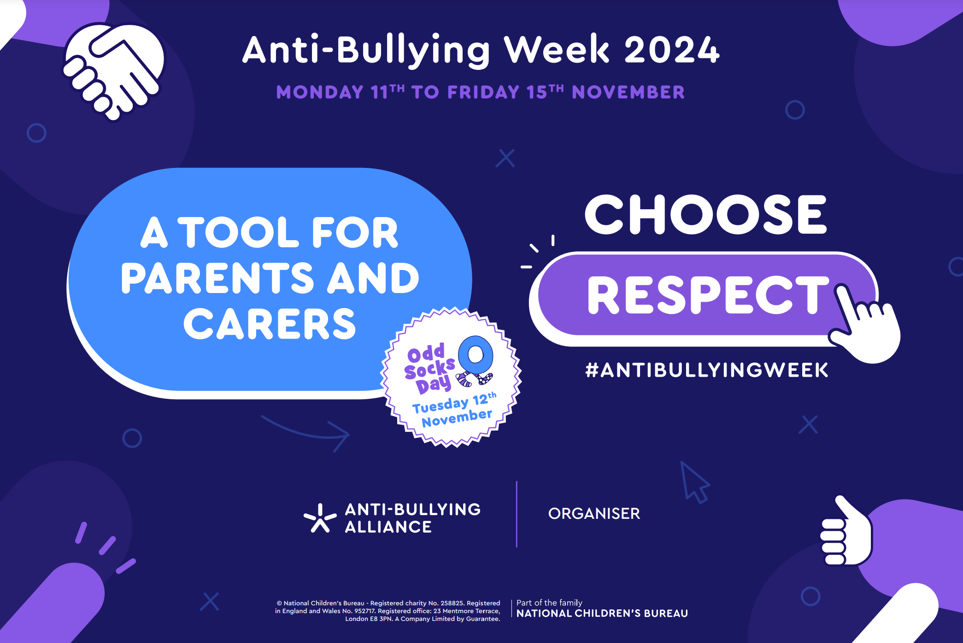

Slide 3
30% of children have been bullied in the past year.
On average, one child in every classroom experiences bullying every day
Anti-Bullying Week - what is it and what does it achieve document_2023 FINAL.pdf

Slide 4
What do the statistics show us?
5%
23%
32%
Of pupils across Ealing fear going to school because of bullying ‘often or very often’
Of pupils across Ealing said they had been ganged up on in the last month
Of pupils in Year 4 and Year 6 at OLOV said they had been bullied through their mobile phone, internet, games or social media in the last month
Ealing Health Related Behaviour Survey, 2023

Slide 5
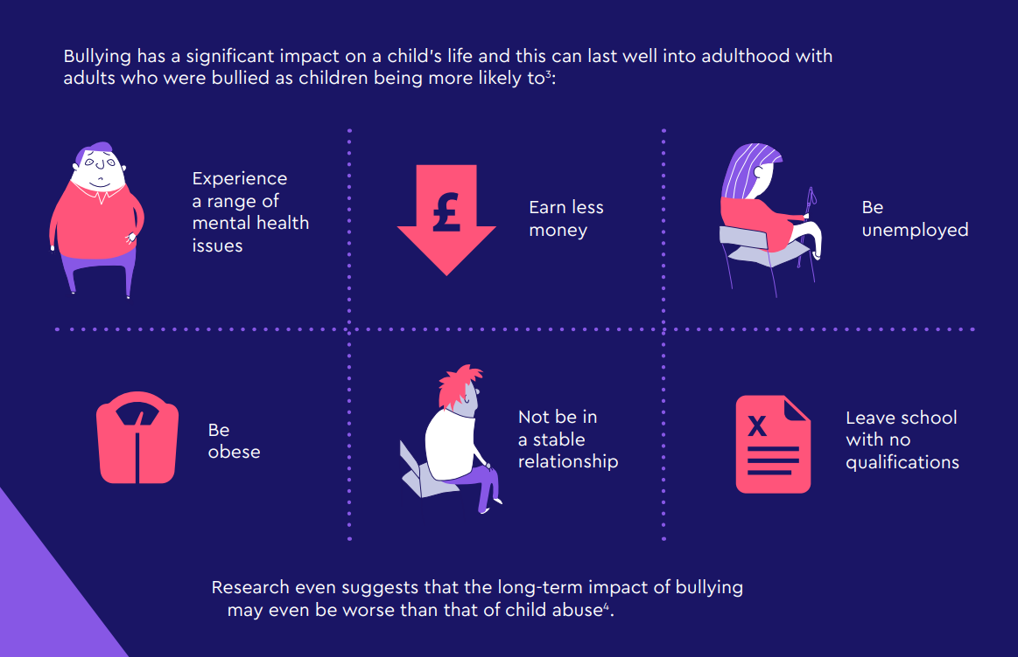
Anti-Bullying Week - what is it and what does it achieve document_2023 FINAL.pdf

Slide 6
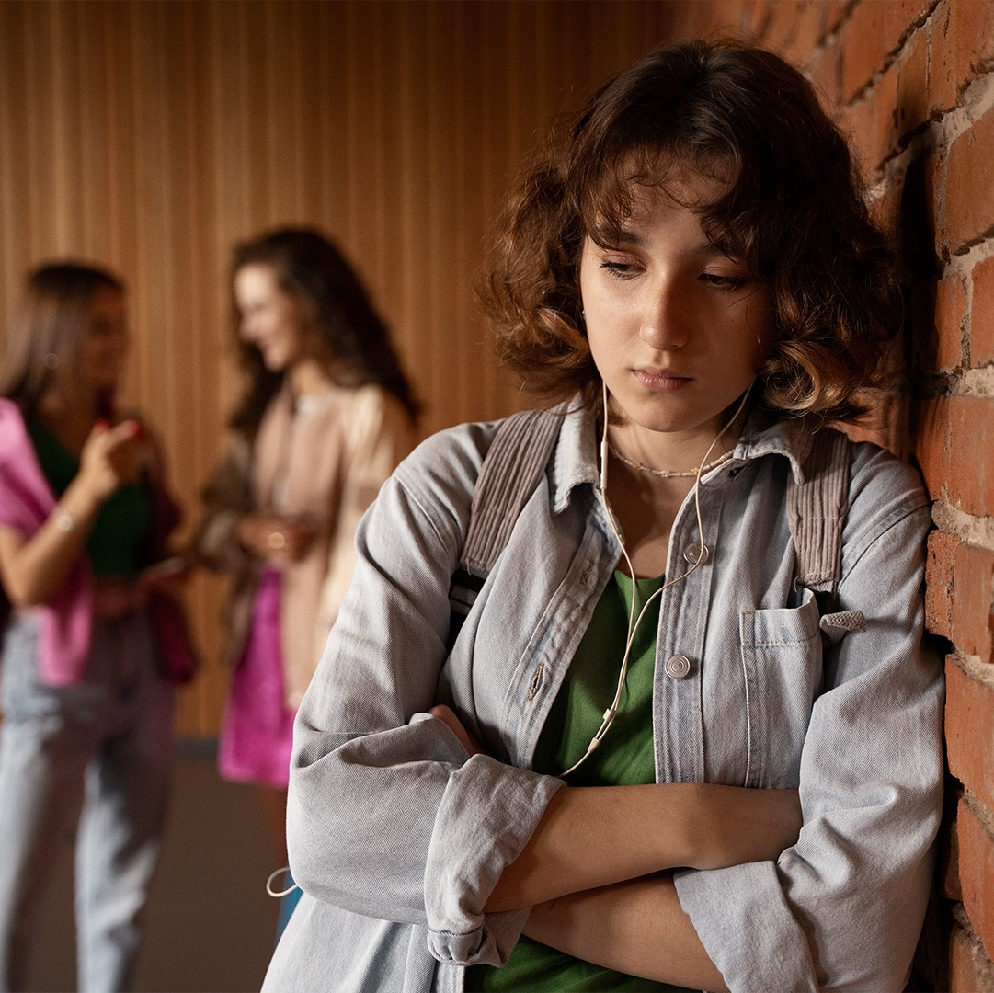
Definition of Bullying:
The Anti-Bullying Alliance defines bullying as:
The repetitive, intentional hurting of one person or group by another person or group, where the relationship involves an imbalance of power.
Bullying can be physical, verbal or psychological.
It can happen face-to-face or online

Slide 7
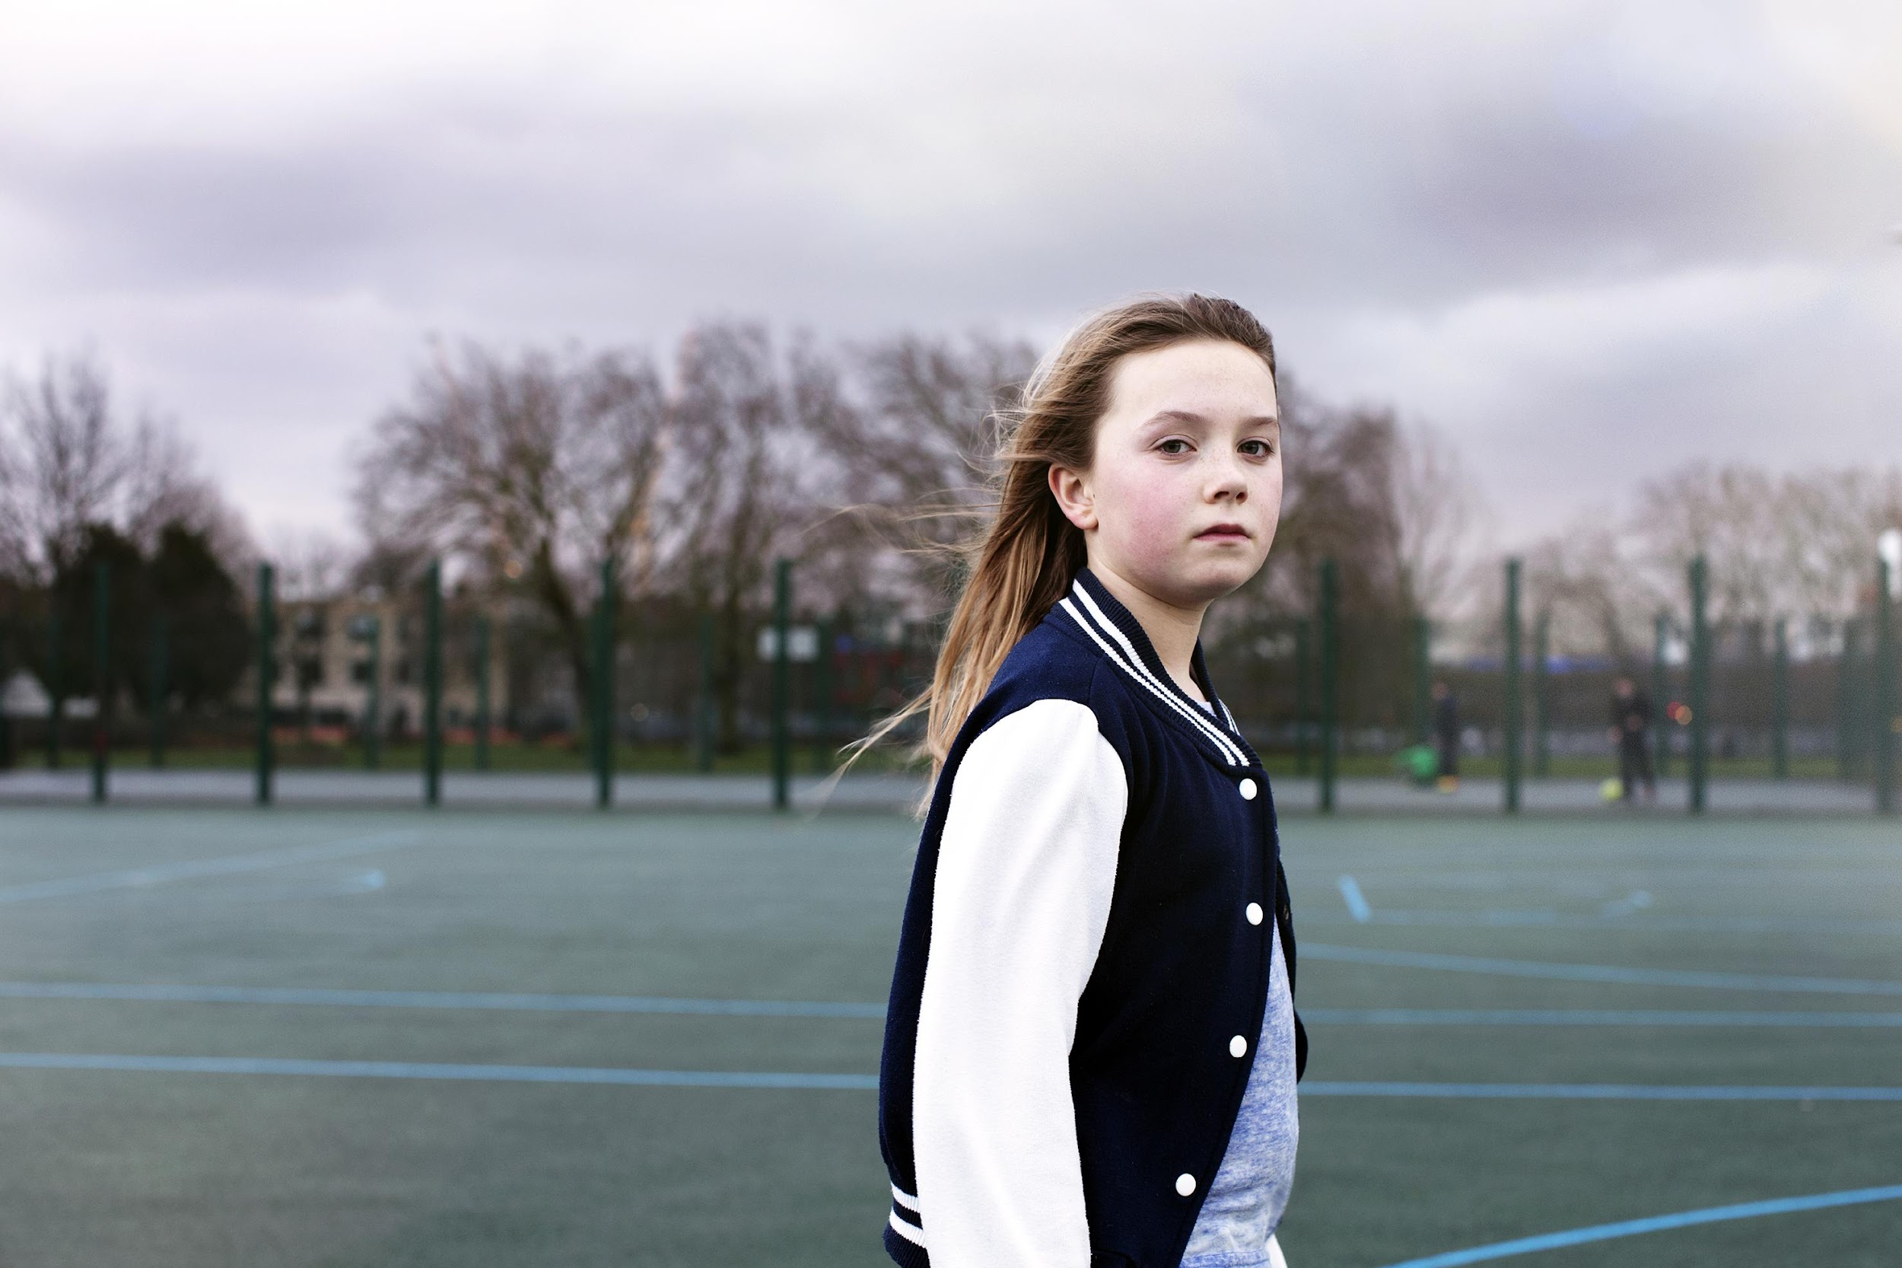
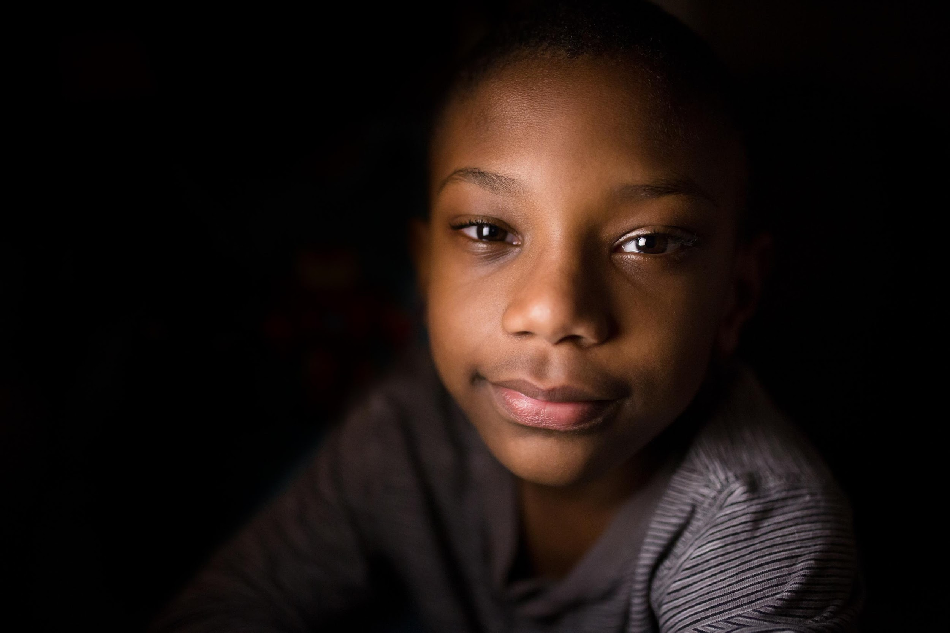
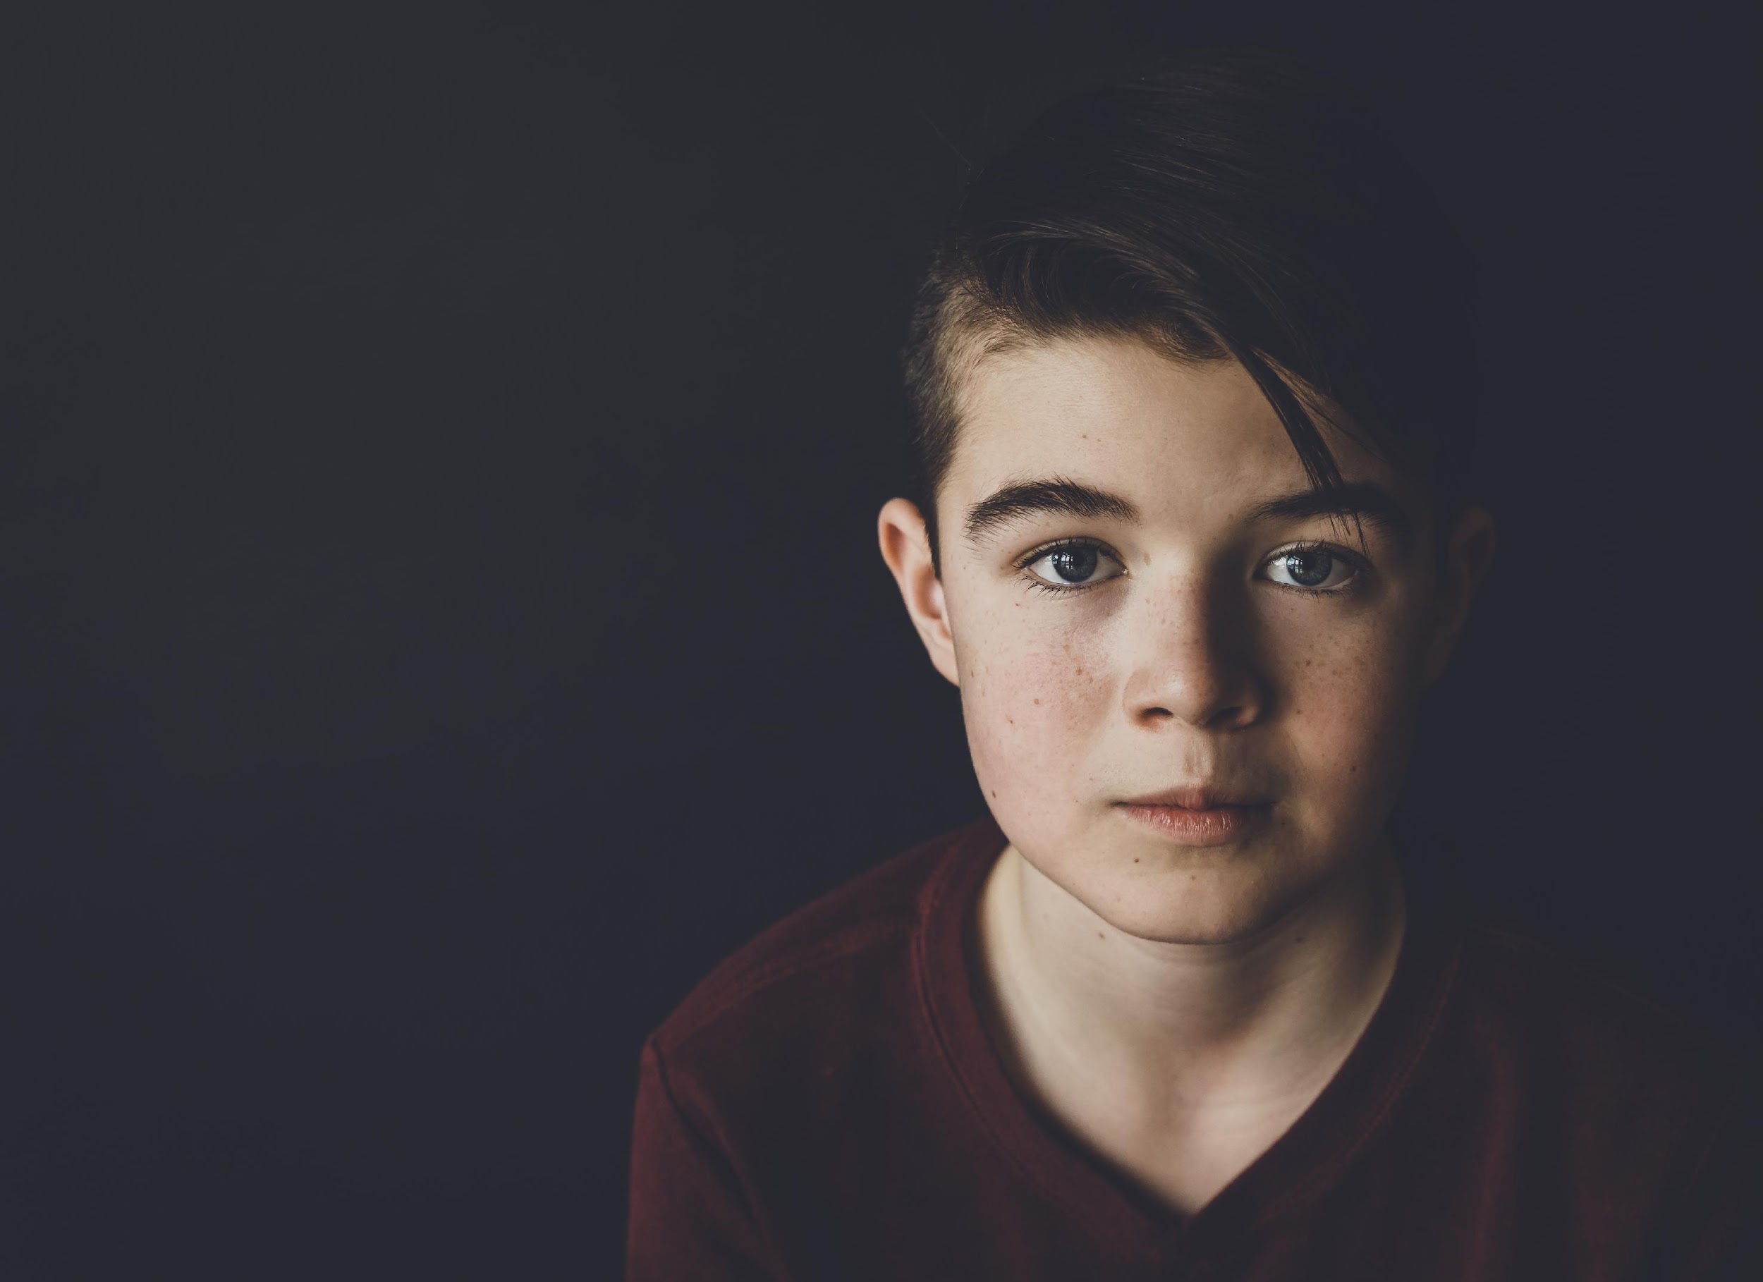
The ways children experience bullying…
The person or people who are being targeted or experiencing the bullying behaviour
—The Victim
Children can witness bullying in person or online, the vicarious harm that can be caused by ongoing witnessing harm can be damaging
—The Witness
We encourage the move away from the word ‘bully’ which labels the person and can become self-fulfilling and instead describe bullying behaviour
—The Perpetrator

Slide 8
Cyber-Bullying- Victims and the Vicarious impacts
1 in 6 children experience cyberbullying.
Children who are bullied face to face, are now often being targeted online as well.
2018 to 2022 shows a concerning increase in cyberbullying, with boys cyberbullying others rising from 11% to 14% and girls from 7% to 9%. Similarly, reports of being cyberbullied have escalated from 12% to 15% for boys and from 13% to 16% for girls.
18.1% who experienced an online bullying behaviour and 14.7% who experienced an in-person bullying behaviour did not tell anyone.
Boys are being targeted with more violence and harmful behaviour through online algorithms.
1-3. One in six school-aged children experiences cyberbullying, finds new WHO/Europe study
4. Bullying and online experiences among children in England and Wales - Office for National Statistics
5. Social media: Why algorithms show violence to boys - BBC News

Slide 9
Not all unkind behaviour is bullying…

Slide 10


Not every unkind behaviour is bullying…
Rude
Mean
Bullying
When someone says or does something
ACCIDENTALLY or
NOT ON PURPOSE
and they do it once that is RUDE
When someone says or does something
INTENTIONALLY OR ON PURPOSE
and they do it once that is MEAN
When someone says or does something
INTENTIONALLY OR ON PURPOSE and they
KEEP DOING IT
that is BULLYING

Slide 11
Skills to empower young people:
Respect
Empathy
Resilience
We need to recongise and respect differences. We need to model this in all our relationships.
We need to learn to consider others feelings. “I understand you are feeling X because of this”
Learning when to walk away or when to own up and accept blame.
Allyship
Confidence
Self-Control
Are we being a good friend to those who need it? How would we want someone to show up if that was us?
Self-belief is critical, ensuring children don’t let the thoughts and views of others define them.
Regulating our feelings and thoughts. Our thoughts are just that, we always can choose how we respond.

Slide 12

Dealing with friendship troubles
Communicating Feelings
Learning to Compromise
“It makes me feel X when Y happens”
Not “you made me feel”- taking back the power
Practice, sharing, negotiating, setting boundaries and considering others needs
HELP!
Self-Confidence
Asking for help
Positive affirmations and resilience are key skills, are children confident in who they are? Do they have the confidence to walk away?
Ensure children know who the trusted adult is in different places or online. Model curosity when problems arise and help children solve it themselves.

Slide 13
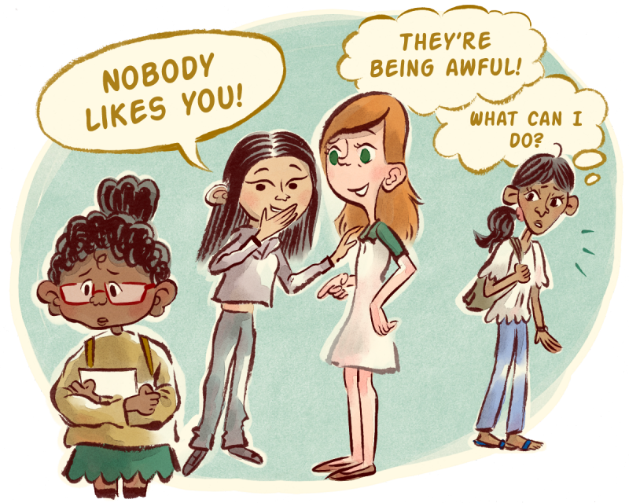
Active Bystanders… UPSTANDERS!
From Bystanders, to Active Bystanders to Upstanders…
Children more so than adults are likely to intervene if they see someone being hurt. As they get older, the rate of active bystanders drops.
How can we be an upstander?
Be a Buddy
Interrupt
Speak Out
Tell someone

Slide 14
How do I talk to my child about bullying?
4. If your child is experiencing an issue, listen and reassure them that coming to you was the right thing to do. Ensure they know they aren’t to blame.
5. Involve your child in the next steps, ie discussing with a chosen member of staff that they feel safe with.
6. Encourage children to build resilience, empathy and be able to set boundaries, this will help them in the long term.
7. Empower children to call in behaviours which don’t feel right and allow them to say no.
Prevention is better the cure. Begin conversations around healthy friendships and bullying before it happens.
Regularly discuss healthy friendships, online safety and check in with how they are feeling with different scenarios that arise
Ask open questions, be curious and explore problems with your child avoid the temptation to lead with the question “are you being bullied?”
4. Ask how situations made them feel? Ask if they have witnessed unkind behaviours

Slide 15



Where can I get more support?
Reach out
Step 1- Talk to the school
Ensure they are aware of the problem and share your concerns.
Ensure your child knows who to speak to at home and at school.
Online Support
KIDSCAPE- Anti-bullying Adive
YoungMinds- provides advice and information about young people’s mental health and have a parent helpline
NSPCC
Internet Matters
Parentsafe from LGFL
ABW Parents Pack 2024.pdf

