Slide 1

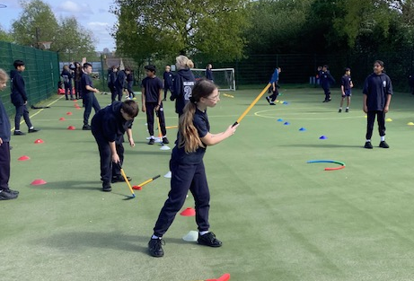
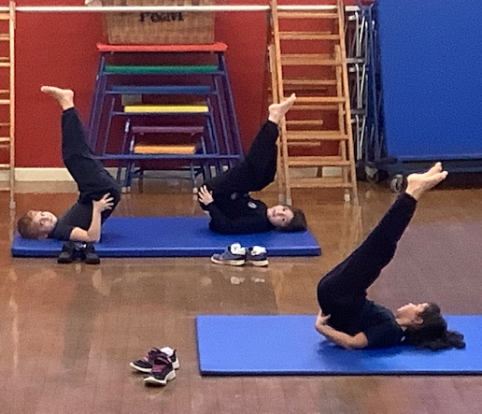
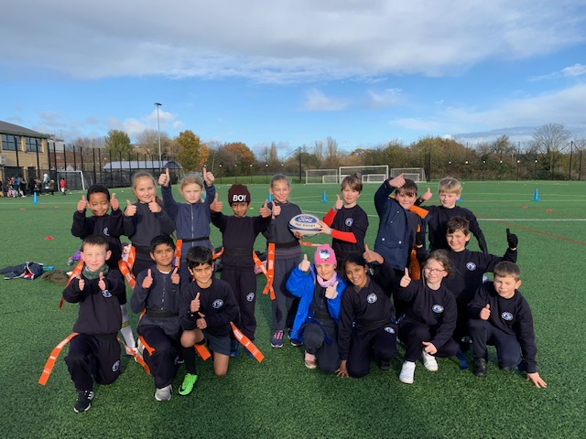
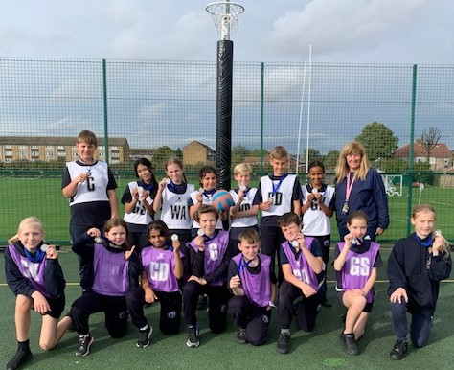
P.E & Sport at
Our Lady of the Visitation
2023-24
MOVE, LEARN, GROW
LEARN, PRACTICE, COMPETE

Slide 2
P.E Curriculum
2 hours of quality P.E per week. We follow the Real P.E programme which focuses on the physical literacy, emotional and thinking skills to achieve in PE, Sport and life.
This inclusive approach tackles teamwork, co-operative learning and allows each pupil to challenge themselves. We want our pupils to be confident, fun loving learners in P.E.
Y5 and Y4 pupils attend weekly swimming lessons at Dormers Wells Pool. Additional swimming lessons take place in Summer Term for any pupils in Yrs 4/5/6 who is yet to achieve their 25m target.

Slide 3
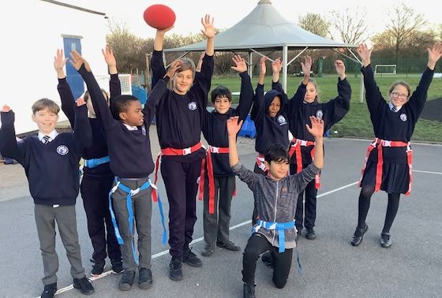
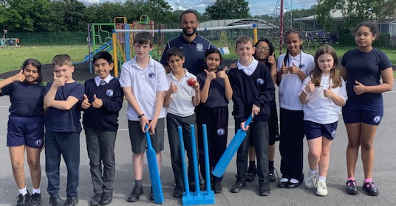
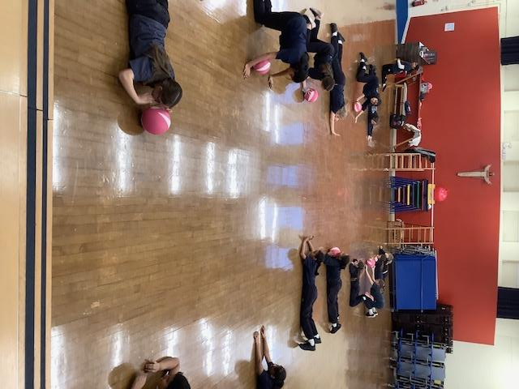
In addition
We offer afterschool sports clubs :
- Tennis, Gymnastics, Basketball and Football (external providers Get Set4Tennis & BFCCST)
- Free clubs Gymnastics (50% targeted e.g PP),
Team Up (Girls only multi-sports)
Active Me (aimed at those not doing other clubs).

Slide 4
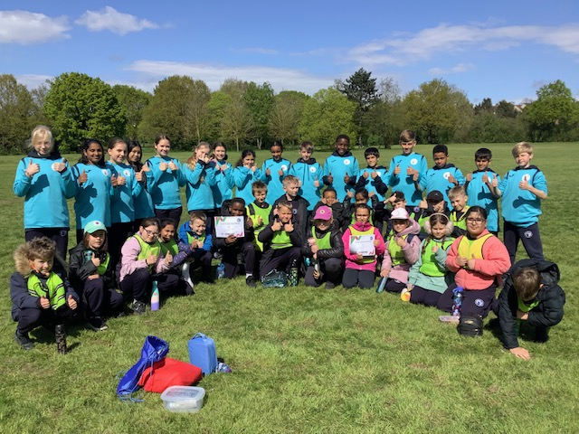
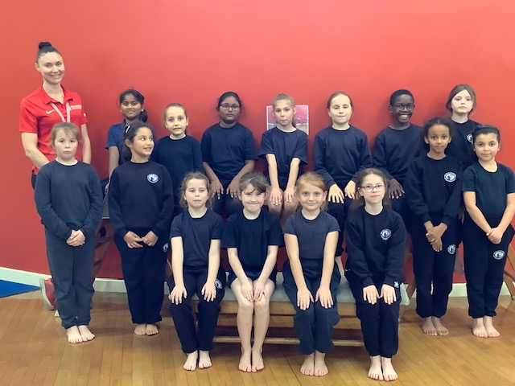
Continual Professional Staff Development
Willow Tree Sports Partnership provided CPD support through one to one support for 6 weeks and SL received support with planning and monitoring.

Slide 5
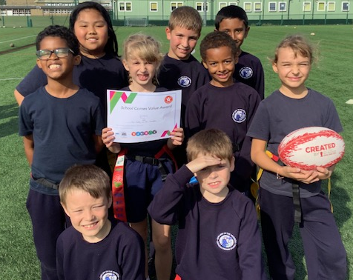
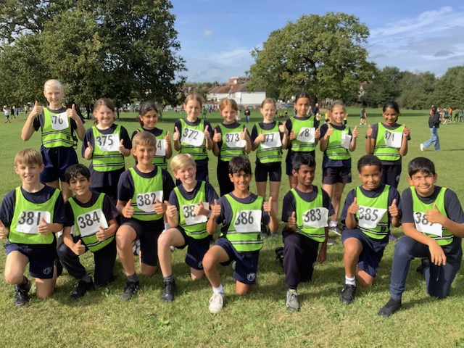
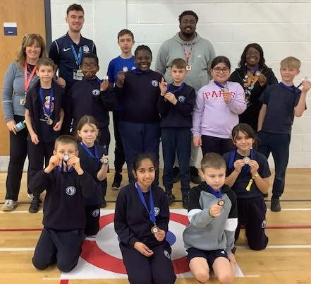
Sport Competitions & Festivals
We aim for 100% of pupils in Yrs 6,5,4 to experience an interschool sports event each school year.
School Sports days- split into EYFS, Y1&Y2, KS2.

Slide 6
New this year.
Sensory Circuit
Each morning we have a sensory circuit set-up to stimulate and support pupils (target group)
Music in the Playground at lunchtime
Girls only football on Fridays
Gymnastic Club and Cricket Club

Slide 7

School Gamesmark
Evaluates range and inclusivity of
sports opportunities at school.
Includes Pupil Leadership roles: Young Sports Leaders: Playground Leaders, Sports Ambassadors and Sports Crew.
Our Lady of the Visitation are targeting Platinum in 2023-24

Slide 8
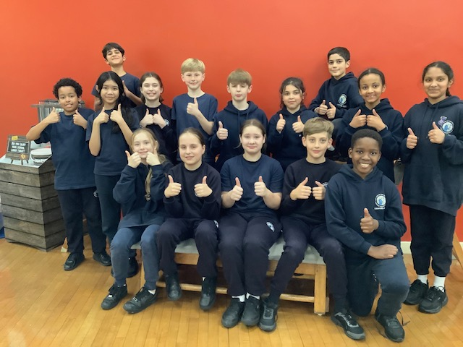
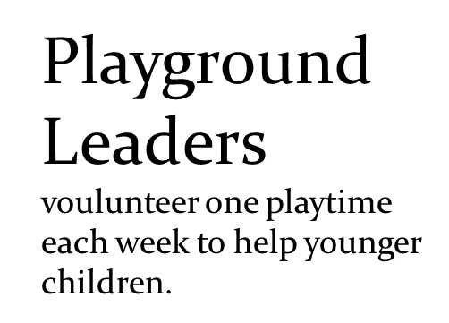
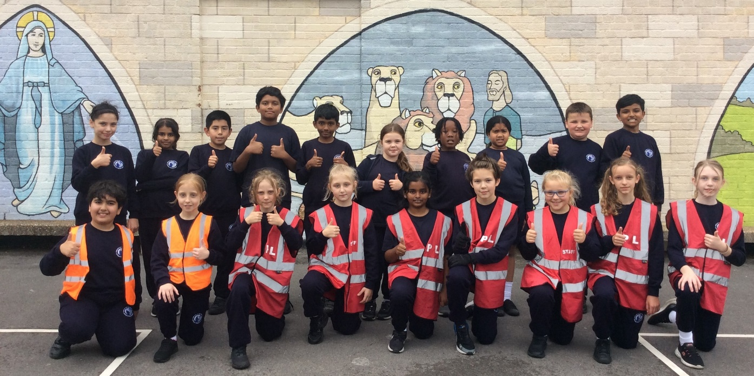
Young Ambassadors
We have 15 Y6 pupils training this year: their challenges include sharing their passion for sport, promoting teamwork and sports values, creating games to share and making posters about Being Active and Healthy lifestyle choices

Slide 9
Aims for 2023-2024
Maintain and enhance the delivery of Real P.E in curriculum time throughout the school (inc cpd).
Embed “Active Me’ & healthy lifestyle choices
Maintain and develop sports clubs OSHL
Develop an inter-school activity with St Anselm’s
Achieve Platinum Games Mark
Continue to share enthusiasm for PE & Sport.
Go Team Visitation!

Slide 10
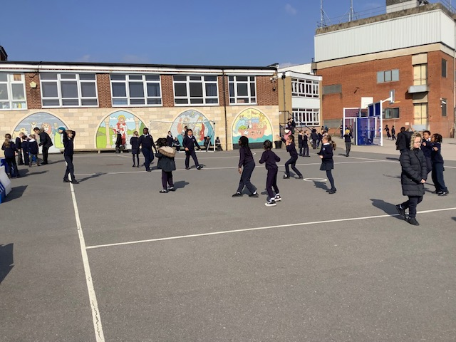
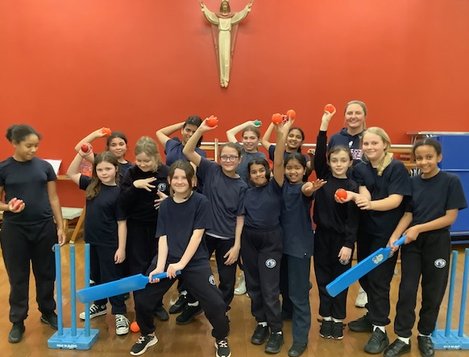
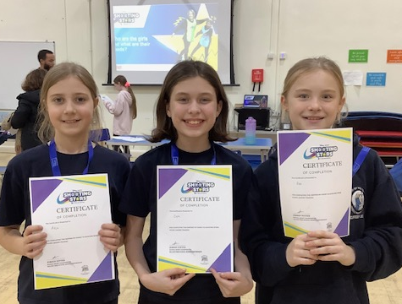
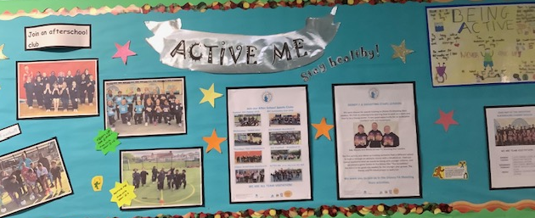
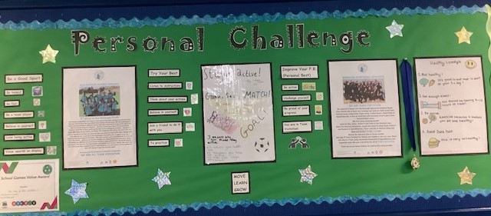
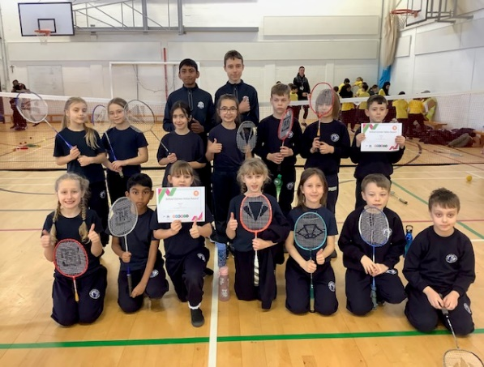
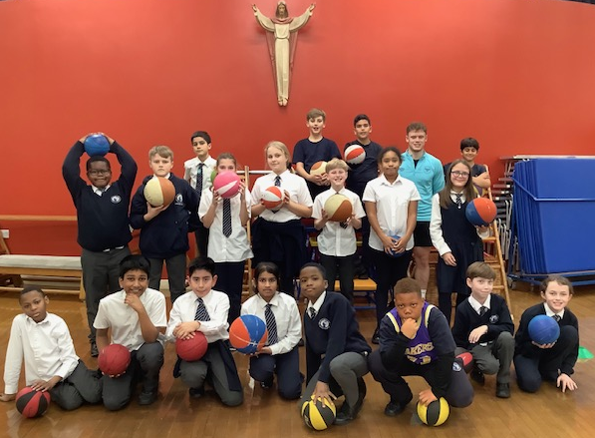
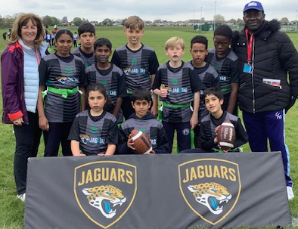
We are Team Visitation!

