Slide 1


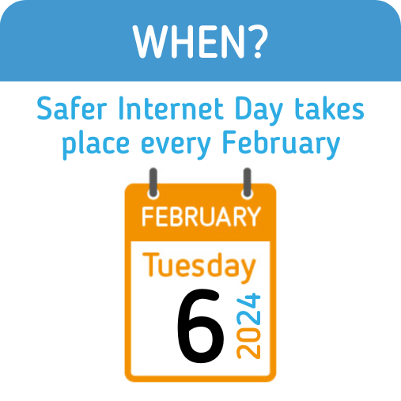
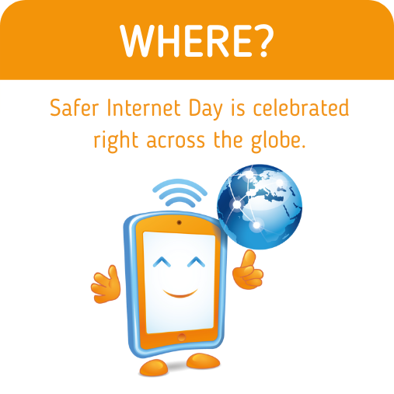
Safer
Internet
Day
Assembly

Slide 2
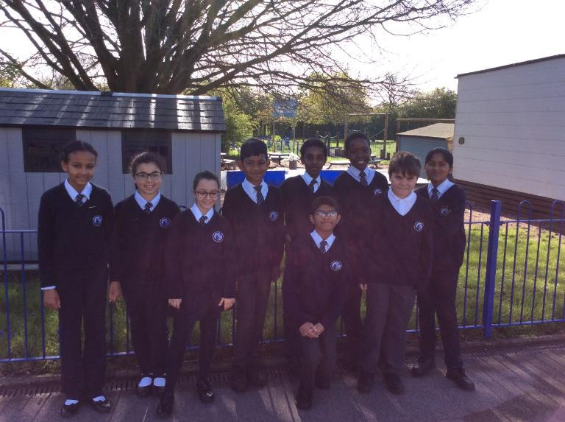
Notes:
Sethika - Good morning, everyone! We, your Digital Leaders, are excited to take you on a journey through some crucial aspects of staying safe in the vast world of the internet. Next week, we are celebrating Safer Internet Day and we wanted to do an assembly on keeping you safe online.

Slide 3


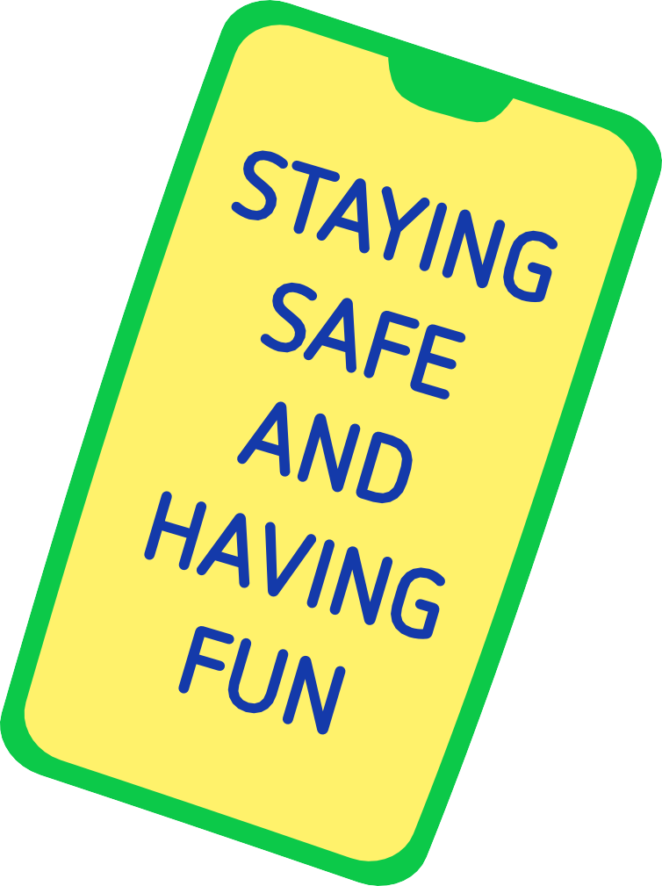
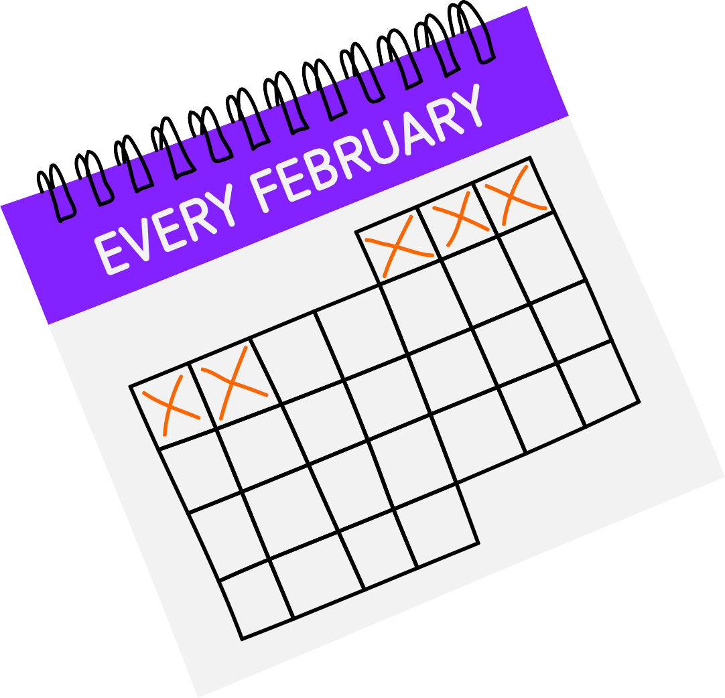
Notes:
Miss Spicer - What is Safer Internet Day?
All go and walk round and talk to the children
Address the audience - “What is Safer Internet Day?” Listen to the audience’s responses.
Alex - Safer Internet Day is held every February all around the world.
It’s a special day when we think about using the internet and technology.
Hands up if you have used a laptop, a tablet like an iPad, Mum’s or Dad’s or someone else’s phone, a games console like a Switch, an Xbox or a PlayStation, a smart speaker a question, like Alexa or Siri.
Look at audience responses
Saba - All of these devices and more can connect to the internet. That means we can do fantastic things like listen to music, play games, watch videos or chat with friends and family.
Safer Internet Day is a chance to celebrate all the amazing things technology can help us with, but also to think about any worries we might have going online.

Slide 4



Notes:
Edessa - It’s not just schools who join in with the day, lots of other people get involved too, including the government, lots of charities, sports clubs, the police and even the companies who make your favourite apps and games.
By doing this, you’re joining in with thousands of others in marking the day!

Slide 5
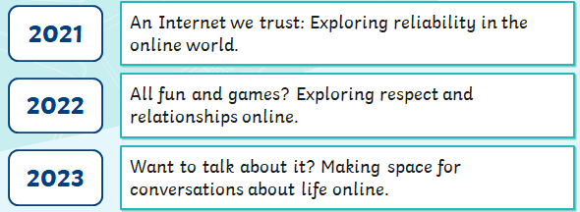
Each year, Safer Internet Day is based around a theme.
Here are the themes from the past three years.
Notes:
Sandy– Each year, Safer Internet Day is based around a theme.
Here are the themes from the past three years.
Alex - 2021
Saba - 2022
Sandy - 2023

Slide 6

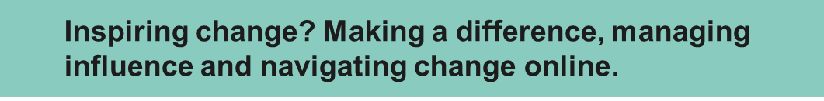
Notes:
Sandy - 2024
Alex - Safer Internet Day is a chance to celebrate all the amazing things technology can help us with, but also to think about any worries we might have going online.

Slide 7







Notes:
Alexander - Think of many different devices we use to access the internet.
How many can you think of?
All go and walk round and talk to the children
Saba - Address the audience - “How many can you think of?” Listen to the audience’s responses.

Slide 8

Notes:
Emmanuel - In a world where the internet is as common as a pencil, it's crucial to know how to use it wisely. Our first tip for today is fundamental: think before you click.
Alex - Absolutely, Emmanuel! Before you click on any link or share personal information, take a moment to think. Is it from a trusted source? Does it look safe? Being smart online is about protecting your digital footprint and ensuring a secure online experience.

Slide 9
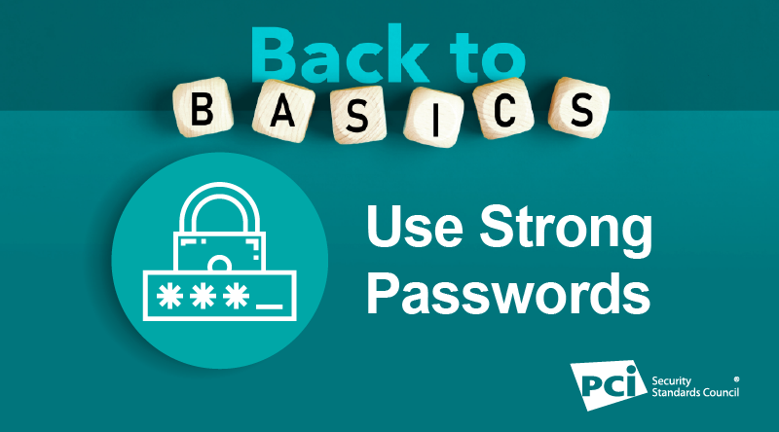
Notes:
Samuel - Now, let's dive into the fascinating world of passwords. No more "password123"! It's time to level up. Create strong, unique passwords using a combination of letters, numbers, and symbols. Treat your password like a fortress guarding your accounts.
Sethika - And once you've crafted that superhero-like password, guard it with all your might! Your passwords are your secret identity—keep them to yourself to maintain control over your digital world.

Slide 10
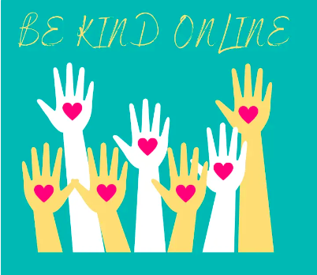
Notes:
Edessa - Moving on, let's talk about kindness online. Just as we wouldn't say mean things in person, we shouldn't do it online either. Our next tip is simple: be kind. Our words have power, even in the digital world.
Sandy - Absolutely, Edessal! If you ever come across something that makes you uncomfortable or upset, don't hesitate to talk to a trusted adult. We're here for each other, both online and offline.

Slide 11

Notes:
Alexander - Now, let's discuss the importance of keeping your devices and apps up to date. Those pesky updates are like digital superheroes—they contain essential security fixes. Don't ignore them; let them shield your gadgets from potential threats.

Slide 12
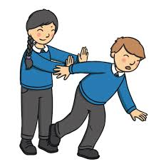
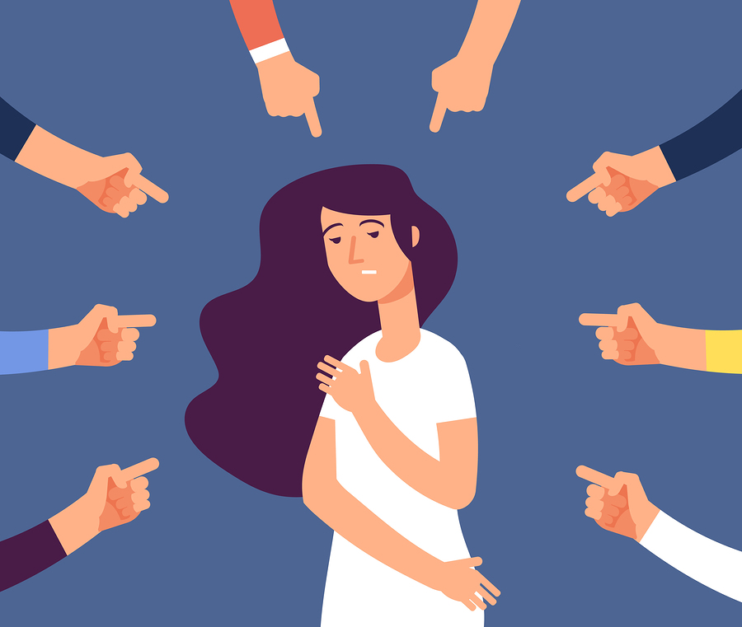
What is bullying?
Notes:
Alex - Bullying is when a person tries to hurt someone on purpose, either in what they say or what they do.
It usually happens more than once.
Some people use the Internet to bully others. This is called online bullying.

Slide 13
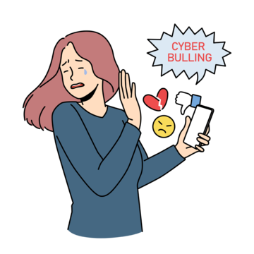
Online bullies may:
•send nasty text messages or emails
•say unkind things about people on social networking sites
•try to get others to say unkind and nasty things too
•send unkind photographs to lots of people
Notes:
Saba - Online bullies may:
•send nasty text messages or emails
•say unkind things about people on social networking sites
•try to get others to say unkind and nasty things too
•send unkind photographs to lots of people
Alex - Online bullying hurts people just the same as any other bullying.

Slide 14

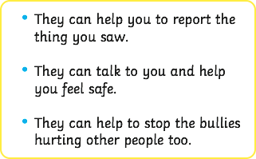
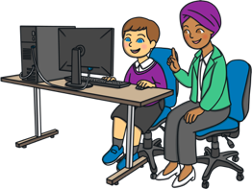
What If You or Someone Else Is Bullied Online?
Notes:
Saba - What if you or someone else is bullied online?
The most important thing …
Alex - Say bullet points and last sentence

Slide 15
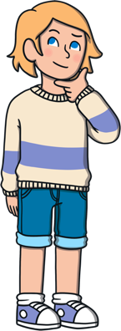





What could you do to help make the Internet a kinder place to be?
Notes:
Miss Spicer - What could you do to help make the internet a kinder place to be?
All go and walk round and talk to the children
Address the audience - “What could you do to help make the internet a kinder place to be?” Listen to the audience’s responses.

Slide 16





Notes:
Sethika - Stay safe
Edessa - Meet
Sandy - Accepting
Alexander - Reliable
Emmanuel - Tell

Slide 17

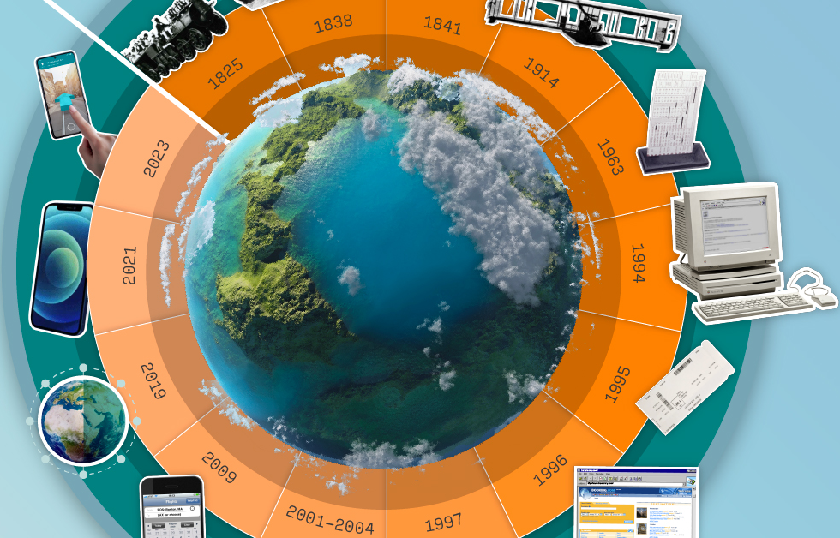
Dear God,
As we mark Internet Safety Day, we thank you for the gift of technology connecting us. Guide us online, granting wisdom for wise choices and courage against harm.
Protect us from cyberbullying and inappropriate content. Let your light shine on the internet, showing what's true and getting rid of anything that's not good
Bless those working for internet safety, and help us use the internet responsibly for learning, connecting, and spreading kindness. May we be digital citizens promoting love and understanding.
Amen.
Notes:
Alex - Dear God,
As we mark Internet Safety Day, we thank you for the gift of technology connecting us. Guide us online, granting wisdom for wise choices and courage against harm.
Saba - Protect us from cyberbullying and inappropriate content. Let your light shine on the internet, showing what's true and getting rid of anything that's not good
Bless those working for internet safety, and help us use the internet responsibly for learning, connecting, and spreading kindness. May we be digital citizens promoting love and understanding.
Amen.

Slide 18
Notes:
Emmanuel - And here's the exciting part! In celebration of Internet Safety Day, we're replacing our regular computing lessons next week with some fun activities. We'll explore the digital world in a way that not only educates but entertains. Get ready for an interactive and enjoyable experience!
Samuel - Thank you all for joining us on in our special Internet Safety Day Assembly! These tips aren't just for today; they're for every day. Being safe online is a shared responsibility, and together, we can make the digital world a better place for everyone. Stay safe, be smart, and enjoy your digital journey!

