Slide 1

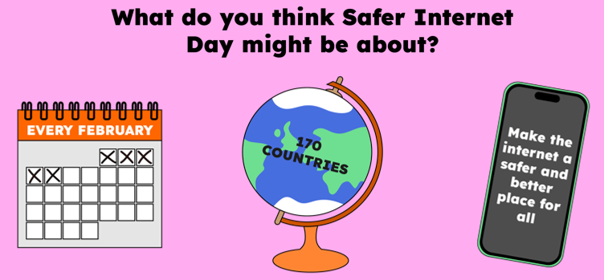
Safer
Internet
Day
Safer Internet Day is held every February all around the world.
Last year, over 170 different countries celebrated the day! Safer Internet Day is a chance to think about any worries we might have about using technology and the internet, but it’s also about celebrating all the fantastic things technology can help us with.
Hello everyone.
In today’s lesson we’re going to be talking about Safer Internet Day.
Notes:
Safer Internet Day is held every February all around the world. Last year, over 170 different countries celebrated the day! Safer Internet Day is a chance to think about any worries we might have about using technology and the internet, but it’s also about celebrating all the fantastic things technology can help us with.
Last year, over half of the children in the UK heard about or joined in with Safer Internet Day.

Slide 2
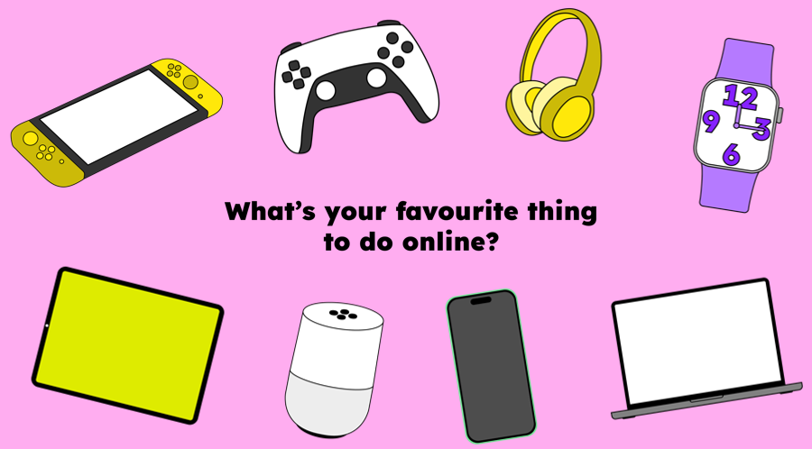
We want this year’s Safer Internet Day to be the biggest and best celebration yet! It’s so important to recognise all the exciting and amazing things we can do online… maybe you like to play games, or chat with your friends. Maybe you use the internet to learn new things, or maybe you love watching videos.

Slide 3
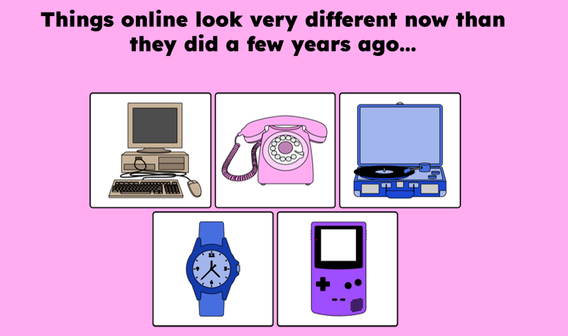
Today we are thinking about changes online.
Computers used to look like this…
You would play music on one of these…
Phones looked more like this…
Watches told us the time and date but not much else…
Gaming was a bit different too…

Slide 4
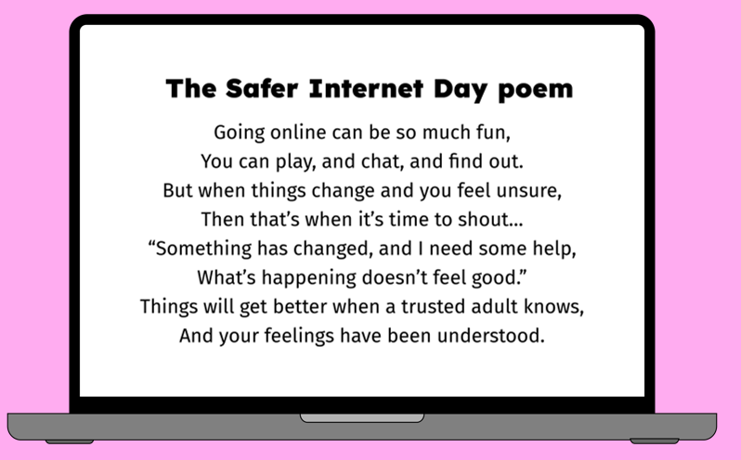

Slide 5


Slide 6
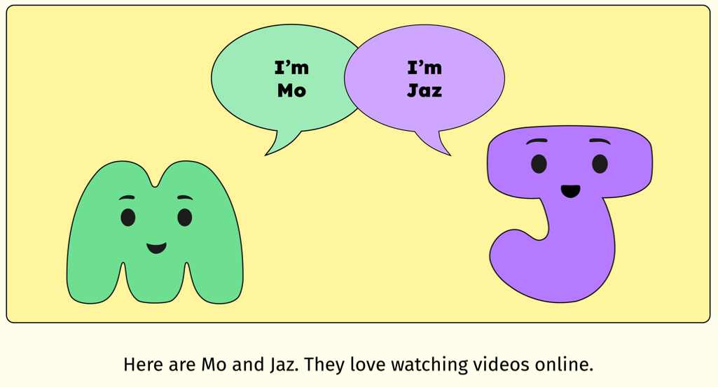

Slide 7
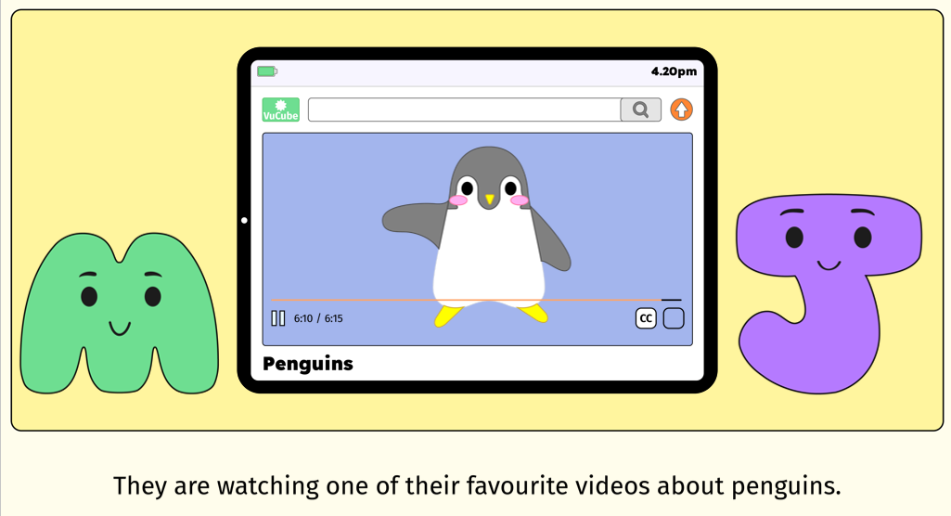

Slide 8
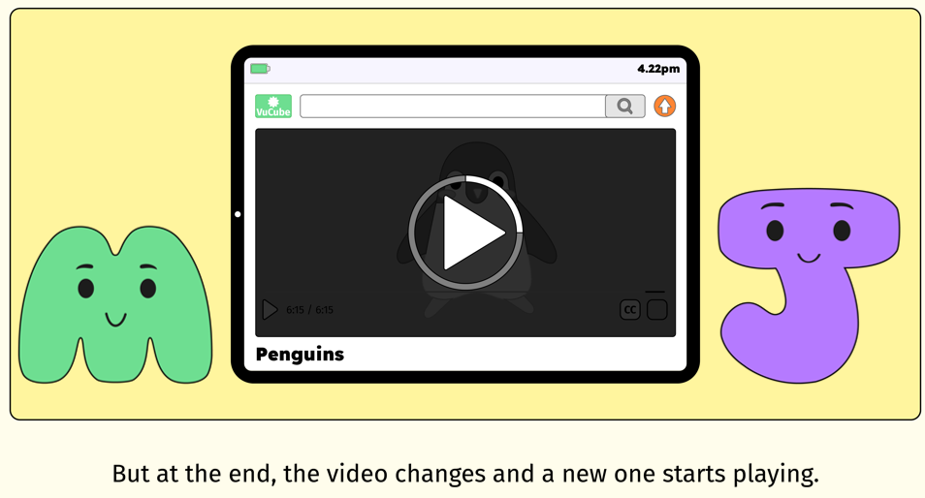

Slide 9
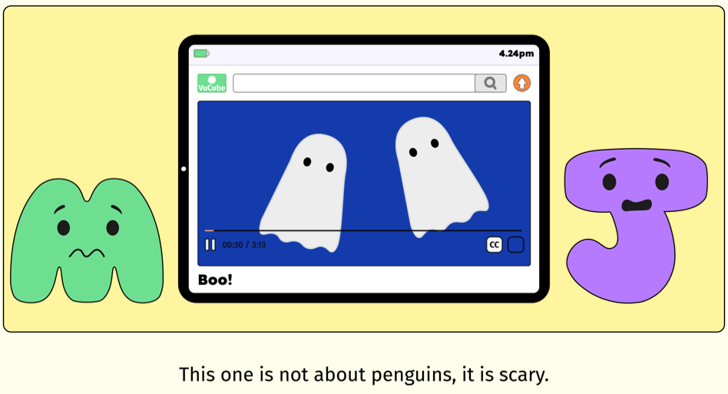

Slide 10
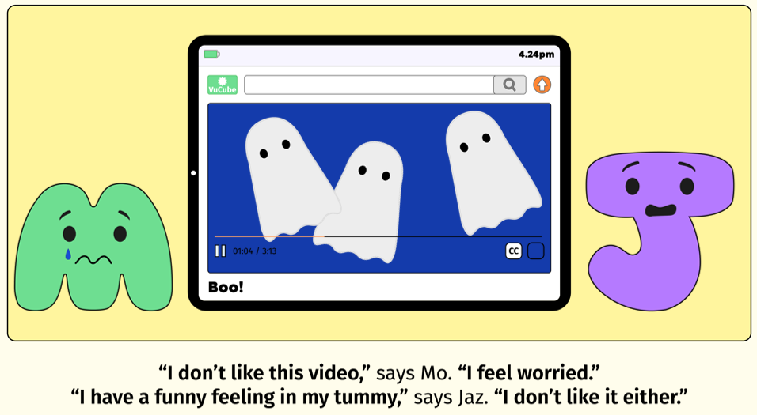

Slide 11
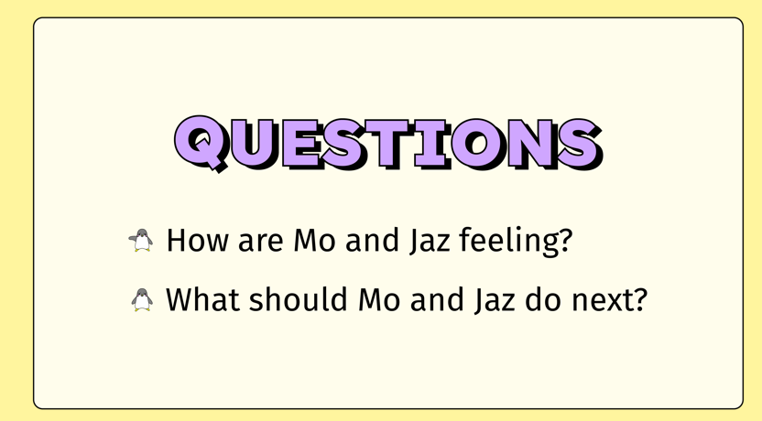

Slide 12
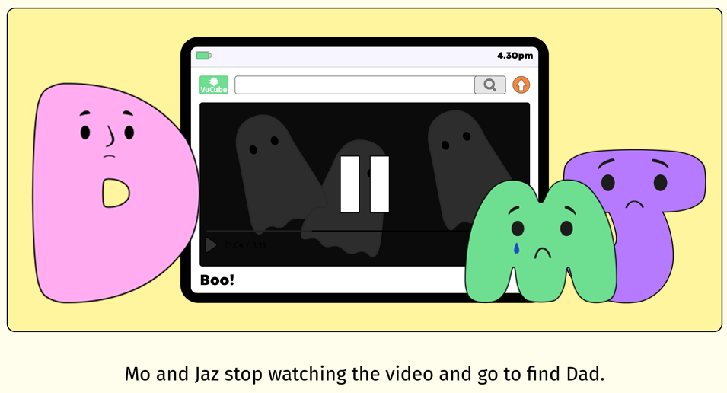

Slide 13
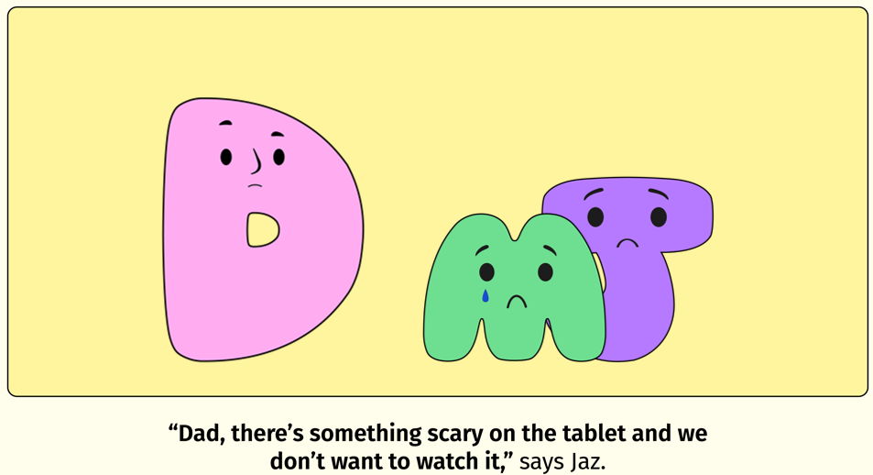

Slide 14
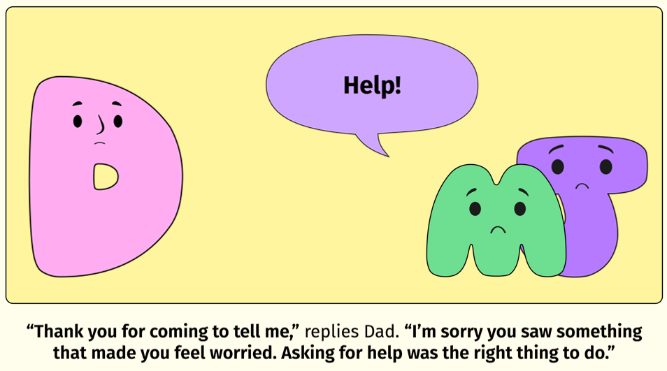

Slide 15
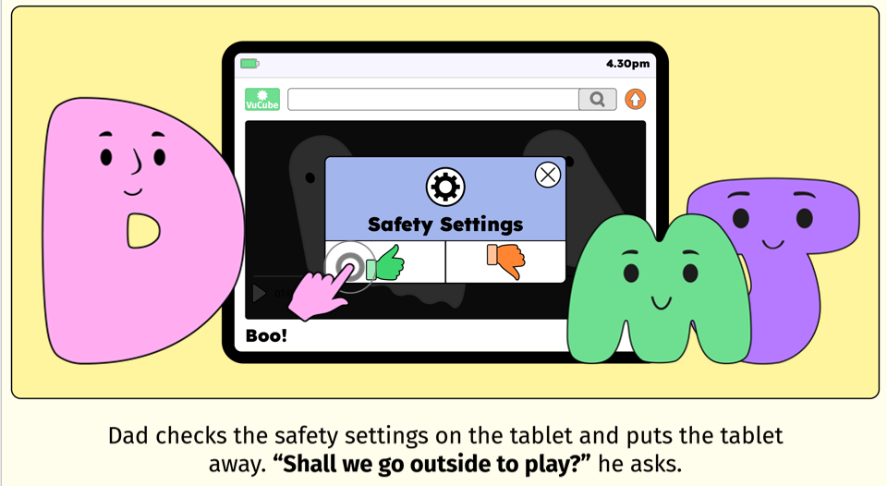

Slide 16
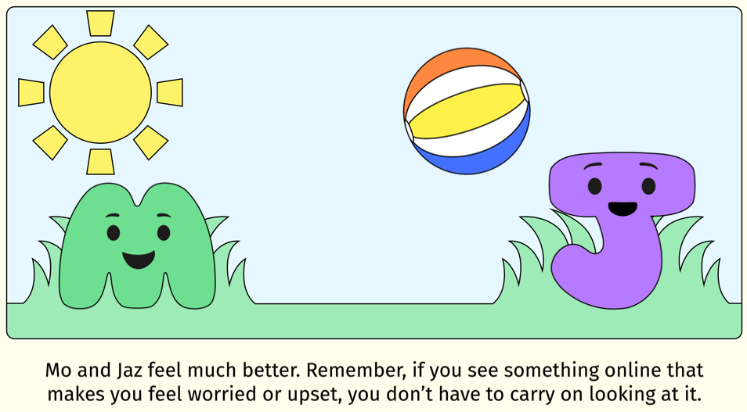

Slide 17
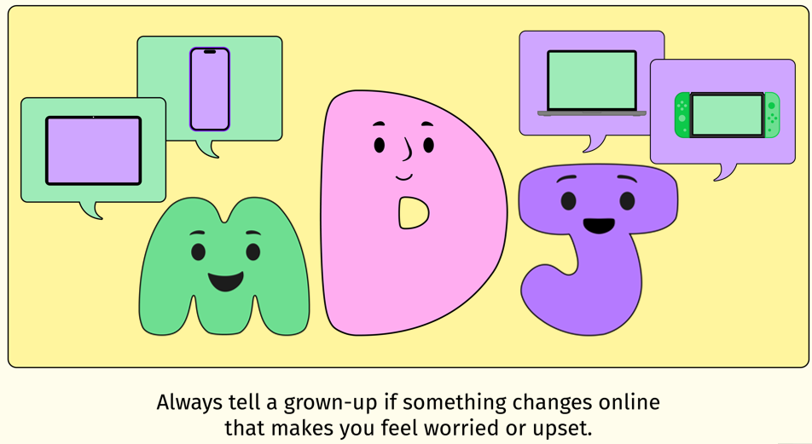

Slide 18
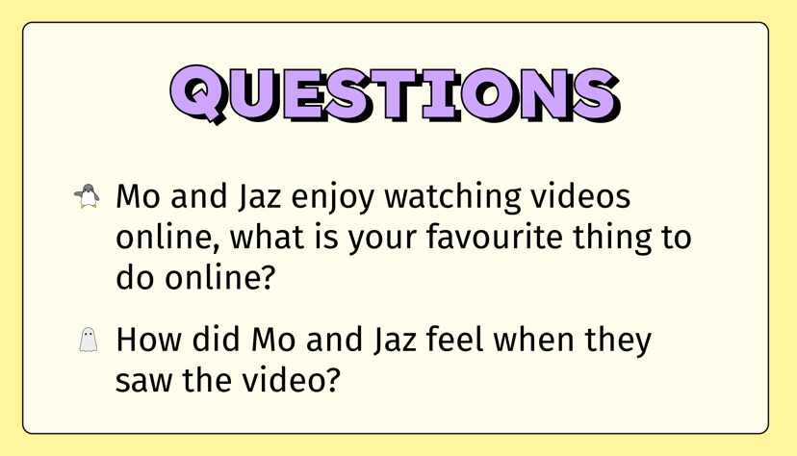

Slide 19
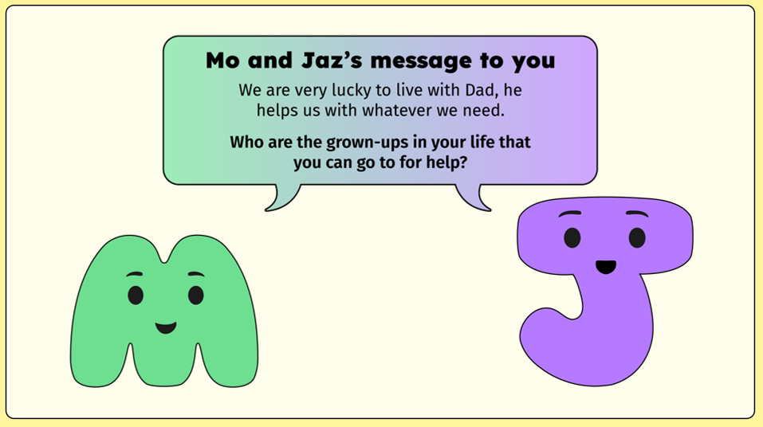

Slide 20
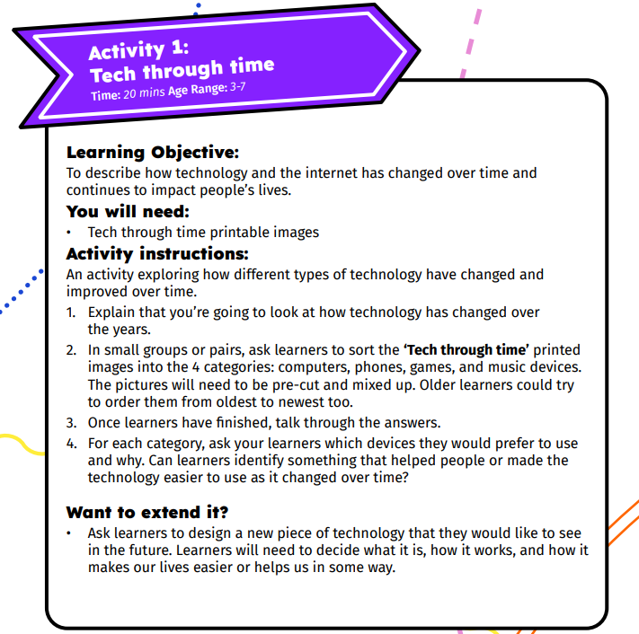
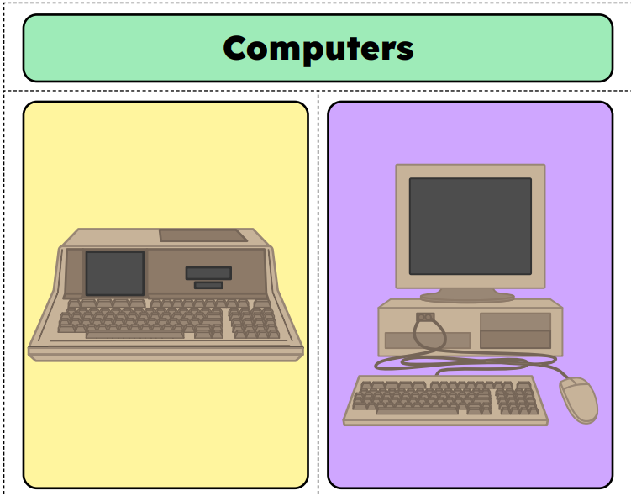

Slide 21
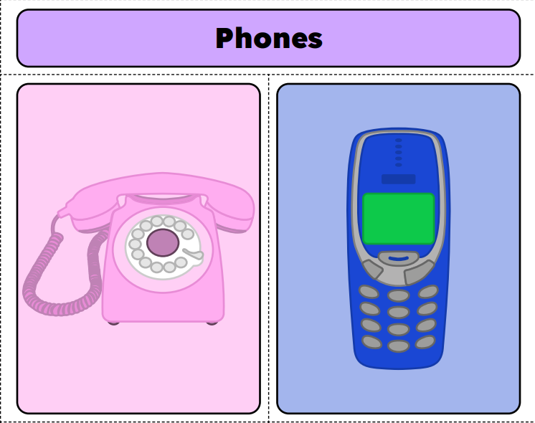
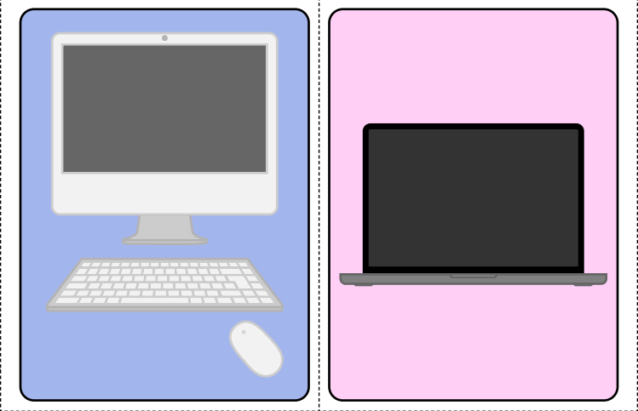
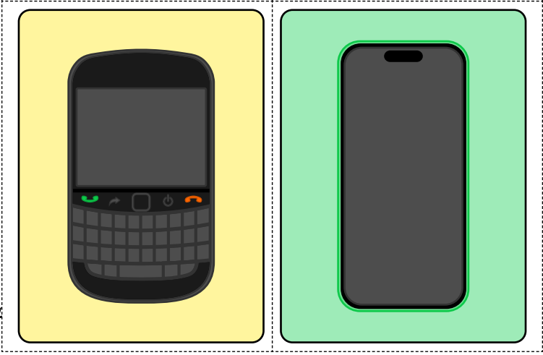

Slide 22
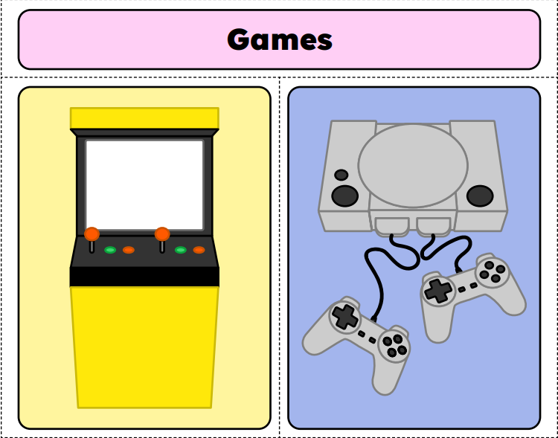
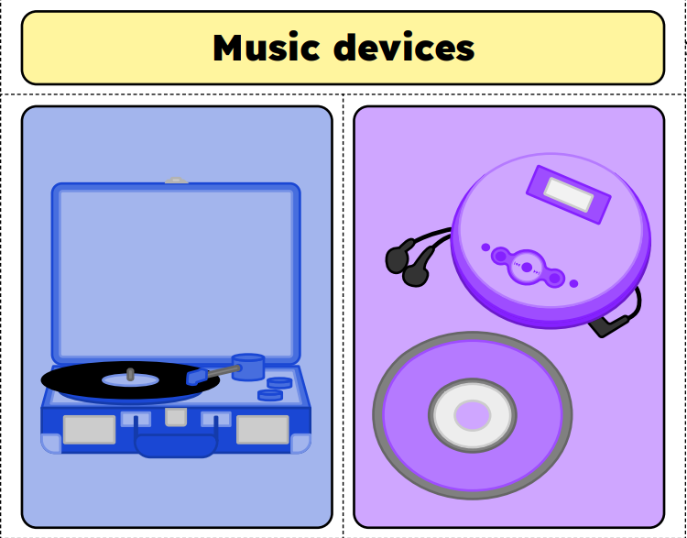
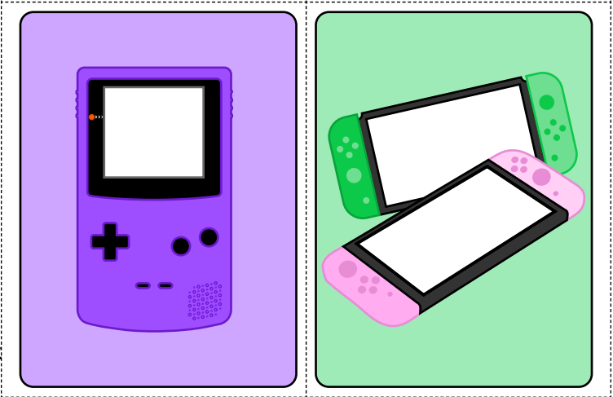
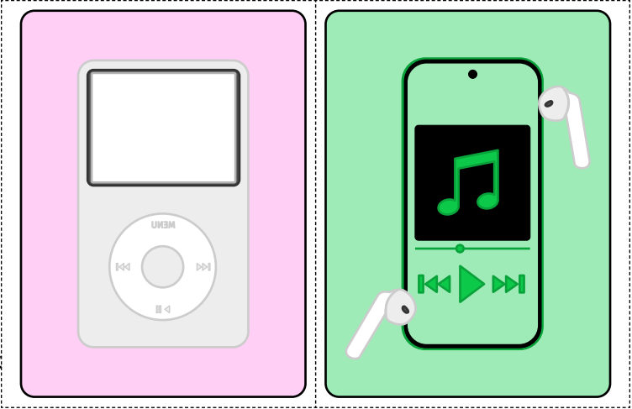

Slide 23


