Slide 1


Computing at Our Lady of the Visitation

Slide 2
Our Intent
In our school we want our children:
To use technology confidently and safely to enhance their lives and the lives of others.
To become computational thinkers and use our creativity to understand and change the world.

Slide 3
Implementation
The Computing curriculum empowers children to develop and apply their skills across diverse digital platforms, fostering progressive learning and engagement.
Introduced in 2021, the Purple Mash Scheme consolidates essential Computing tools for both staff and pupils in our school. It stays current with the latest online safety software and regularly updated resources to optimise children's learning.
Each child has a Purple Mash login which allows them to access their computing learning in school and at home.
Purple Mash supports the teaching of the three distinct strands of the Computing National Curriculum – Computer Science, Information Technology and Digital Literacy.

Slide 4
Impact
Children benefit from a strong scheme that fosters Computing learning and skill development.
They enjoy diverse ways of enhancing their Computing skills and are eager to progress further at home.
Children articulate their learning positively and grasp areas for improvement.
Teachers feel more confident in delivering the Computing curriculum with detailed plans and accessible resources.

Slide 5
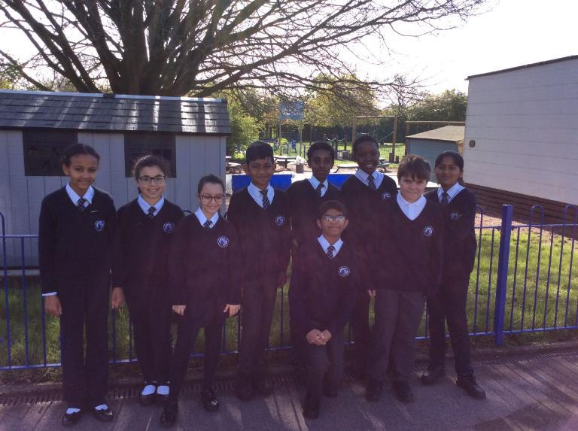

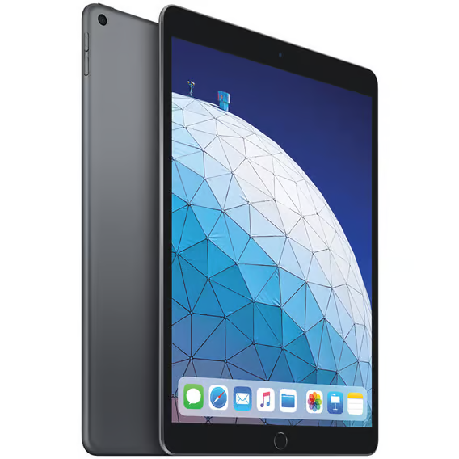

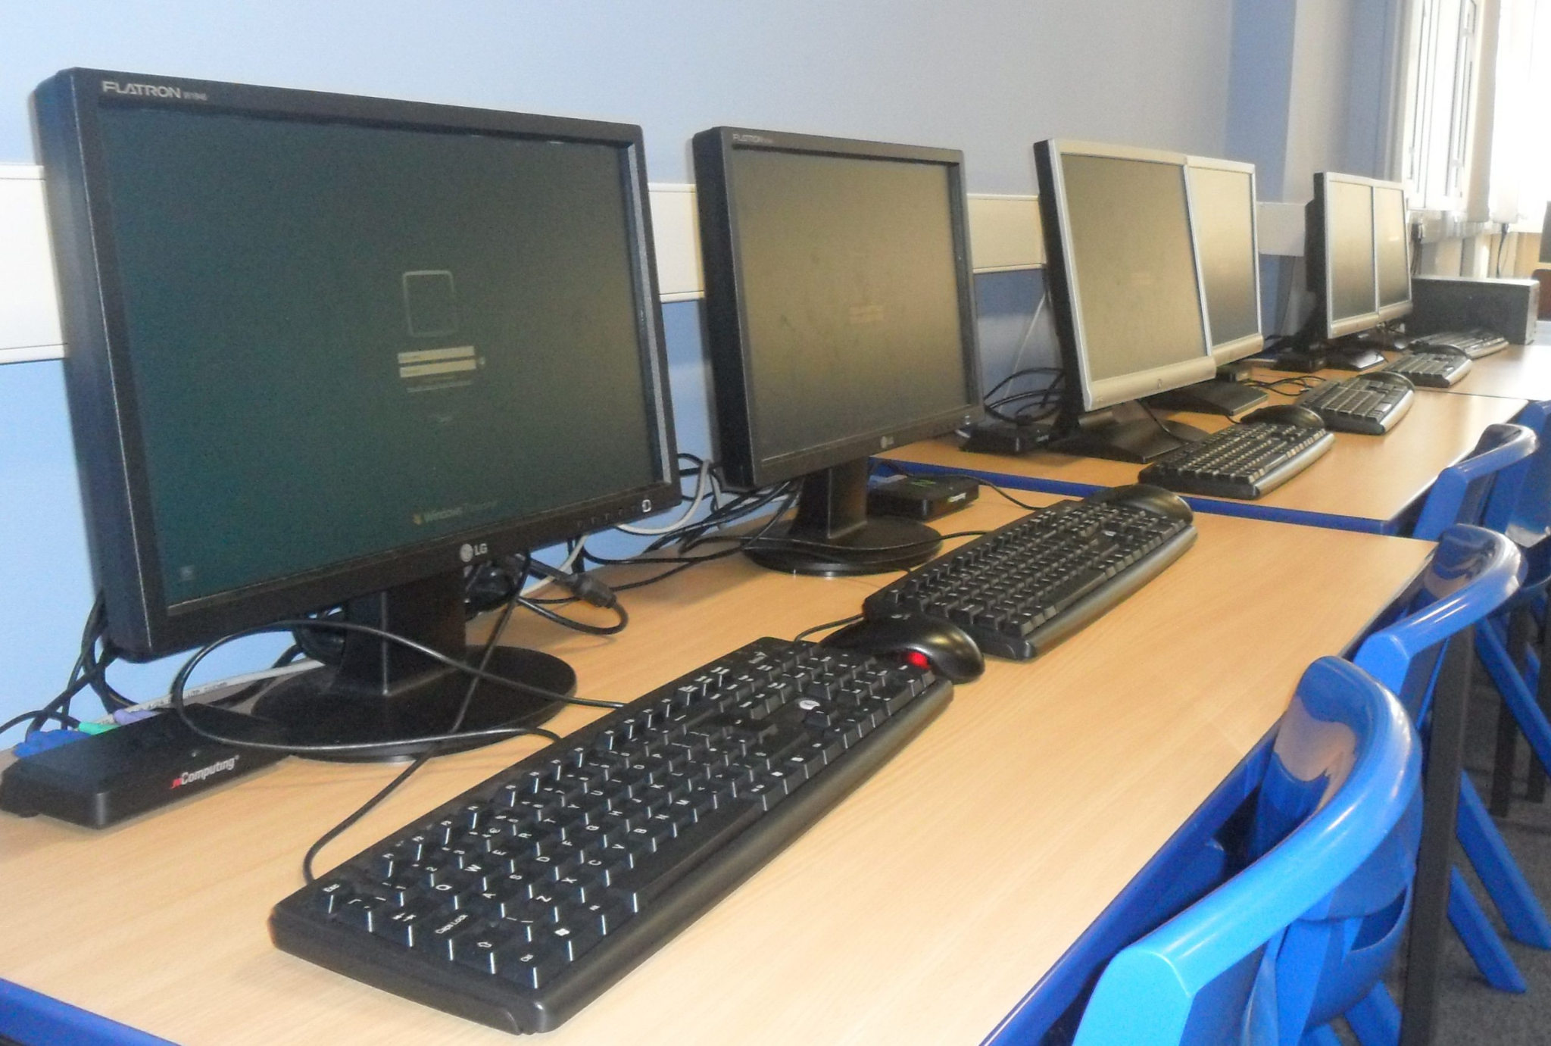
What we have achieved

Slide 6
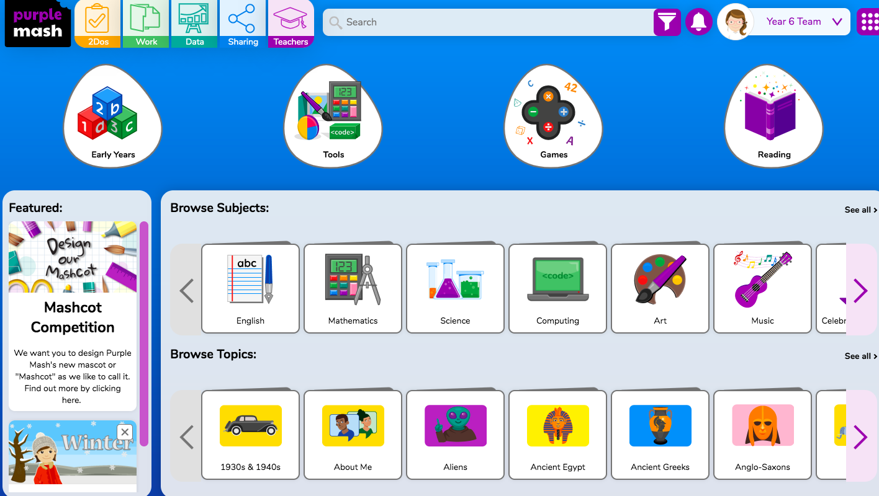
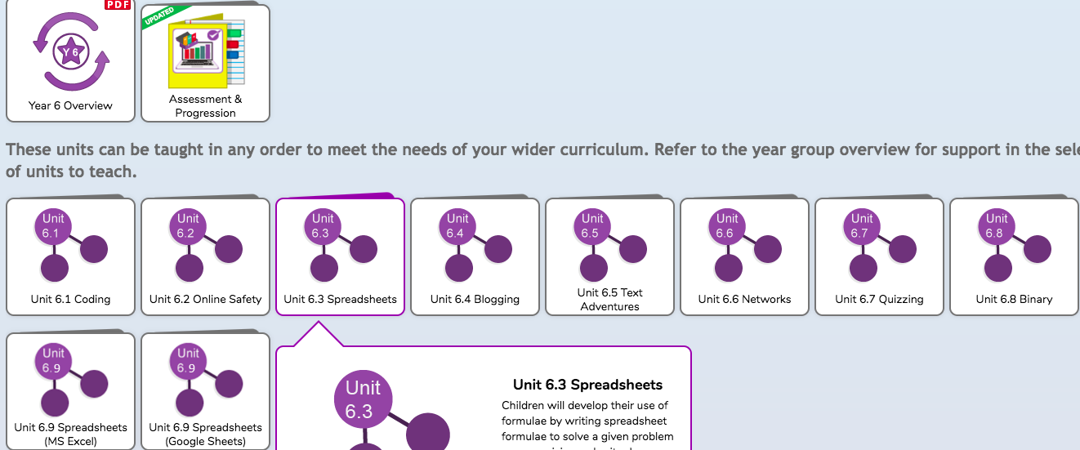
Our Computing scheme in OLOV - Purple Mash
Here teachers have access to planning, resources and additional guidance to support their teaching.
There is also support on how Purple Mash can support other curriculum areas.
Each year group has an ‘Online Safety’ unit which they are advised to teach as their first unit.

Slide 7
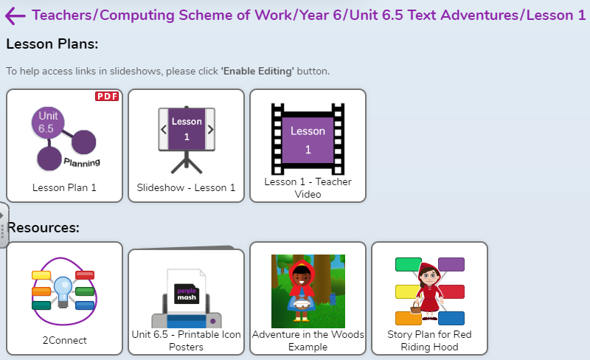
Purple Mash - Planning, PowerPoints, Videos, Resources
Planning is clear step-by-step, which makes the teaching accessible to all teachers.
Teachers are advised to take time to look over plans, in order to familiarise themselves with the content.
PowerPoint presentations support with the input of the lessons.
Teachers use these in whole class teaching before the children are set of on their independent work.

Slide 8
SEN in Computing
Purple Mash offers hands-on teaching and resources, accessible to all children.
Steps unlock upon meeting specific criteria for mastery.
Children have access to repeatable videos for additional support.
PowerPoints provided by Purple Mash include visuals. It's also tablet-compatible for accessibility.
Planning includes guidance on supporting less able students when appropriate.

Slide 9
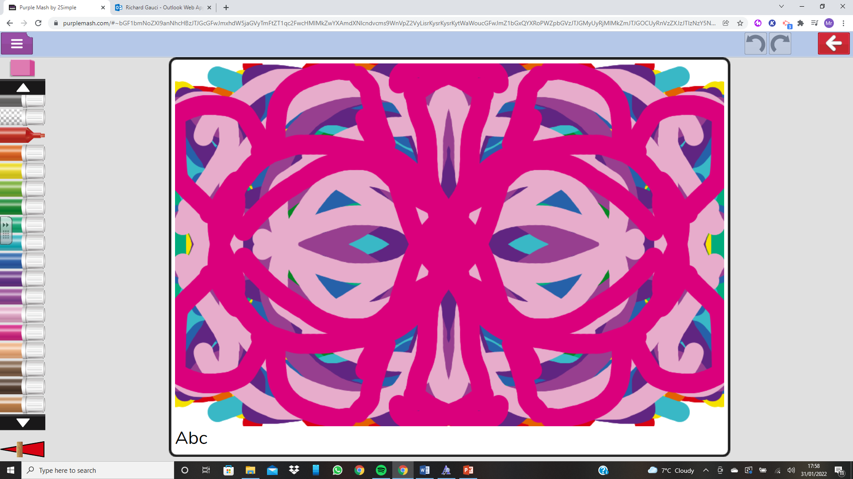
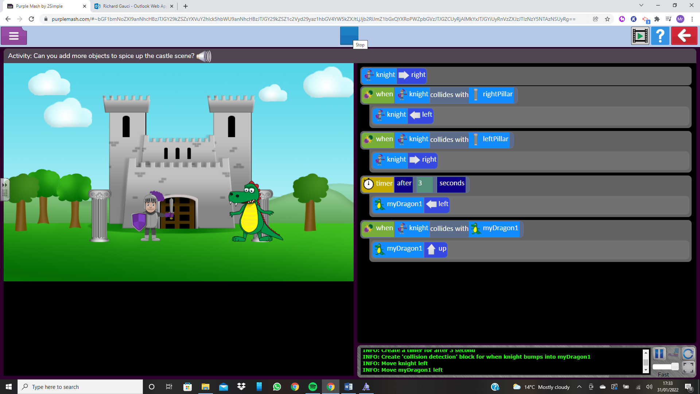
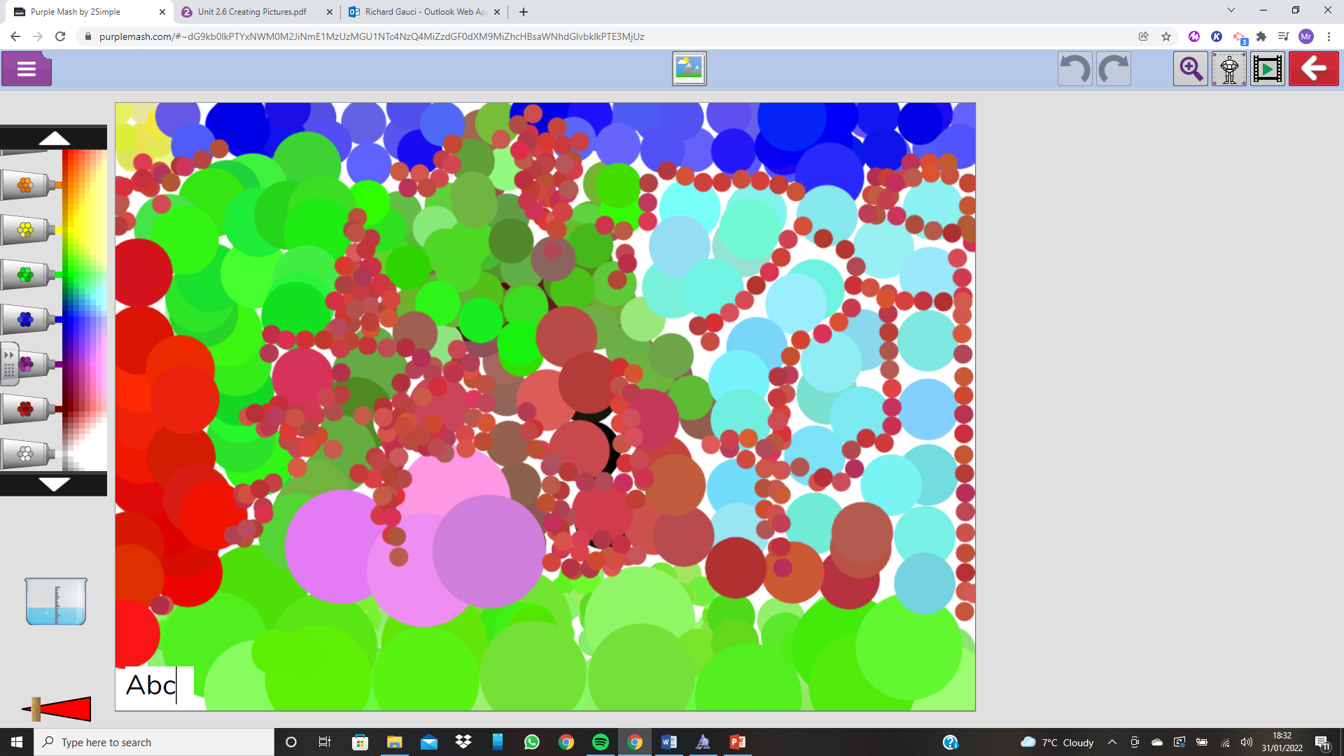
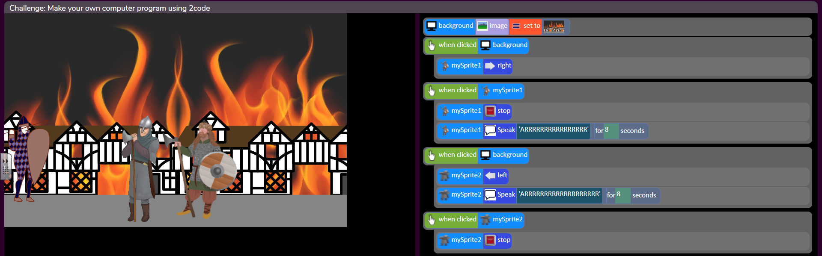
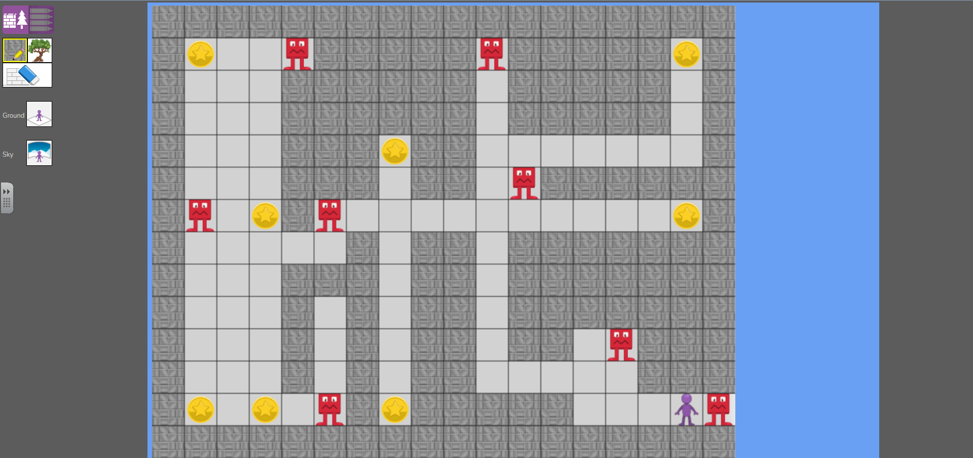
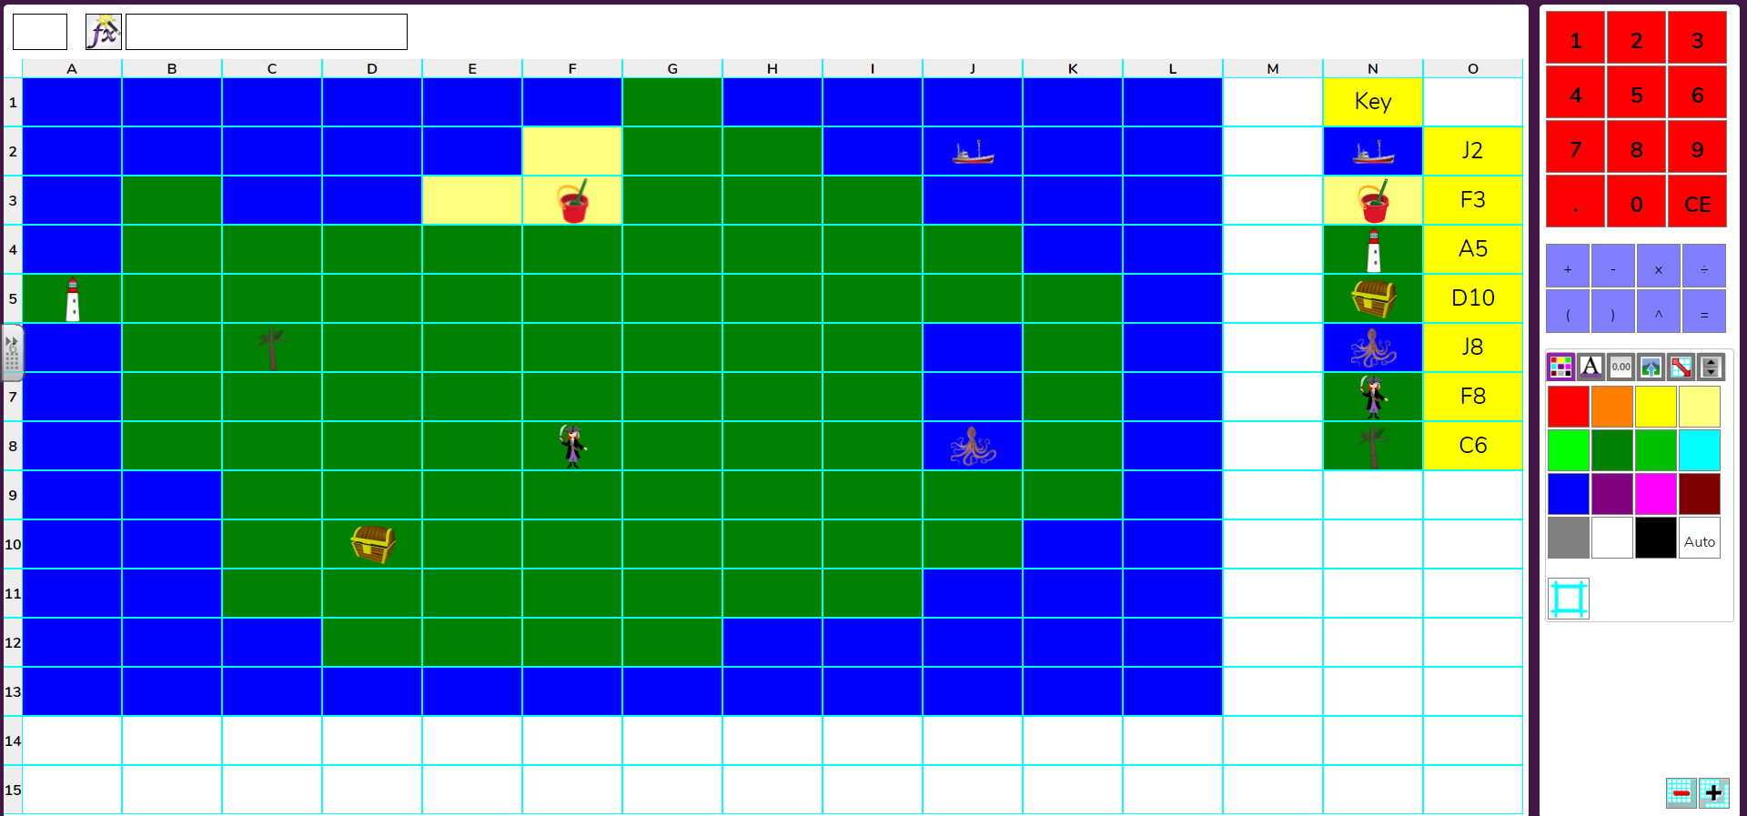
Year 1 exploring and learning the basic skills
Year 5 Coding
Year 4 Coding
Year 2 Creating Pictures – Pointillism
Year 6 Game Design
Year 3 Spreadsheets

Slide 10
Quotes from the children
Year 1 - “I have enjoyed learning how to turn a computer on and type in my password.”
Year 2 - “I really enjoy going onto Purple Mash and playing the games.”
Year 3 - “I enjoyed our coding topic when we wrote instructions to turn the turtle 90 degrees. I also enjoy going into the computing suite to use the computers.”
Year 4 - “I like Purple Mash because I find the topics motivating and fun. I enjoyed the spreadsheets topic because I like the challenge of creating formulas.”
Year 5 -
“I really enjoy coding because I get to try out new things and if I am stuck I can watch the video provided to help me crack the code.”
Year 6 - “Computing allows us to explore the digital world. I enjoy learning new vocabulary from a range of topics. I love being able to use the skills learnt over the years to make games, text adventures and blogs.”

Slide 11
Our Digital Leaders
Digital Leaders are children with a passion for technology who want to share their knowledge with others and promote the use of all things digital throughout the school.
Being a Digital Leader is a fantastic opportunity to take on responsibility, learn new skills, develop and demonstrate leadership skills.

Slide 12
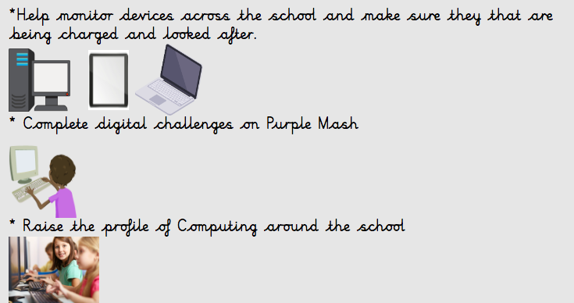
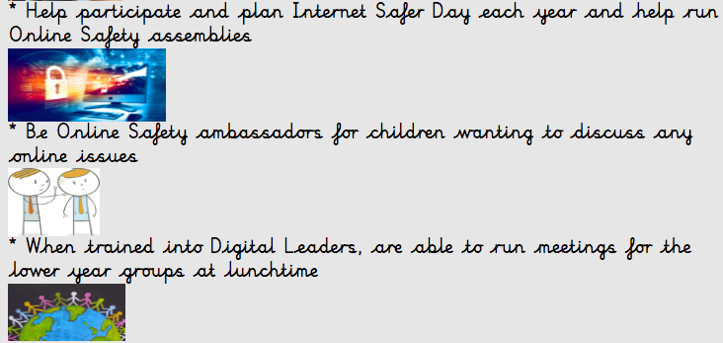
What do our Digital Leaders do?

Slide 13
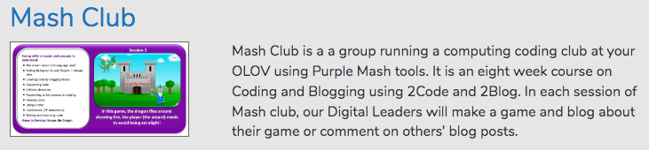
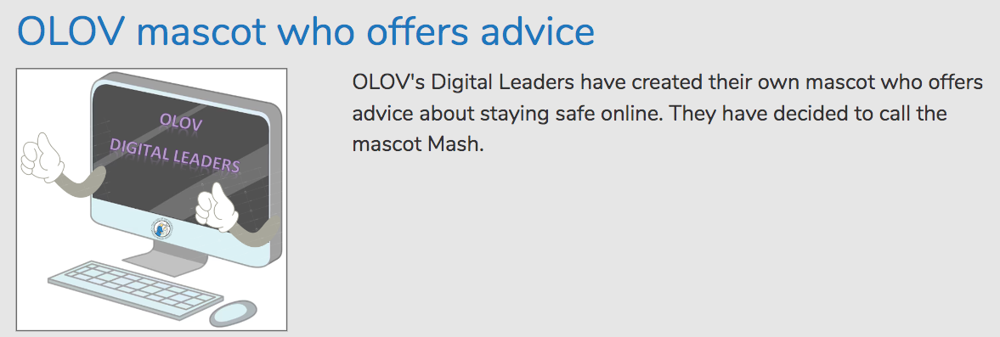
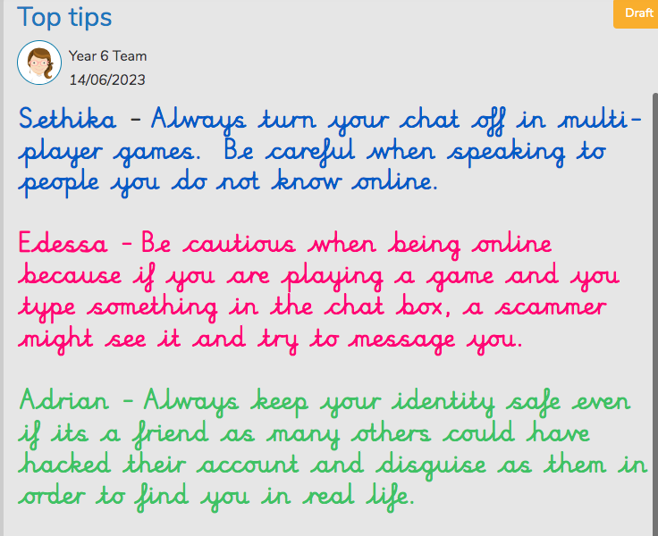
What do our Digital Leaders do?

Slide 14
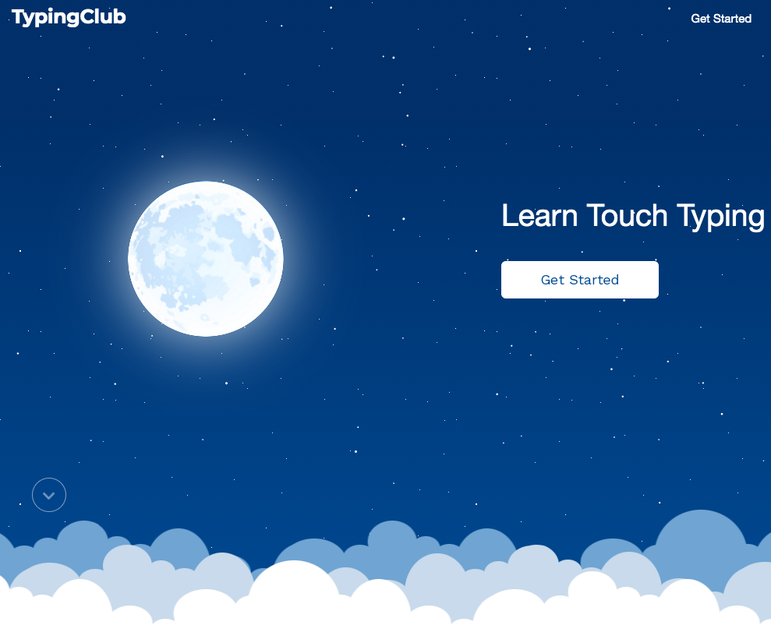
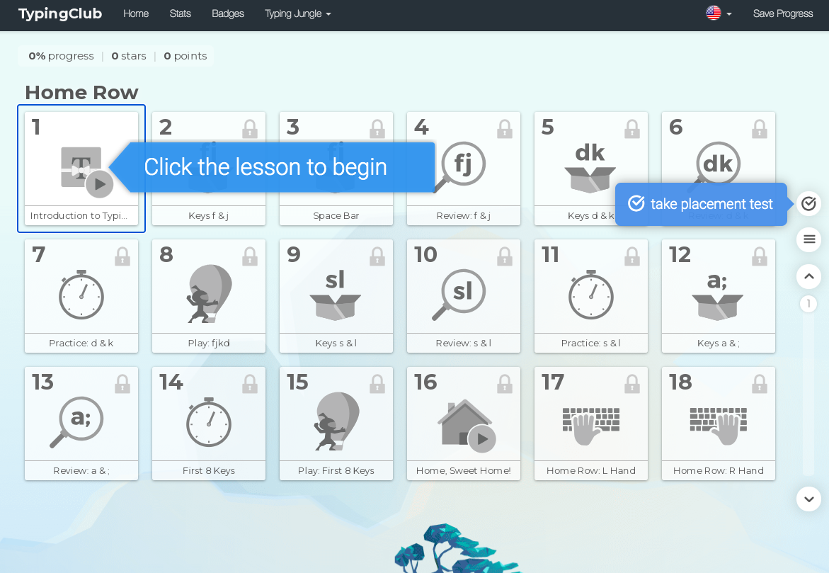
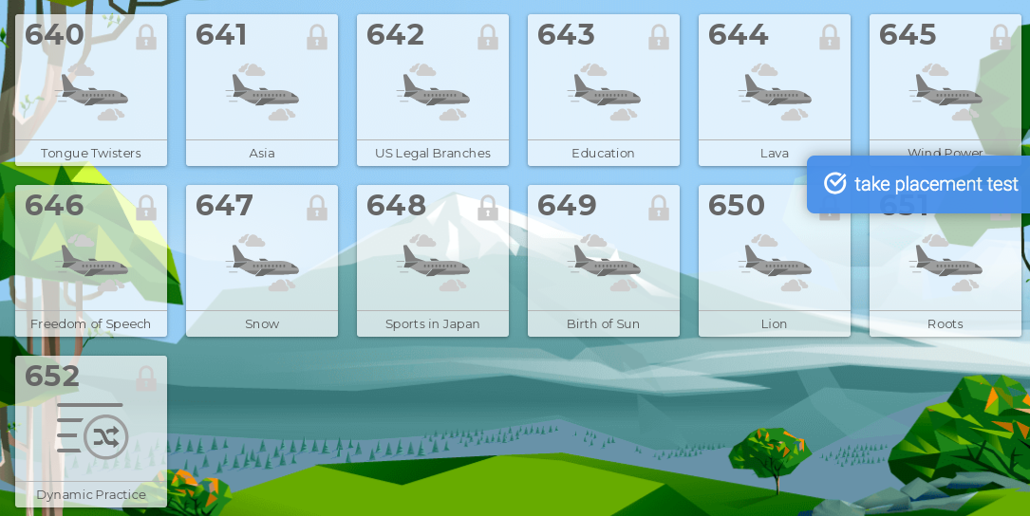
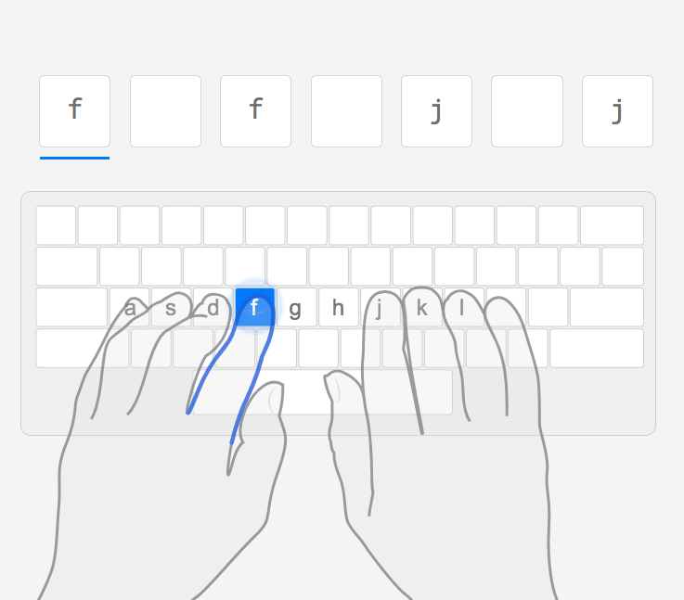
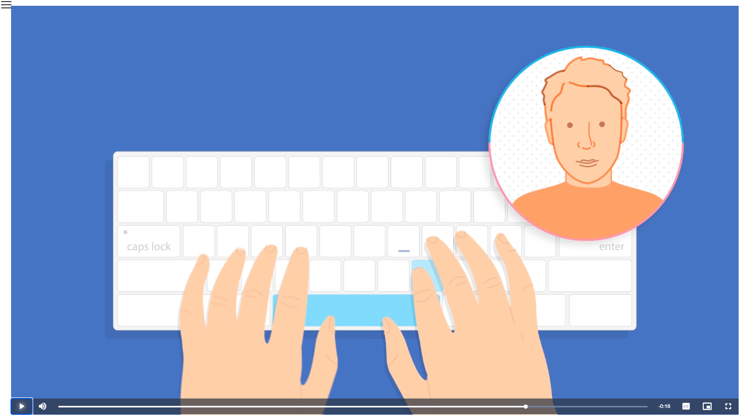
The children get to work through different levels.
Touch Typing
TypingClub is an accessible typing program. Interactive experience. A full range of experiences from games, videos and different typing challenges makes learning fun. Voice over.
A video is provided for the children to watch and interact with.

Slide 15

Online Safety
Online safety is a key priority in the teaching of Computing in our school.
Each year group has planning that supports and reinforces online safety messages including games and quizzes.
We celebrate Internet Saver Day each year, this year it will be celebrated on the 6th of February and the theme is Inspiring change? Making a difference, managing influence and navigating change online'

Slide 16
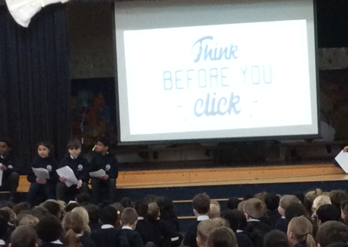
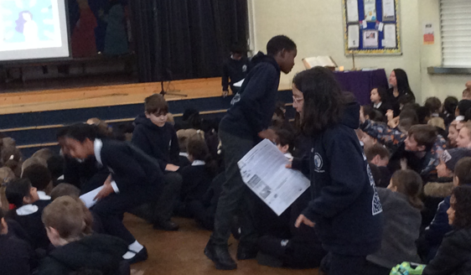
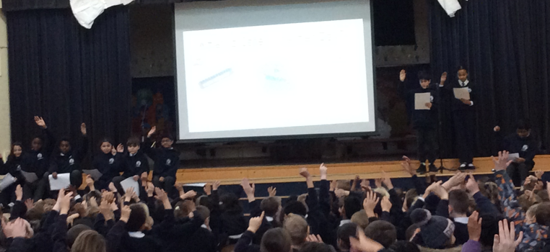
This year our Year 6 Digital Leaders led an assembly on Online Safety for Internet Safer Day

