Slide 1


DIGITAL LEADERS

Slide 2

DIGITAL LEADERS
Children with a passion for technology who want to share their knowledge with others and promote the use of all things digital throughout the school.
It is a fantastic opportunity to take on responsibility, learn new skills, develop and demonstrate leadership skills and help pupils, staff and parents at our school.

Slide 3
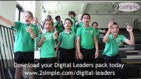

Slide 4

What Digital Leaders will do at our school
Fetch and set up laptops, tablets and devices – ensuring they are charged.
Review apps and software and make recommendations about what we should use.
Complete the Digital challenges on Purple Mash.
Contribute and run meetings for Staff, Pupils and Parents.
Raise the profile of Computing within the school.
Decide on main aims to achieve over the year.
Test new Purple Mash tools.
Notes:
We have included some roles but this can be edited to suit the needs of your school – other ideas can be found: https://static.purplemash.com/mashcontent/applications/digital-leaders/docs/Digital_Leaders_What_Can_Digital_Leaders_Do/What_can_digital_leaders_do%20281020.pdf

Slide 5
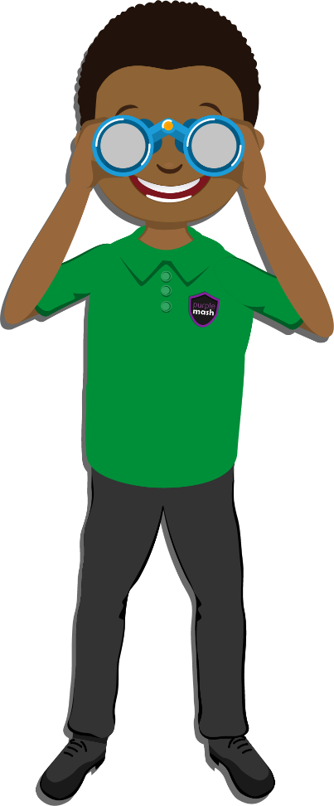
Benefits of being a Digital Leader
Develop your computing skills.
Help pupils, staff and parents.
Showcase computing at school and at events.
Develop your leadership skills.
Make new friends.
Represent the school.
Notes:
We have included some benefits but this can be edited to suit the needs of your school – other ideas can be found: https://static.purplemash.com/mashcontent/applications/digital-leaders/docs/Digital_Leaders_What_Can_Digital_Leaders_Do/What_can_digital_leaders_do%20281020.pdf

Slide 6
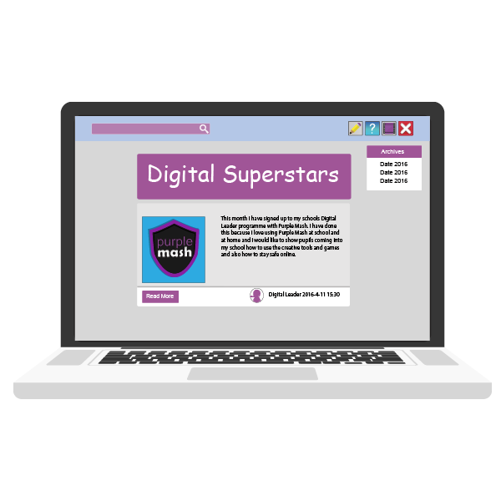
DIGITAL LEADERS
We will meet weekly at in the Computing Suite/Classroom.
You will need to bring enthusiasm and ideas.
Notes:
Edit this page with when you will meet and where

Slide 7
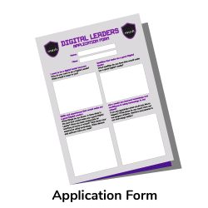
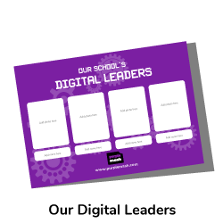
How to apply:
Notes:
Put details on here if how children can apply – there is an application form within the DL area of Purple Mash https://static.purplemash.com/mashcontent/applications/code/docs/Digital_Leaders_Application_Form/Digital_leaders_application_form%20281020.pdf

Slide 8

Are
you
ready?
Notes:
Put details on here if how children can apply – there is an application form within the DL area of Purple Mash https://static.purplemash.com/mashcontent/applications/code/docs/Digital_Leaders_Application_Form/Digital_leaders_application_form%20281020.pdf

Slide 9
Notes:
Blank slide for you to edit

Slide 10
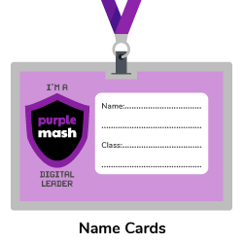
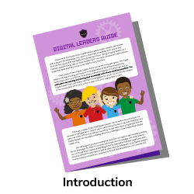
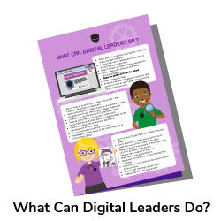
Notes:
Range of clip art to use

