Slide 1

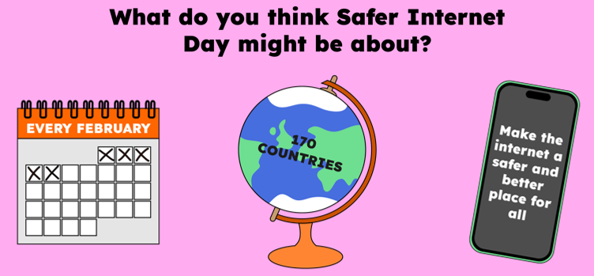
Safer
Internet
Day
Safer Internet Day is held every February all around the world.
Last year, over 170 different countries celebrated the day! Safer Internet Day is a chance to think about any worries we might have about using technology and the internet, but it’s also about celebrating all the fantastic things technology can help us with.
Hello everyone.
In today’s lesson we’re going to be talking about Safer Internet Day.
Notes:
Safer Internet Day is held every February all around the world. Last year, over 170 different countries celebrated the day! Safer Internet Day is a chance to think about any worries we might have about using technology and the internet, but it’s also about celebrating all the fantastic things technology can help us with.
Last year, over half of the children in the UK heard about or joined in with Safer Internet Day.

Slide 2
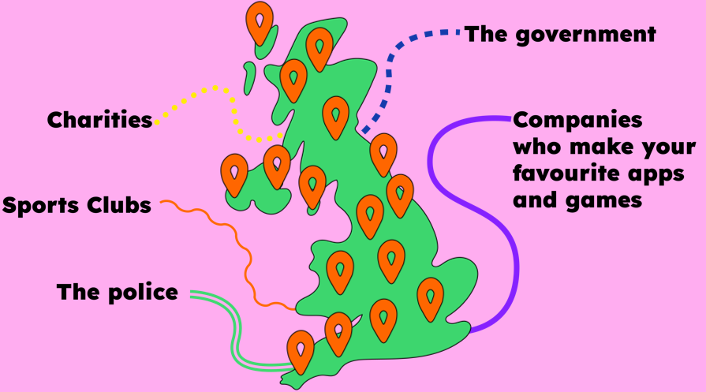
And it’s not just schools who join in with the day, lots of other people get involved too, including the government, lots of charities, sports clubs, the police and even the companies who make your favourite apps and games.
By participating in this lesson, you’re joining thousands of others in celebrating the day!

Slide 3
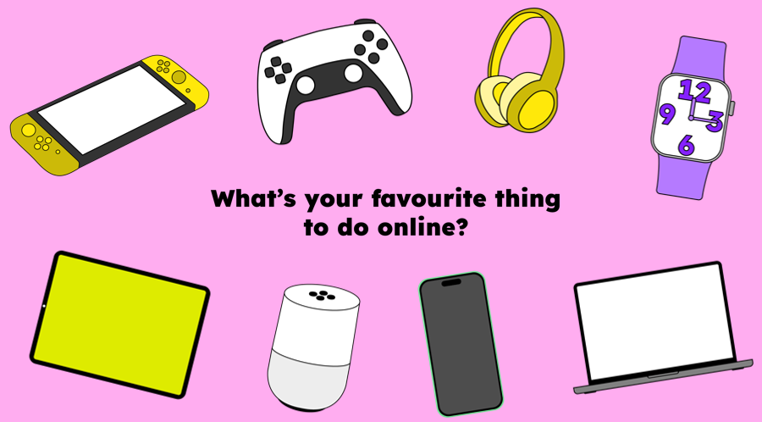
We want this year’s Safer Internet Day to be the biggest and best celebration yet! It’s so important to recognise all the exciting and amazing things we can do online… maybe you like to play games, or chat with your friends. Maybe you use the internet to learn new things, or maybe you love watching videos.

Slide 4
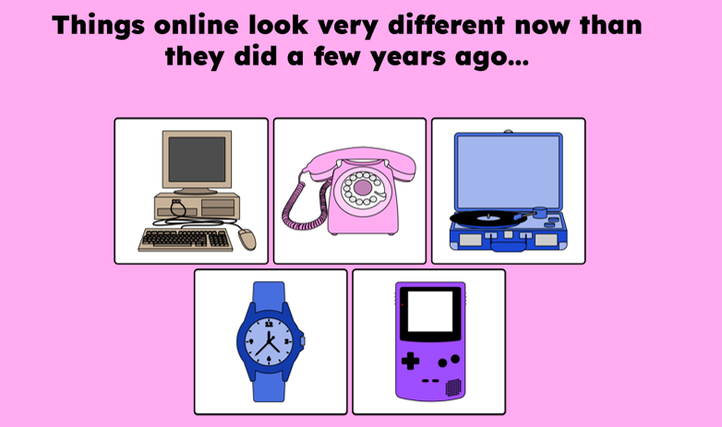
Today we are thinking about changes online.
Computers used to look like this…
You would play music on one of these…
Phones looked more like this…
Watches told us the time and date but not much else…
Gaming was a bit different too…

Slide 5
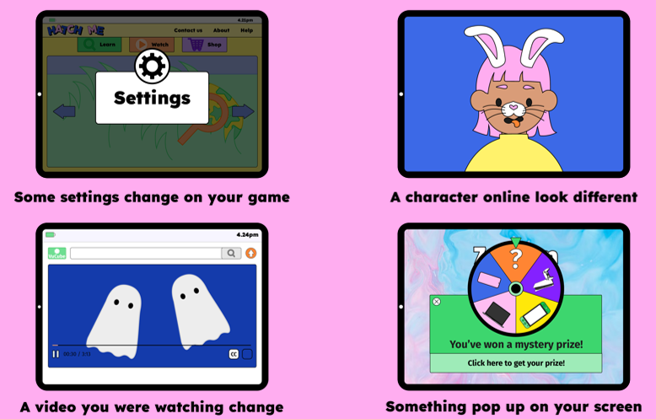
There are lots of smaller changes that happen online and on our devices every day.
Can you think of any changes you have seen?
Put your hand up if you have seen…

Slide 6
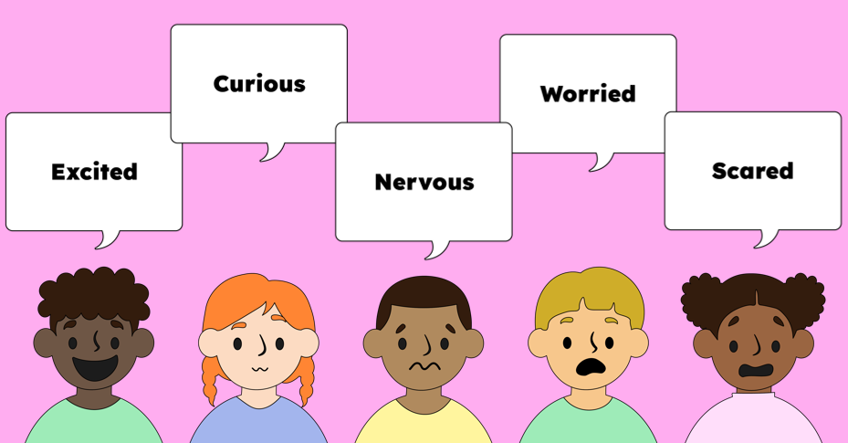
Seeing things change can make us feel different emotions… We might feel…
Some changes online can be great, but some changes that you or your friends have seen might make you feel some of the negative feelings.

Slide 7
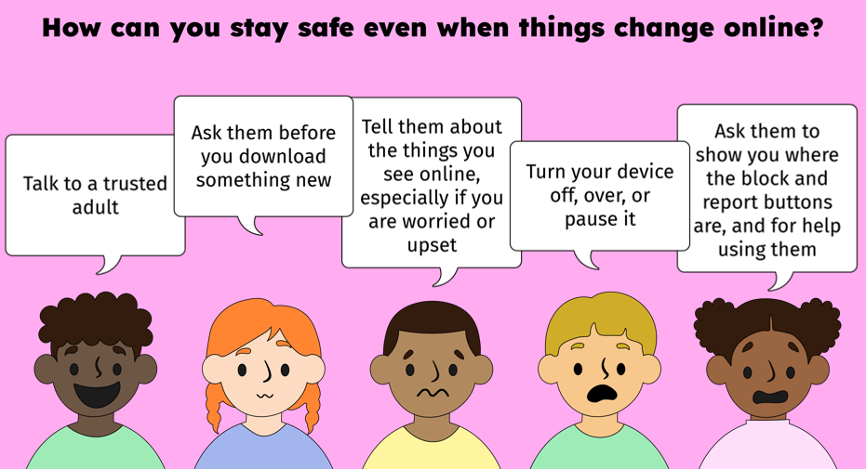
It’s important that everyone feels safe when they go online.
How can you stay safe even when things change online?
·Talk to a trusted adult…
·Ask them before you download something new
·Tell them about the things you see online, especially if you are worried or upset
·Turn your device off, over or pause it. You don’t need to keep watching something if it’s upsetting you.
•Ask them to show you where the block and report button is and for help to use it

Slide 8
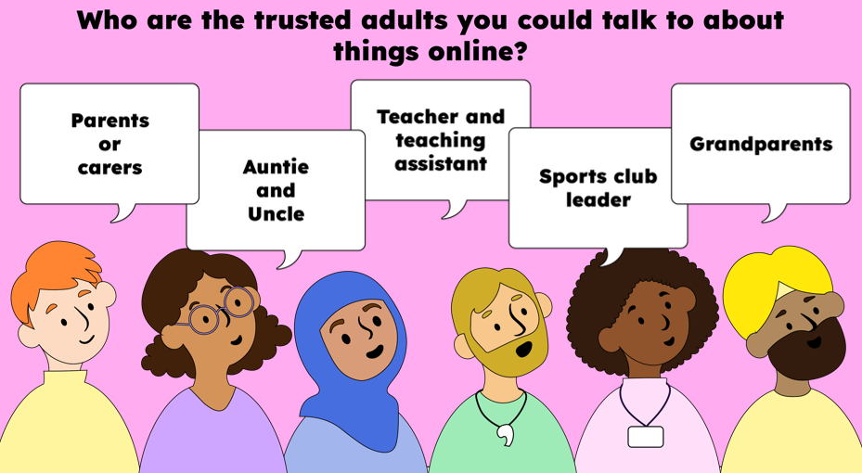

Slide 9
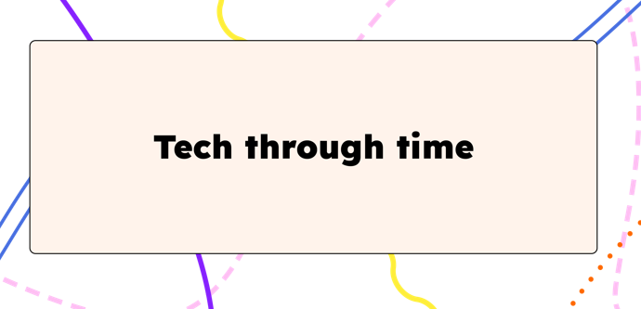


What do we call this?
What can we do with an interactive whiteboard?
How is this different from a chalkboard?
How has this technology improved how teachers teach a class?
Do you know what this is called?
How do you think teachers used this to help them teach a class?

Slide 10
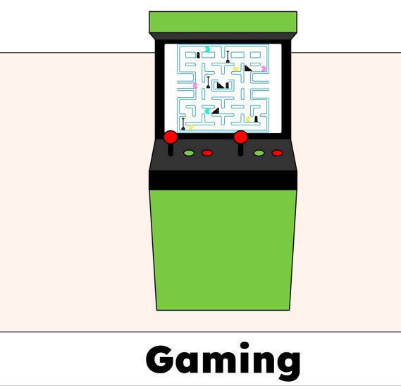
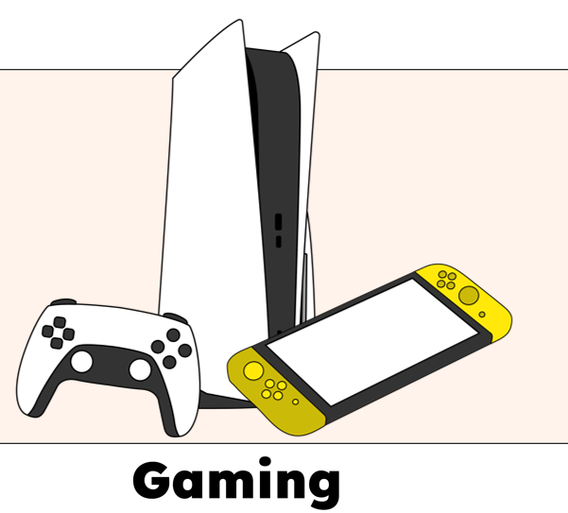
What are these gaming consoles called?
How are these consoles different from the Space Invaders arcade machine?
What can you do on these consoles that you couldn't do on the Space Invaders arcade machine?
How are the graphics different from the Space Invaders arcade machine?
How has this improvement in technology made our lives better?
Do you know what this is?
How would you describe the gameplay and graphics?
How would you describe the controls?

Slide 11
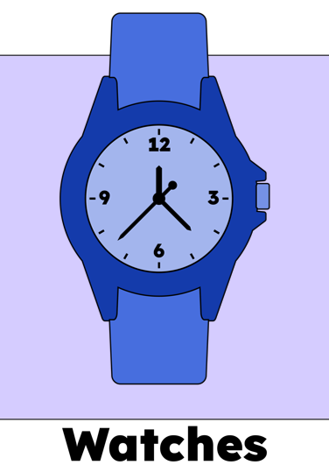
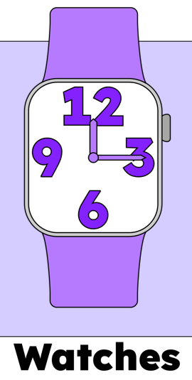
What is this called?
What do we use it for?
Can it do anything else?
What is this called?
How is this different from the first watch?
What different things can we do on a watch like this?
How has this improvement in technology made our lives better?

Slide 12
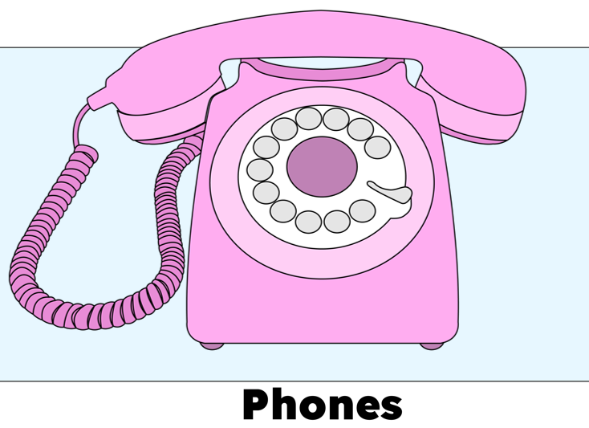
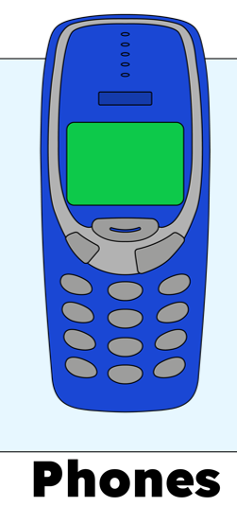
What is this called?
What is it used for?
Can it do anything else?
How do we make a call on a phone like this?
What is this called?
What do you think you can do on this phone that you couldn't do on the phone before? (e.g. send text messages, play games)
How did this improvement in technology make our lives better? (e.g. Can make a phone call anywhere, can send messages rather than calling)

Slide 13
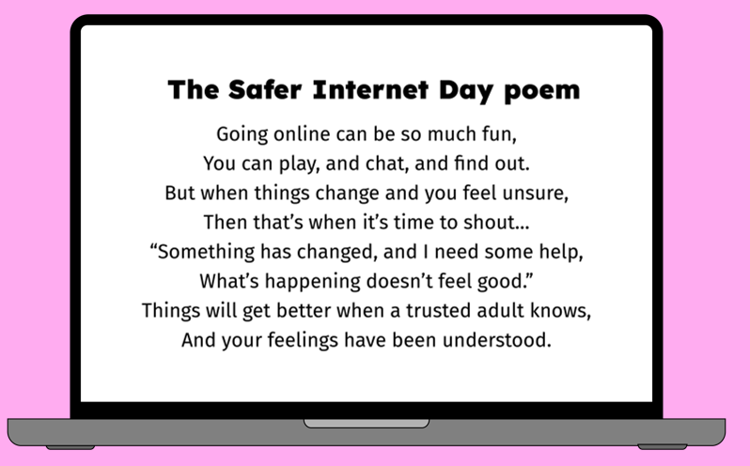

Slide 14
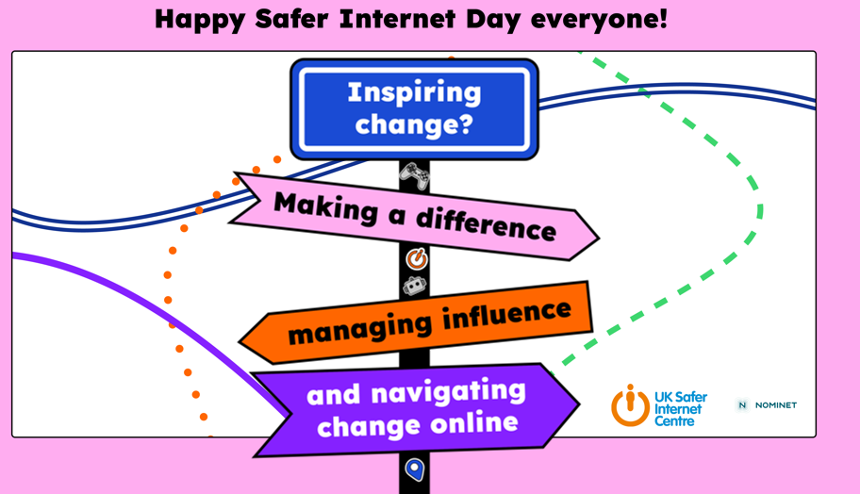

Slide 15
Here at OLOV part of our job is making sure you feel safe and happy, in all parts of your life – including online!
If you ever have a worry about something that’s happened online, you can come to us for help and advice. We’ll always listen carefully and give you some ideas of what you can do. Sometimes, if we’re worried that you or somebody else might be in danger, we have to pass on what you’ve told us to a special member of staff. At OLOV that person is Miss Coll and Mrs Etheridge.
If we have to speak to them, it’s not because you’re in trouble, it’s just because they have the special job of making sure every child here is safe.

Slide 16
Year 3/4

Slide 17
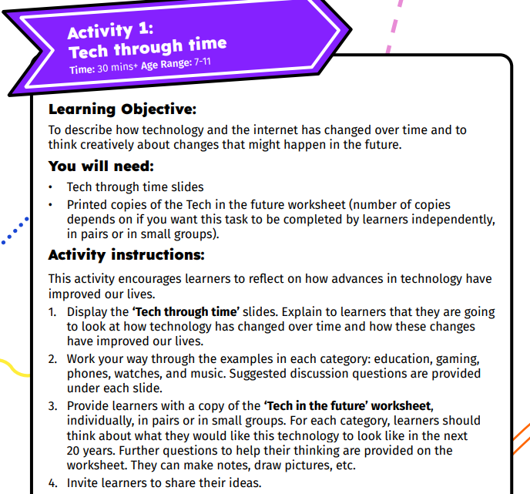

Slide 18
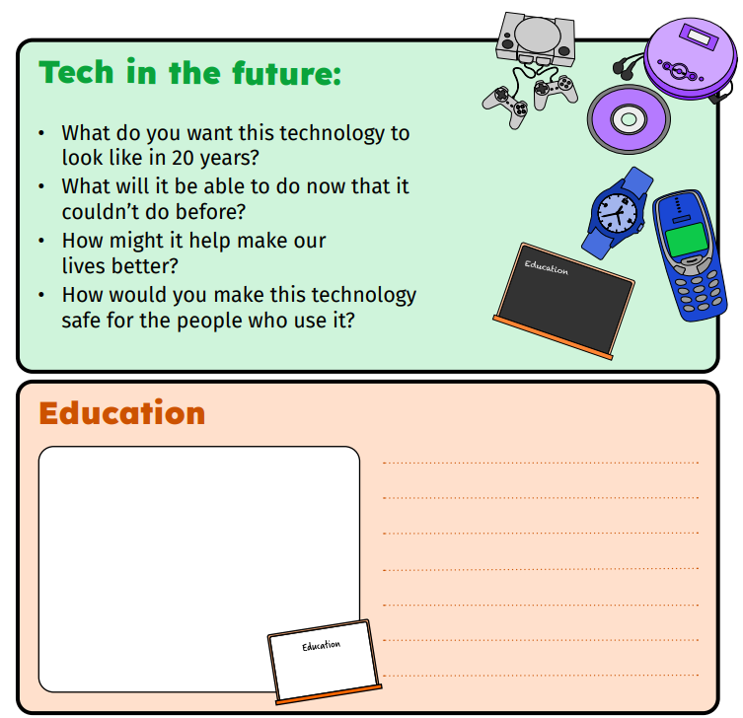
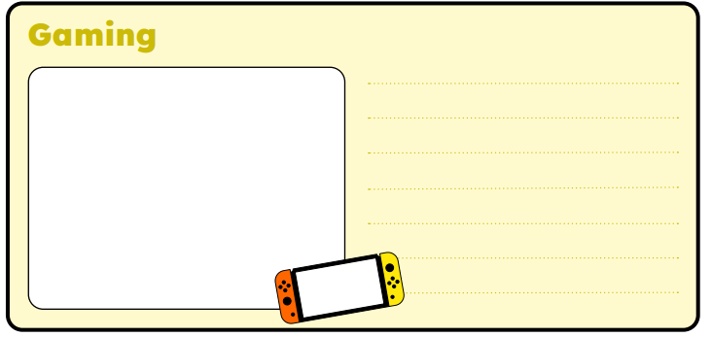
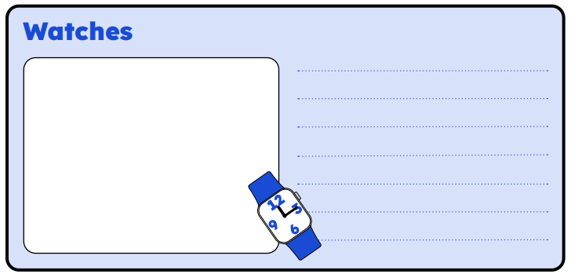

Slide 19
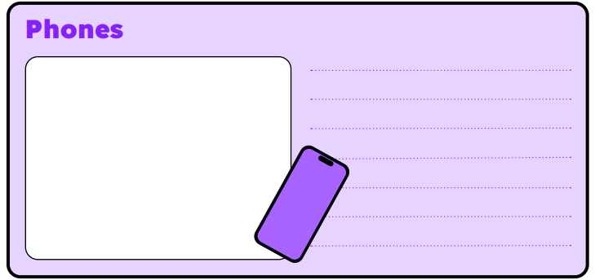
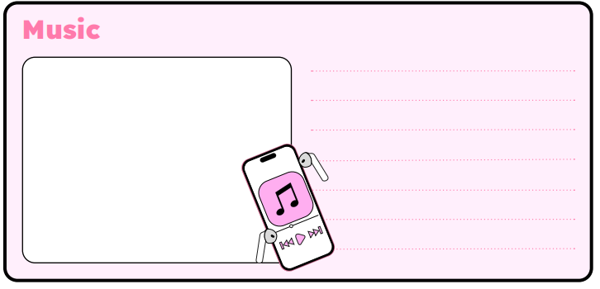

Slide 20
Year 5/6

Slide 21
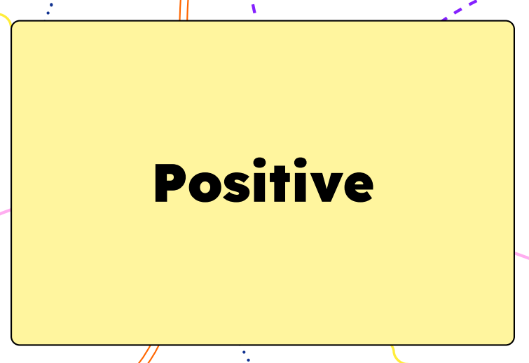
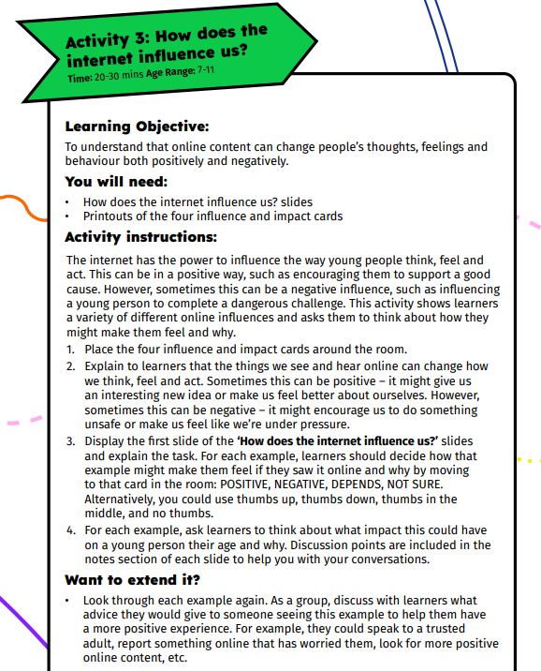
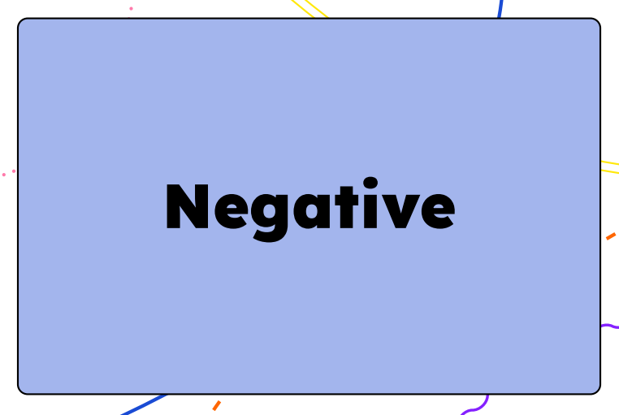


Slide 22
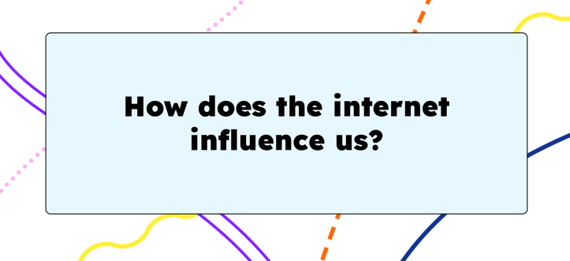
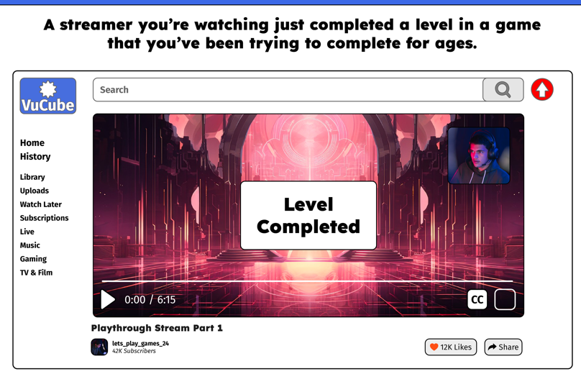
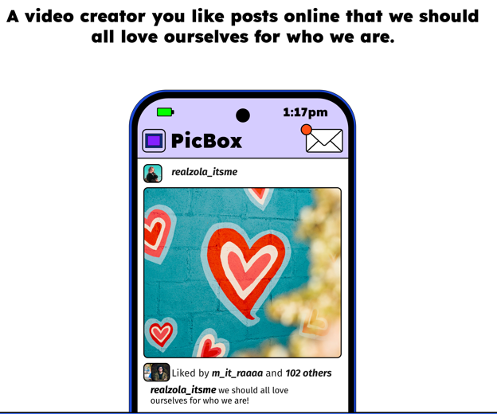
May be positive influence, as a young person might feel good that their favourite streamer has completed the level. They may also be influenced to use their videos to help them complete the level themselves.
However, there may be some negative influence here – it might make a young person feel frustrated that they haven’t been able to complete the level yet.
Positive influence – influences young people to feel good about themselves

Slide 23
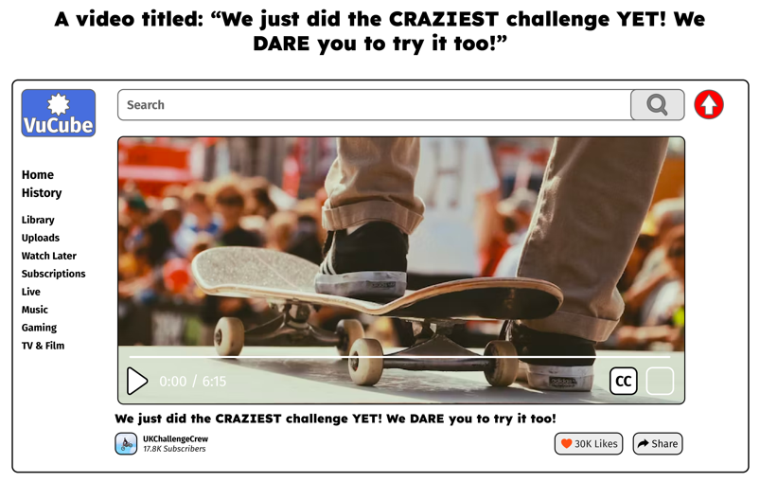
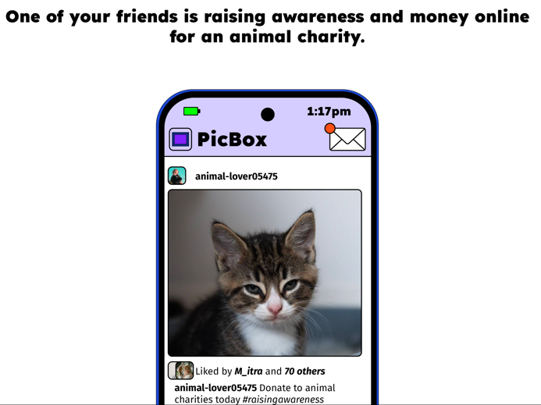
This is a positive influence – it could make a young person aware of the charity and encourage them to donate money if they are able to. They might also feel proud of their friend.
The dramatic language and the dare may influence some young people to try out the challenge themselves – this could be very dangerous. Some challenges could result in harm to a young person.

Slide 24
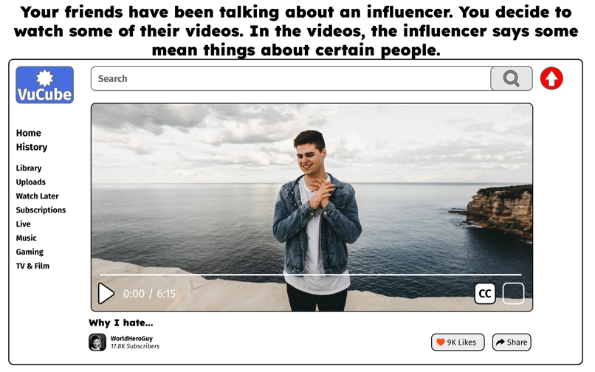
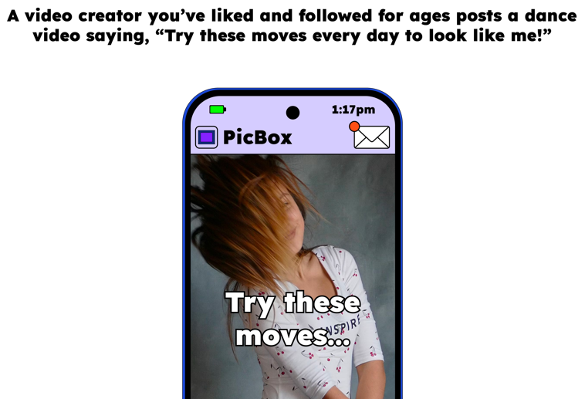
This could be a negative influence – it might make some young people feel bad about their appearance and under pressure to look like the video creator.
This is a negative influence. Some influencers may use their popularity to spread negative messages about people. If they have lots of followers, these negative messages can be spread quickly. If they are popular, people may begin to believe the same things as them.

Slide 25
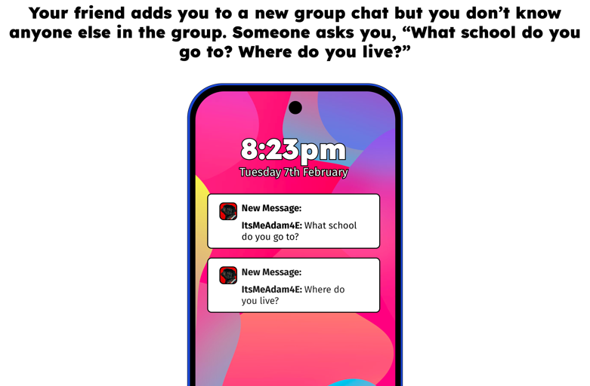
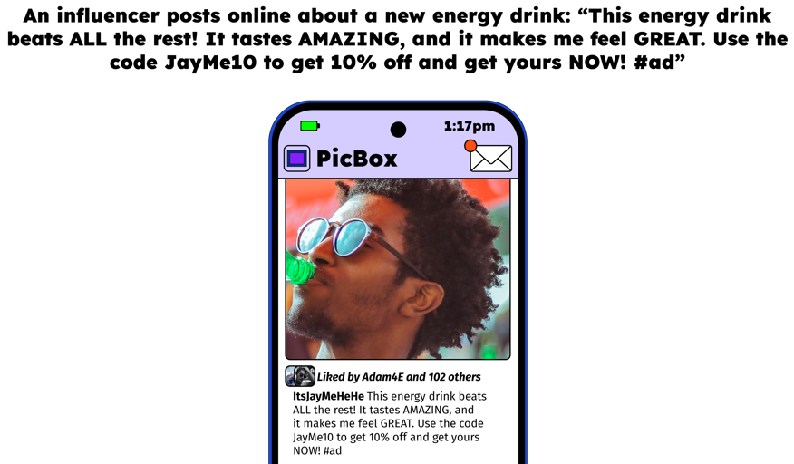
This could be a negative influence, as the energy drink might not be suitable for children. They might also feel pressured to spend money – if they don't have the money, this might make them feel bad about themselves.
This is potentially a negative influence – you shouldn’t share your personal information with someone who you only know online, so you are being influenced to do something that you shouldn’t.

Slide 26
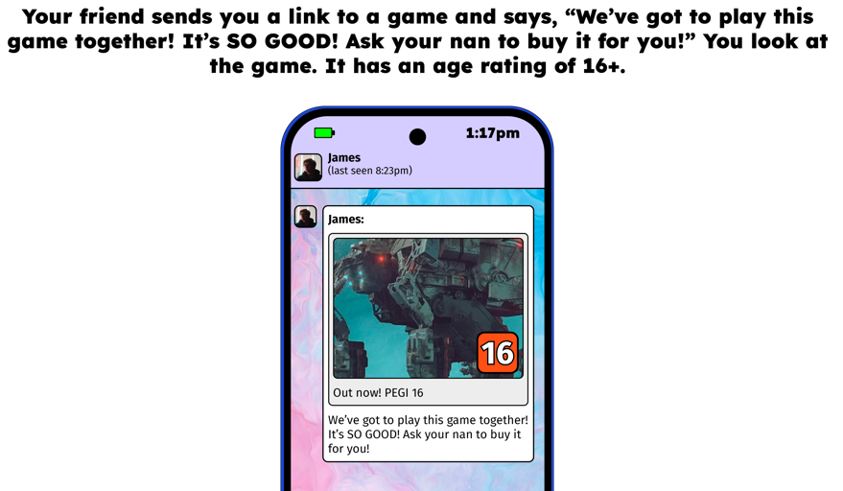
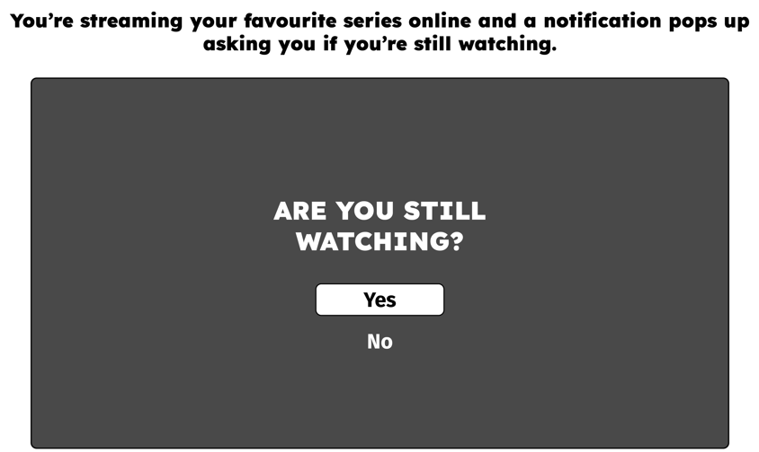
This could be a positive influence, as it could help a young person better manage their screen time and encourage them to take a break.
It could also have some negative influence – it could make a young person feel bad/stressed that they've been watching so much of their series.
This is a negative influence – although it’s nice if your friend wants to play a game with you, they are trying to persuade you to play a game that is not suitable for your age.

