Slide 1


In Computing we want to be able to use technology confidently and safely

Slide 2


In Computing we want to :
be able to use technology confidently and safely
become computational thinkers
To be a computational thinker we want to:
Take a problem
Break it down to understand
Come up with ideas that could work as solutions.
Think outside the box
Computational thinking is about learning to solve problems, with or without a computer.

Slide 3



3 main strands of the Computing curriculum:
Information technology is about the use of computers for functional purposes, such as collecting and presenting information, or using search technology.
Digital literacy is about the safe and responsible use of technology, including recognising its advantages for collaboration or communication.
Computer science is understanding how computers and networks work. Learning basic computer programming.

Slide 4

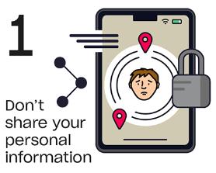
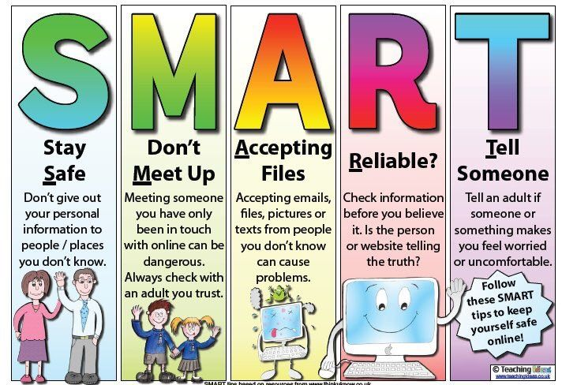
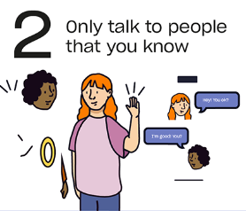
Tips for the week
Can you tell your partner your own online safety tip?

Slide 5
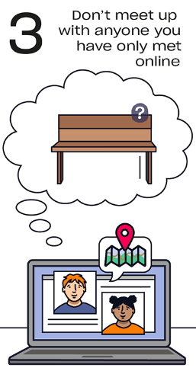
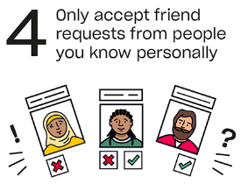
Tips for the week
Have a go at making your own online safety poster.

Slide 6
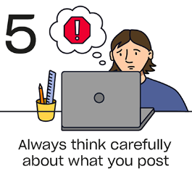

Tips for the week
Why do you think it’s important to know how to keep safe online?

Slide 7
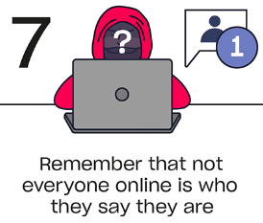

Tips for the week

Slide 8
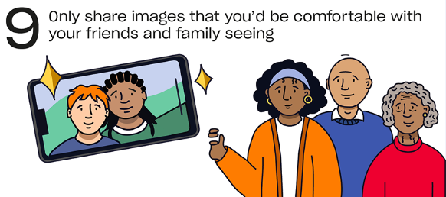
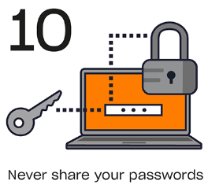
Tips for the week

Slide 10
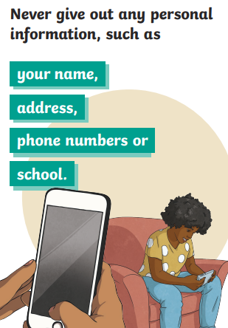
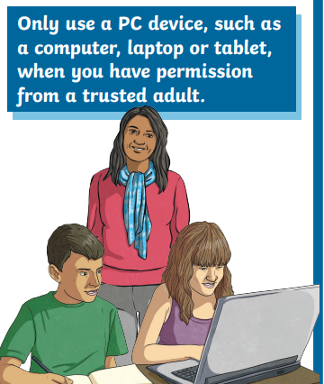
Tips for the week
Wk 9th January 2023

Slide 11
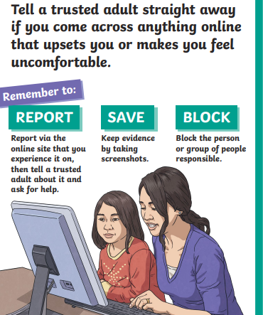
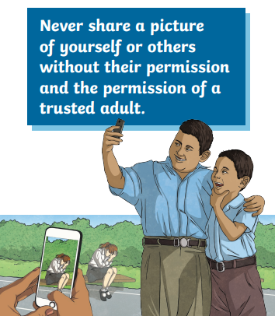
Tips for the week
Wk 16th January 2023

Slide 12
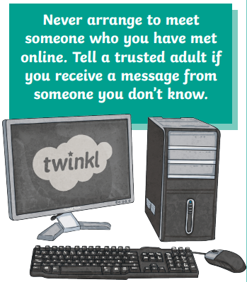
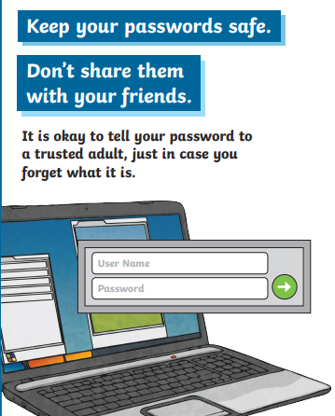
Tips for the week
Wk 23rd January 2023

Slide 13
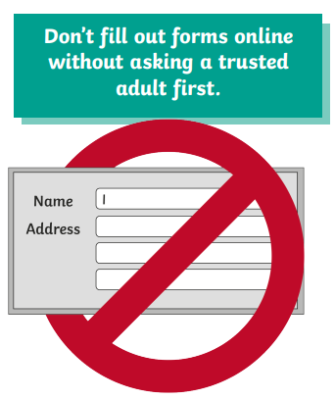
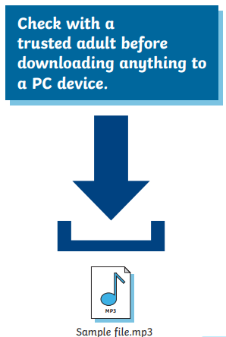
Tips for the week
Wk 30th January 2023

Slide 14
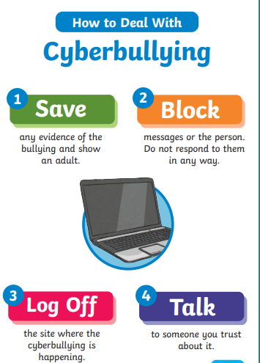
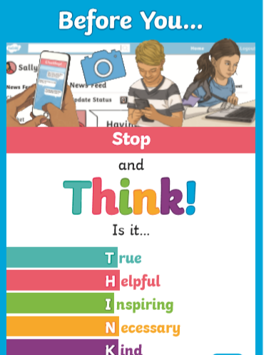
Tips for the week
Wk 6th February 2023

