Slide 1
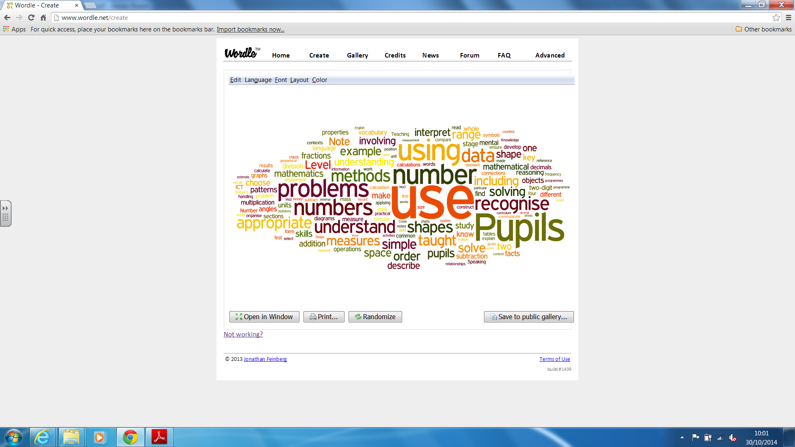
Helping my Child at Home with their times tables.

Slide 2
Why?
Develop core skills
Use and apply them in EVERY maths lesson
Foundations which are built on in class
May find maths challenging as they can’t draw on these core skills.

Slide 3
How to Teach Times Tables
May not be the same as you learnt them
You may have struggled as you were only taught one way
Need to find out which way helps/works for your child

Slide 4
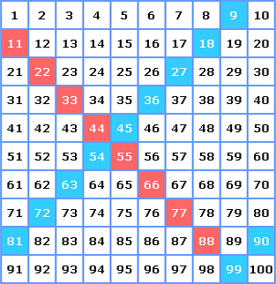
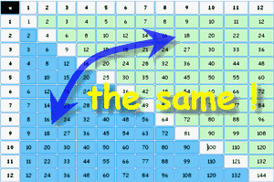
How to Teach Times Tables
Patterns
Commutative Law

Slide 5
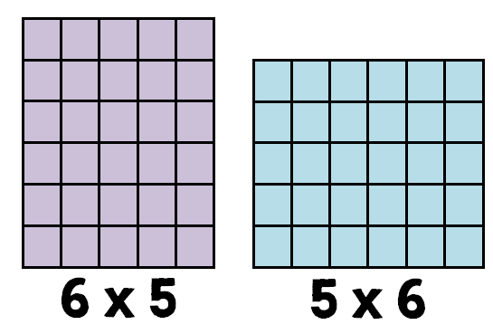
How to Teach Times Tables
Patterns
6 lots of 5 5 lots of 6

Slide 6
How to Teach Times Tables
Patterns/tricks
x 2
Always even
Doubling
x 5
5
10
15
20
25
30
35
x 11
11
22
33
44
55
66
77
x 9
Hands
Add tens - subtract ones
x 6
Double 3s
x 12
x10 x2 add together
e.g. 12 x 7 = 84
10 x 7 = 70
2 x 7 = 14
70 + 14 = 84
x 8
Double 4s

Slide 7


Slide 8
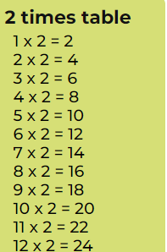

Slide 9
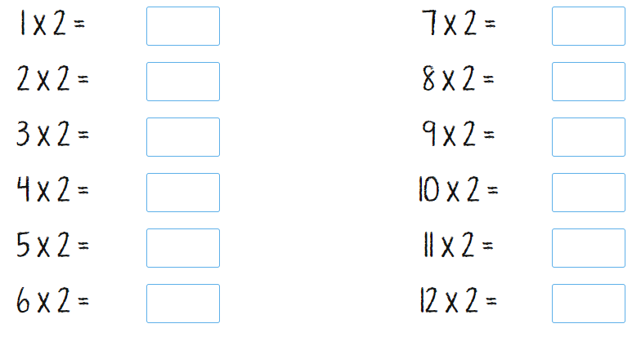

Slide 10
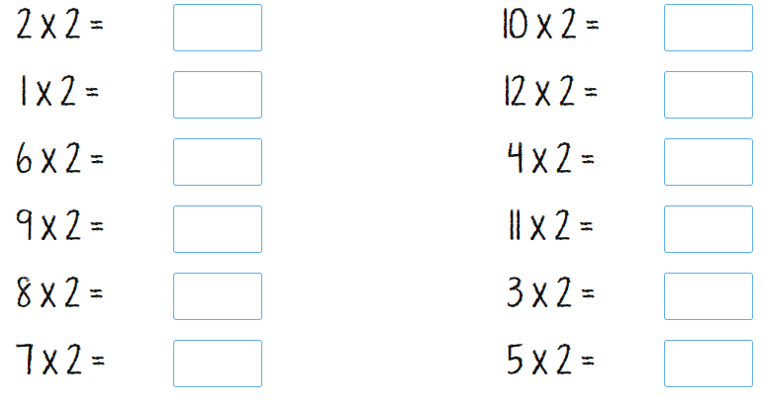

Slide 11
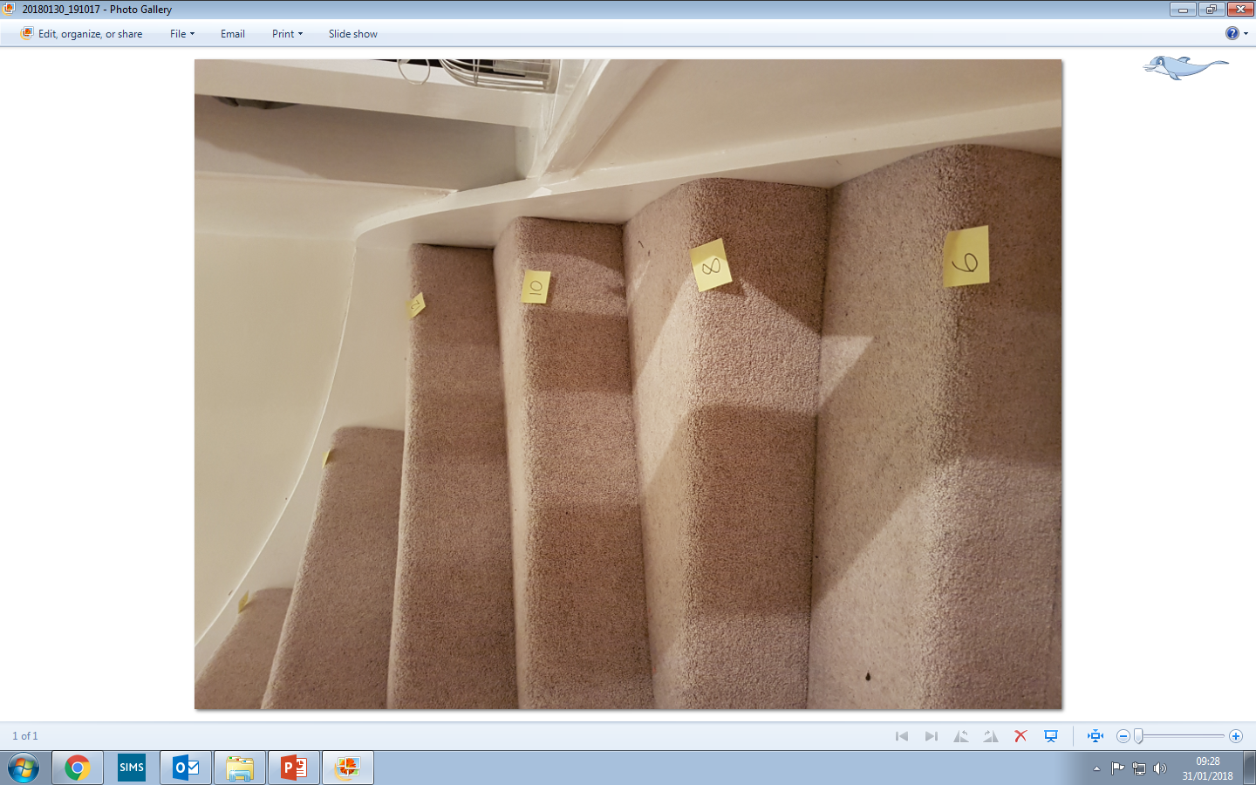
How to Teach Times Tables
Movement
Marching
Blue tack/ Post it notes on stairs to march up and down to

Slide 12
How to Teach Times Tables
Songs – Musical Maths

Slide 13
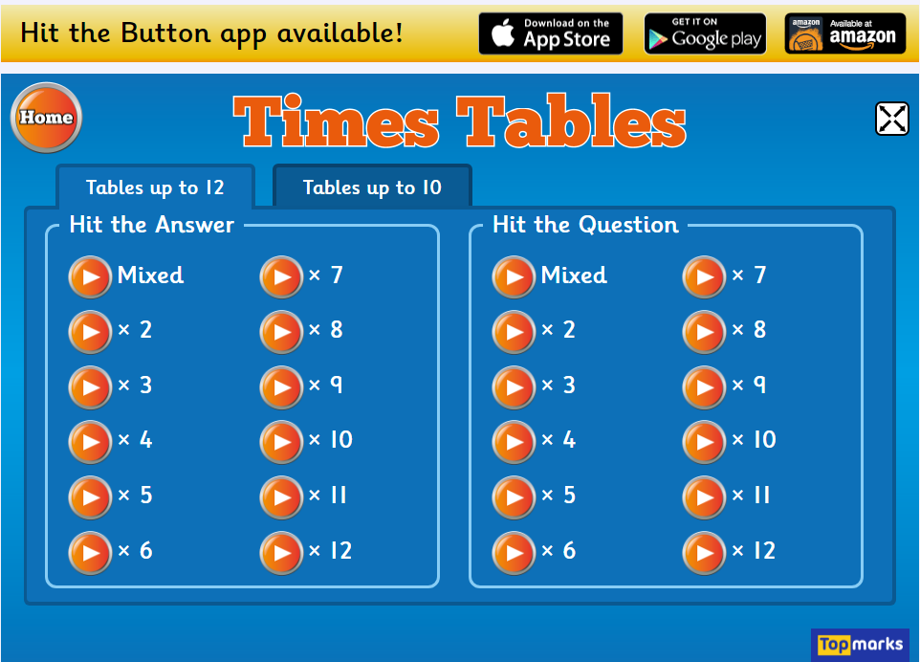
How to Teach Times Tables
Online Games
Just by searching “times table games” you will find hundreds of sites
www.topmarks.co.uk/maths-games/hit-the-button
MyMaths
TTRS

Slide 14

Questions and Feedback Forms

