Slide 1
What do we think about maths?
What do you think of when you hear the word ‘maths’?
Think back to your own experiences of learning maths.
Notes:
So what was maths like for you at school. Maybe you loved maths. Maybe you hated it. Well if you’re like most people, when somebody mentions maths to adults, they immediately think back to the time they were at school and if we just briefly look at what maths was like 30/40 years ago, it was very much about teaching methods. Certainly when I was at school, I remember spending a lot of time completing row of sums, I used to queue up at the teachers desk and either look forward to getting lots of red ticks when I got the addition but the moment we went onto subtraction and decomposition, my book looked very different! And when we went onto long multiplication and division, I just hoped that I was sitting next to someone who knew what they were doing.

Slide 2
How things have changed
In the past, when we were at school, a lot of time was given to practising methods.
Research showed that children found certain methods difficult, forgot them quickly and made persistent errors.
The days of maths lessons being pages of endless calculations
done in silence, are for the most part gone.
Notes:
Today’s lessons are far more concerned with investigation and collaboration – lessons are busy and active!
Teaching methods have also changed – children now learn how and why a method works, rather than simply the method itself.

Slide 3
What do we learn from this?
Today’s teaching methods are not just about getting the right answer, but more about understanding how the method you used works and trying to develop children’s number sense
There’s always more than one way to work something out!
Different methods suit different learning styles.

Slide 4
Good practice in Maths today
The new National Curriculum for maths aims to ensure that all pupils:
Become fluent in the fundamentals of mathematics
Reason mathematically by following a line of enquiry... and developing an argument, justification or proof using mathematical language
Can solve problems by applying their maths to a variety of problems.

Slide 5
Good practice in Maths today
Teaching methods have changed – children now learn how and why a method works, rather than simply the method itself.
Today’s lessons are far more concerned with investigation and collaboration – lessons are busy and active.
Problem solve in a real life context and apply maths to do so.

Slide 6
Current expectations
Content has generally become more challenging and expectations have been raised.
Children learn fewer things in more depth – ‘mastery’
Firmer foundations with less acceleration
Earlier and more challenging requirements for multiplication tables
More emphasis on problem solving and reasoning, using mathematical vocabulary to communicate, justify or prove

Slide 7
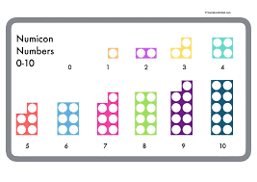
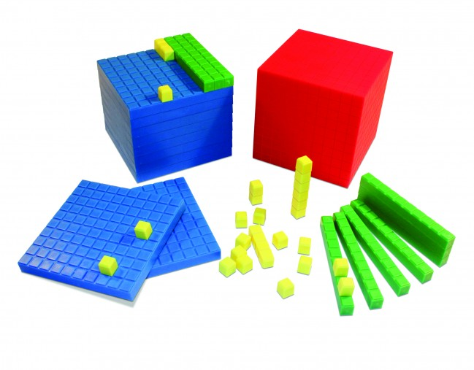
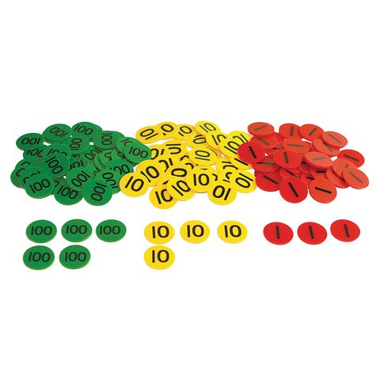

Slide 12
Top tips for parents and families:
Be positive about maths. Don't say things like "I can’t do maths" or "I hated maths at school“ in front of your child; your child might start to think like that themselves.
Point out the maths in everyday life. Include your child in activities involving maths such as using money, cooking and travelling.
Praise your child for effort rather than talent - this shows them that by working hard they can always improve.
If you would like to improve your own numeracy skills - try this free online tool the National Numeracy Challenge to improve your maths level.
Don’t put too much pressure on the children for the SATS test. Children will get a better result if they feel confident, positive and as relaxed as they can be about the test.

Slide 13
Mathematics
Mathematics
- Paper 1: Arithmetic (30 minutes)
- Paper 2: Reasoning (40 minutes)
- Paper 3: Reasoning (40 minutes)
All tests are externally marked.
Children will sit three tests: paper 1, paper 2 and paper 3.
Paper 1 is for arithmetic lasting for 30 minutes, covering calculation methods for all operations, including use of fractions, percentages and decimals.
Questions gradually increase in difficulty.
Papers 2 and 3 cover problem solving and reasoning, each lasting for 40 minutes.
Pupils will still require calculation skills but will need to answer questions in context and decide what is required to find a solution.

Slide 14
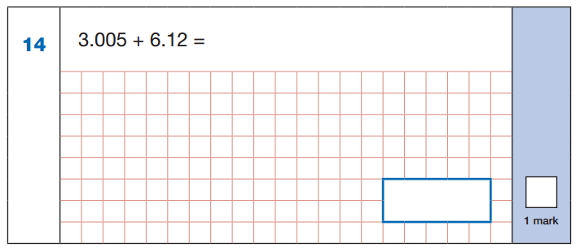
Sample Questions
Maths Paper 1: Arithmetic

Slide 15
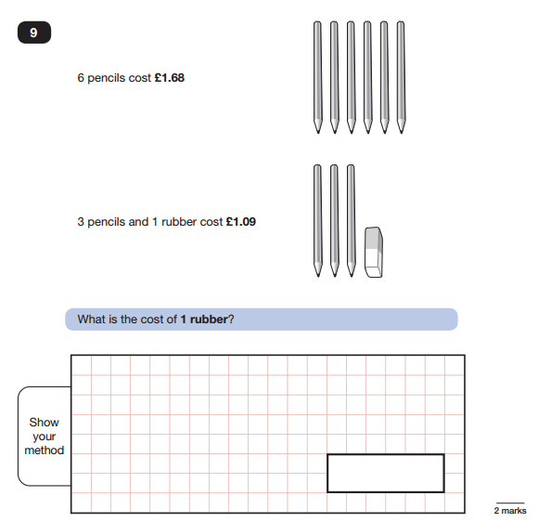
Sample Questions
Maths Paper 2 / Paper 3 : Reasoning

Slide 16

How to Help Your Child
First and foremost, support and reassure your child that there is nothing to worry about and they should always just try their best. Praise and encourage!
Ensure your child has the best possible attendance at school.
Support your child with any homework tasks. CGP books are excellent practise!
Arithmetic (e.g. times tables) is always good to practise.
Talk to your child about what they have learnt at school.
Make sure your child has a good sleep and healthy breakfast every morning!

Slide 17
How to Help Your Child with Maths
Play times tables games.
Play mental maths games including counting in different amounts, forwards and backwards.
Encourage opportunities for telling the time.
Encourage opportunities for counting coins and money; finding amounts or calculating change when shopping.
Look for numbers on street signs, car registrations and anywhere else!
Look for examples of 2D and 3D shapes around the home.
Identify, weigh or measure quantities and amounts in the kitchen or in recipes.
Play games involving numbers or logic, such as dominoes, card games, darts, draughts and chess.

