Slide 1
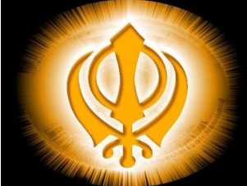


Slide 2
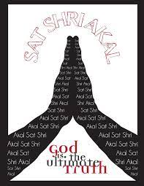
Sat Sri Akaal
Ji Ayaan Nu
Blessed is the person who says God is Truth.
Welcome.

Slide 4
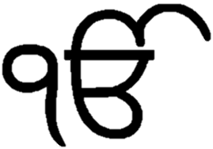
“Ik Onkar”
There is only one God

Slide 5
Is your God the same as Ms Hashi’s God?
Is your God the same as my God?
What do Muslim’s call God?
Do you know what Sikh’s call God?

Slide 6
Waheguru
(WAAH-E-GURU)
Wonderful Lord

Slide 7
Sikh is the Sanskrit word
for disciple or student

Slide 8
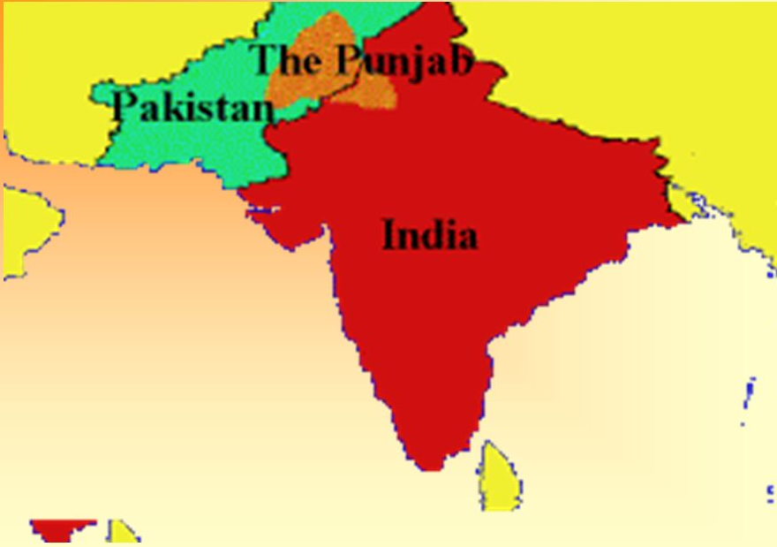
Sikhism was born in the Punjab area of South Asia, which now falls into the present day states of India and Pakistan.

Slide 9
5th largest religion in the world
There are approximately 26 million Sikhs globally, of whom 23 million live in India where they are less than 2% of the 1.4 billion population. The vast majority, 18 million (78%) live in the state of Punjab where they constitute 58% of the state's population.

Slide 10
The Three Golden Rules Sikh’s must follow:
remember God constantly
to earn an honest livelihood
to share their earnings with everyone through charity.
Pray
Work
Give

Slide 11
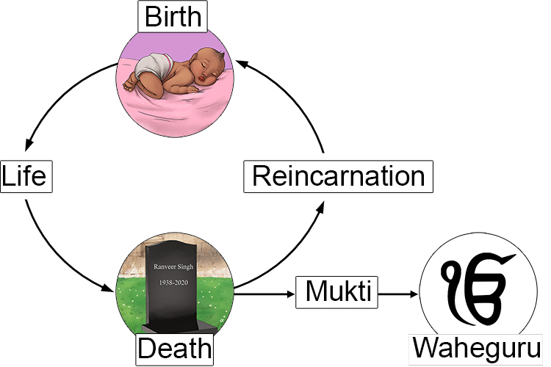
Circle of Life

Slide 12
10 Sikh Gurus were messengers sent from God to enlighten mankind.
The Guru’s lived by example of how God wanted people to be.
The 11th Guru is the holy book called the Sri Guru Granth Sahib Ji.
Who else was sent from God?

Slide 13
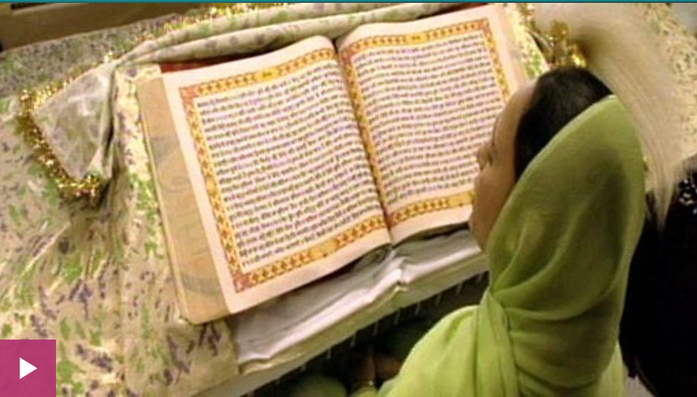
One who performs selfless service, without thought of reward, shall attain his Lord and Master. Guru Granth Sahib 286

