Slide 1
As I kneel before you (859)
1.As I kneel before you, as I bow my head in prayer, take this day, make it yours and fill me with your love.
Ave Maria, gratia plena, Dominus tecum, benedicta tu.
2. All I have I give you, ev’ry wish and dream are yours. Mother of Christ, Mother of mine, present them to our Lord. (chorus)
3. As I kneel before you, and I see your smiling face, ev’ry thought, ev’ry word is lost in your embrace. (chorus)

Slide 2
Rights and responsibility

Slide 4
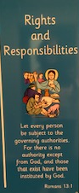
Let every person be subject to the governing authorities.
For there is no authority except from God, and those that exist have been instituted by God.

Slide 5
What are our rights as humans

Slide 6
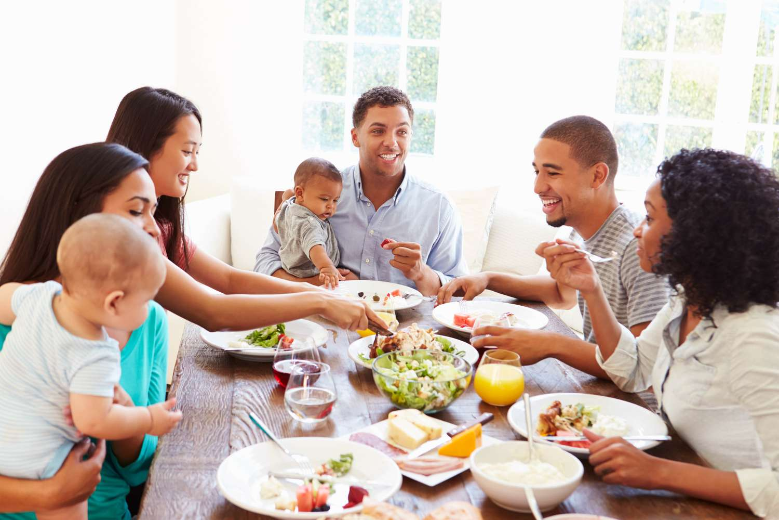
The right to food (everyone MUST have enough to eat)

Slide 7
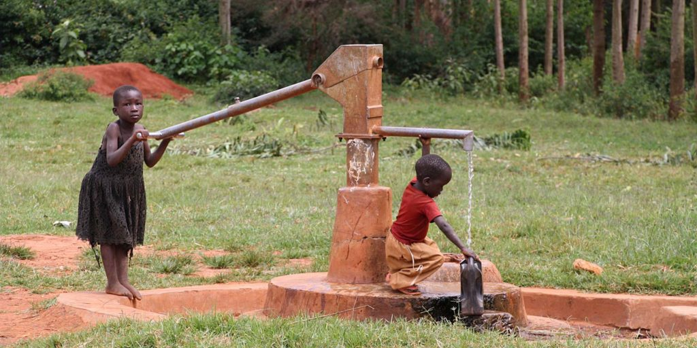
The right to clean water (everyone MUST have access to clean water)

Slide 8
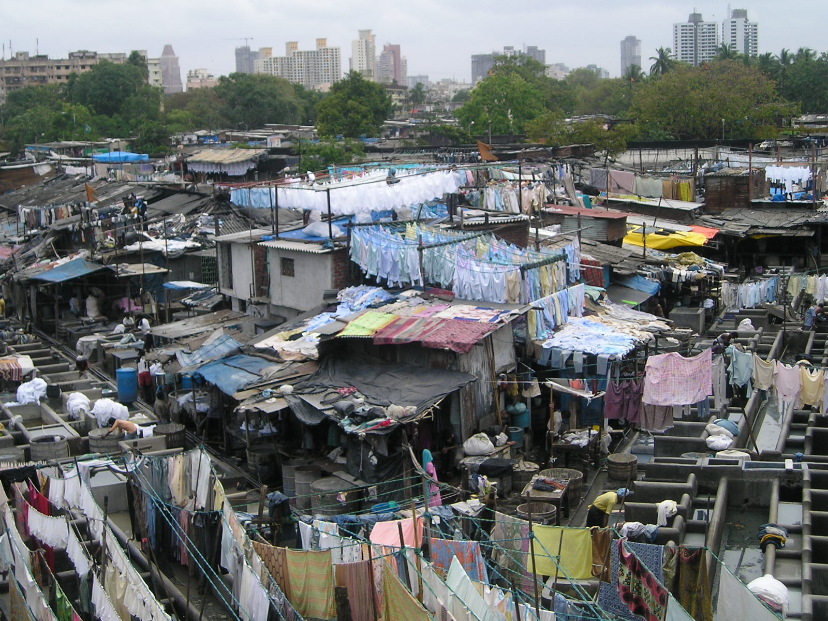
The right to shelter (everyone MUST have a home to live in)

Slide 9
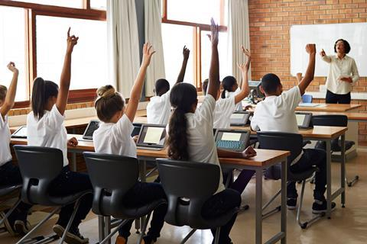
The right to education (everyone MUST be able to go to school to learn)

Slide 10
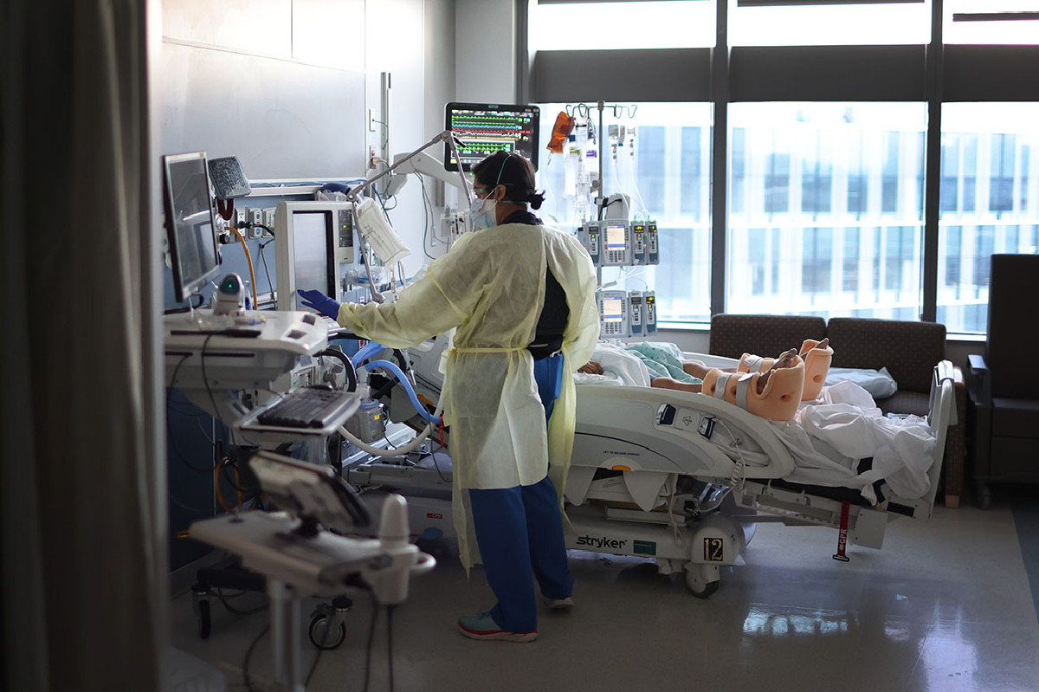
The right to health care (everyone MUST be able to get the medical care they need to be healthy

Slide 11
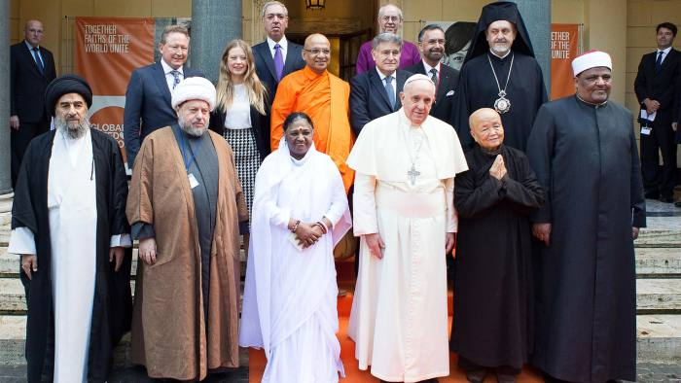
The right to practice their religion ( everyone MUST be allowed to follow their religious beliefs without fear of harm)

Slide 12
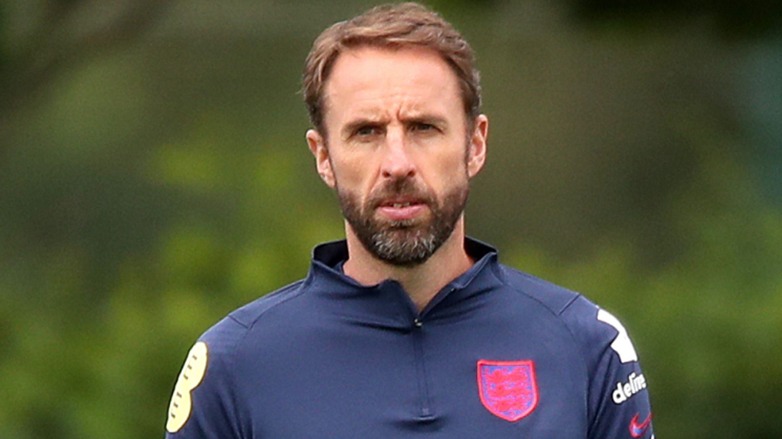
We also have responsibilities

Slide 13
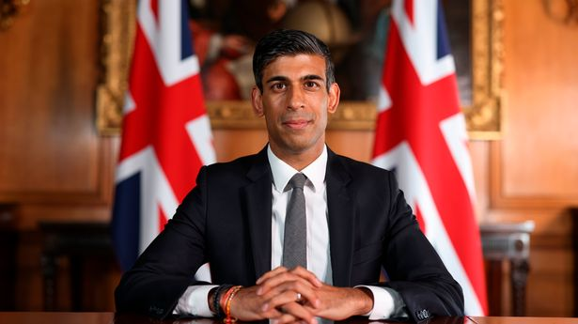

Slide 14
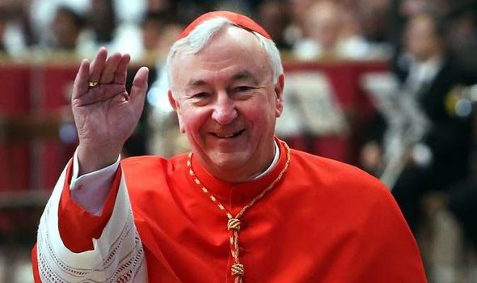

Slide 15
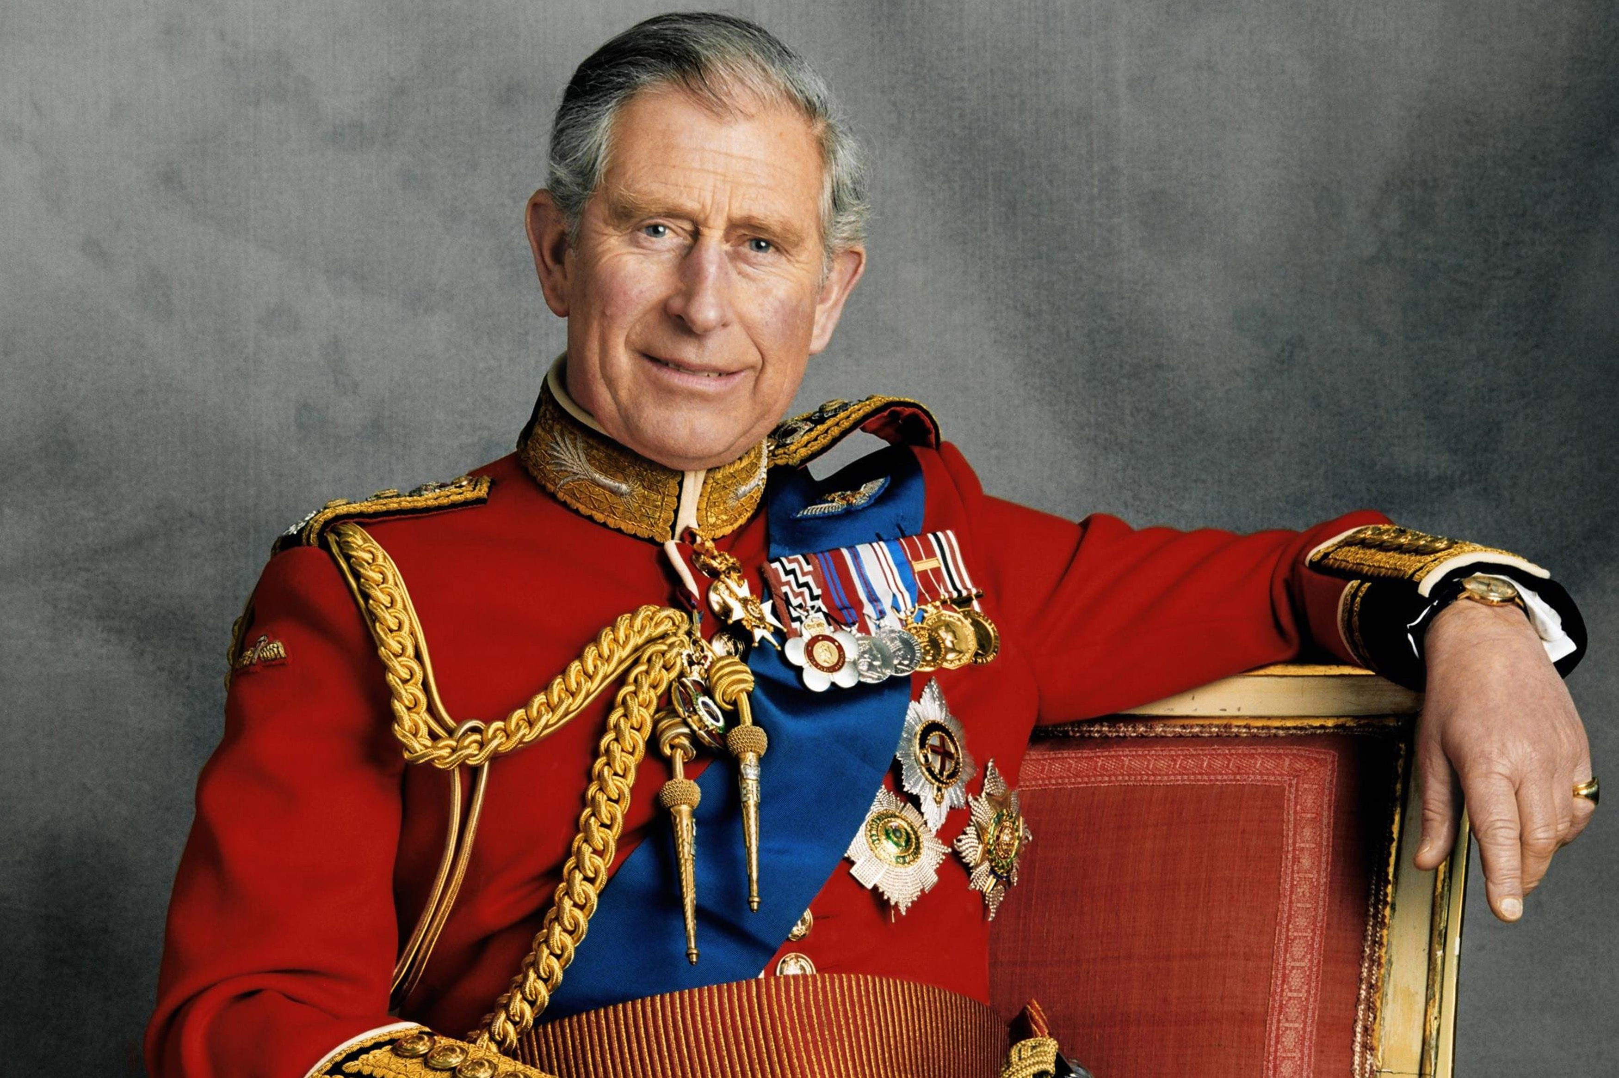

Slide 16
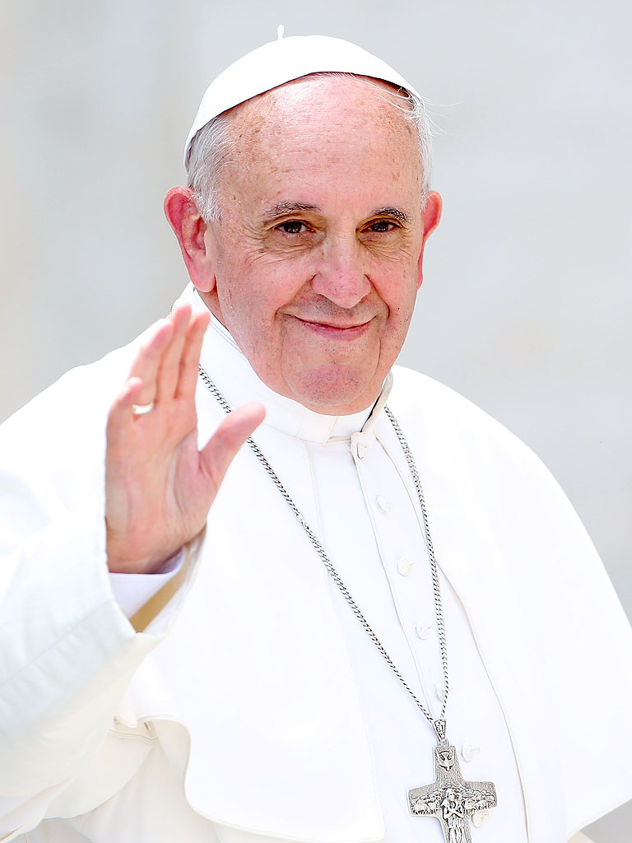

Slide 17
What is our responsibility
We have a responsibility to take care of our neighbours and ourselves.
Jesus said, “I give you a new commandment, that you love one another. Just as I have loved you, you also should love one another. John 13. 34
Who was Jesus telling us to love? To be responsible for?
The people in our class. The people in our school.
The people in our community; the parish, in our street, the people we pass everyday.
The people in our wider community; in places like Asia, Africa and South and Central America where they lack proper food and clean water, have health problems and don’t have much education.
Many people in this country and across the world are poor and live in poverty. Their basic rights are not being met!

Slide 18
As Catholics we believe that the biggest responsibility we have is to love each other.
I would like you to think about your responsibility to care and love for others – does this reading from the Bible say how you could go about that?
1 Corinthians 13: the gift of love
If I give away all my possessions, and if I hand over my body so that I may boast,* but do not have love, I gain nothing.
Love is patient; love is kind; love is not envious or boastful or arrogant ⁵or rude. It does not insist on its own way; it is not irritable or resentful; it does not rejoice in wrongdoing, but rejoices in the truth. ⁷It bears all things, believes all things, hopes all things, endures all things.
Love never ends.

Slide 19
What can we do in school to show that we are responsible for others
Listen in class so that others can learn
Let others have a turn to answer questions
Share the resources
Play with others so that they are not lonely
Tell an adult if you are worried about someone in school
Speak kindly to others so that they know you care for them

Slide 20
What can we do to help the poor in our community and overseas
Raise funds through charity work – Mary’s meals, CAFOD, Catholic Children’s society
Collect food for the food bank
Marian service – giving flowers to people in the parish
Visiting the care homes
Singing at the Friendship Club, Parish Fare
Giving to the homeless

Slide 21
We believe that charity work is an important aspect of our faith and education. You will be learning about the issues facing these organisations and the positive impact your donations can make. We hope that this experience will inspire them to become lifelong philanthropists.
Early Years - RSPCA
Year 1 - WWF
Year 2 - The Blue Marine Foundation
Year 3 - CAFOD
Year 4 - The Wildlife Trust
Year 5 - Make-A-Wish Foundation.
Year 6 - Crisis Homelessness.

Slide 22
We Pray
Prayer
Lord, help us to put others first and to take care of the people around us.
Thank you for your love for us.

Slide 23
Your Mission
Think about your responsibilities.
Do something that shows how you are putting others before yourself just as Jesus taught us.

