Slide 1
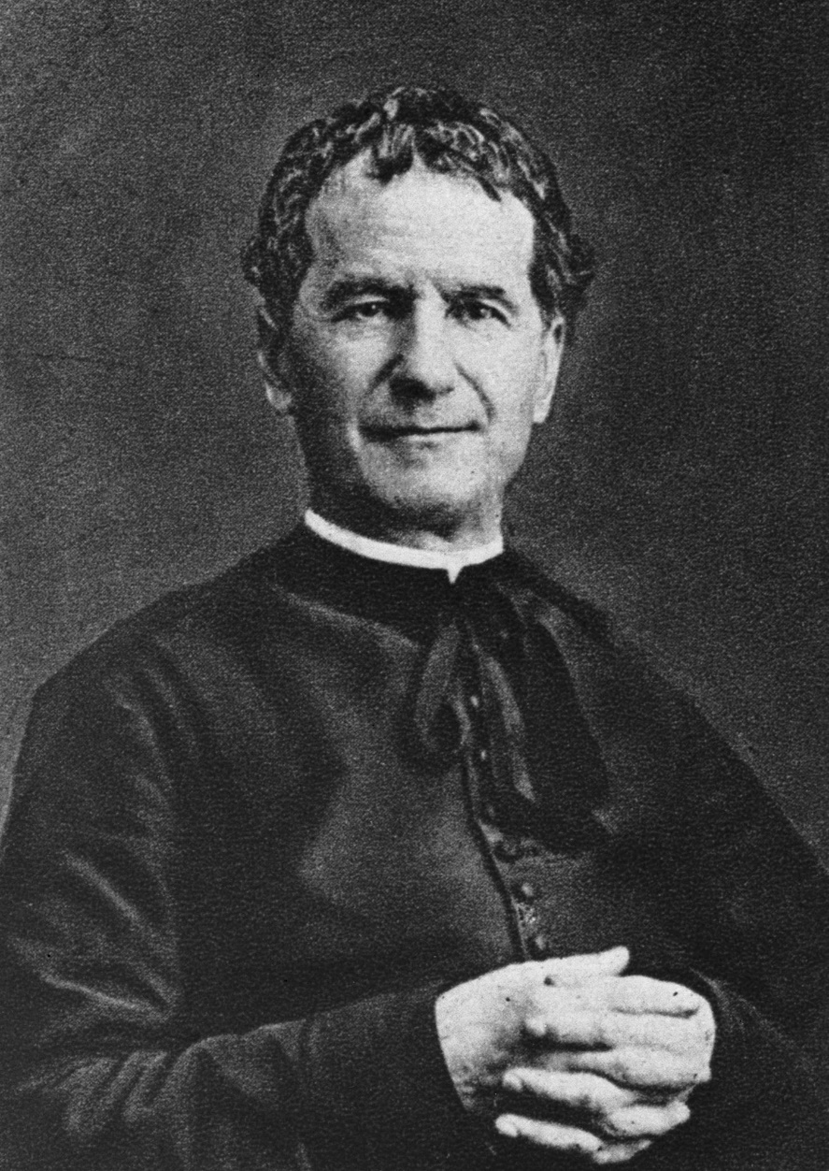
St John Bosco
Feast Day
31st January

Slide 2
St John Bosco is the patron saint of Education
He was born in 1815 in Italy. He was a Roman Catholic priest who dedicated his life to the education of children.
He was very poor as a child and this stopped him getting an education until he was older.
He used that education to help others.

Slide 3
St John Bosco is the patron saint of Education
As a Priest in the Italian city of Turin he saw that many families were living in the slums. Many children were orphaned or abandoned.
They had no schools to go to.
John Bosco knew that without an education they would not be able to get a job and make a better life for themselves

Slide 4
The Salesian Fathers
John Bosco taught the children in market places and soon began giving shelter to children who had no where to live.
With a group of men who he had helped as children he set up the Salesian society. There mission was to educate the poor.
St John Bosco was the founder of the Salesian Fathers whose mission to educate the poor is as important today as ever.
Their teaching methods are based on love not punishment.

Slide 5
Becoming a Saint
John Bosco dedicated his life to serving and living among the poor in Turin, a city in Italy.
He dedicated his life to educating boys.

Slide 6
Let us pray…..
O Saint John Bosco,
Father, Teacher, and Friend of Youth,
you have laboured so much for the salvation of souls:
teach me to be patient and gentle
as I seek the good of my own soul and the souls of my neighbour.
Amen

