Slide 1
Our Lady of the Visitation
Feast Day
31st May

Slide 2
Mary, the mother of Jesus is known by many names. The most common is Our Lady
God asked Mary to do a wonderful thing.
He sent an Angel to Mary to ask her to be Jesus Mother.
Mary said “YES” to God.
She teaches us that we should always listen to God and do what he asks of us.

Slide 3
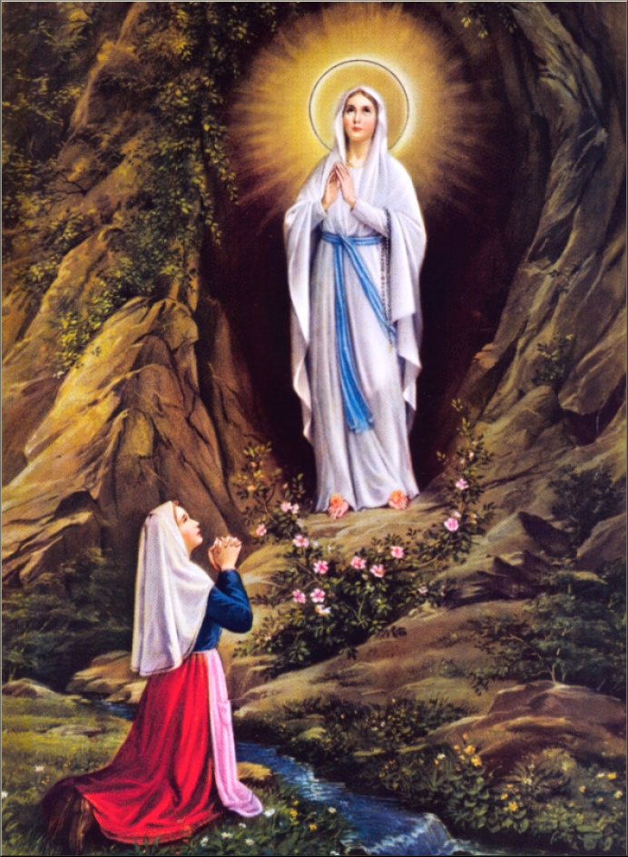
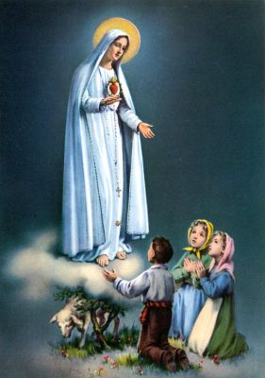
Mary is also known as……
Mother Mary
Mother of Christ
Our Lady of Lourdes
Our Lady of Fatima
Mary appeared to children in many places across the world and shrines have been built to her all over the world.

Slide 4
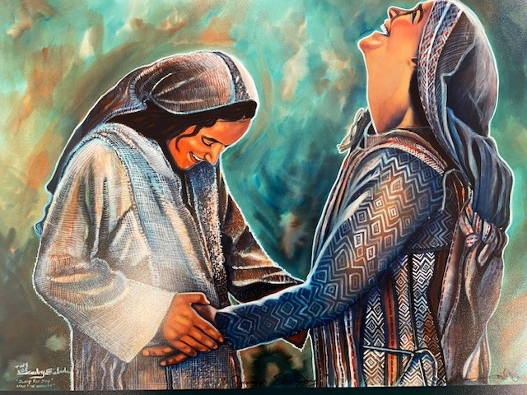
Our Lady of the Visitation
Our Lady of the Visitation is important to us because she is our Patron Saint and the Patron Saint of our Parish.

Slide 5
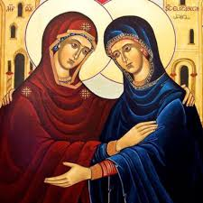
Feast Day 31st May
When Mary was pregnant she heard that her cousin Elizabeth was also going to have a baby. Although it was a long and tough journey Mary visited Elizabeth.
We remember Mary’s charity in visiting Elizabeth and staying with her for three months.
Luke 1:41-43: ‘When Elizabeth heard Mary’s greeting, the baby moved within her. Elizabeth was filled with the Holy Spirit and said in a loud voice, “You are the blessed of all women, and blessed is the child you will bear.”

Slide 6
Let us Pray……
Hail, Mary, full of grace, the Lord is with thee. Blessed art thou amongst women and blessed is the fruit of thy womb, Jesus. Holy Mary, Mother of God, pray for us sinners, now and at the hour of our death. Amen.

