Slide 1
St Vincent Pallotti
Feast Day
January 22nd

Slide 2
St Vincent Pallotti is special to us because our Priests follow his mission. They are Pallottine Priests.
Vincent was born in Rome in 1795.
From the very beginning Vincent was a kind and considerate boy.
He gave away his lunch to the poor people he met on his way to school, often leaving himself without anything to eat.
He even gave away his coat and his shoes if someone needed them.
Vincent spent many hours praying to God and asking him for his guidance.

Slide 3
Vincent became a priest when he was 24. He spent his time helping the poor.
Vincent believed that everyone should do God’s work not just the priests. He encouraged everyone, priests, men, women and children to work together to do God’s work.
His mission was to make everyone an ‘Apostle of Jesus’ so that they could help the poor.
Everyone worked together to do God’s work. They raised money for the poor and worked in prisons and hospitals. They built orphanages and set up apprenticeships so that young people could find work. They worked tirelessly to help the poor and needy. Vincent sent Missionaries all over the world to help others.

Slide 4
Becoming a Saint
Vincent brought food and clothes to people who were sick when no-one else would help them. He did not worry if he got sick because he was doing God’s work. Vincent risked his own life to help others.
One very cold day Vincent met a man who had no coat. He gave the man his coat but afterwards became very ill and died.
The people who knew him, including the pope, considered him a saint during his life because he did such good work.

Slide 5
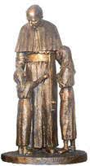
Calling Others
St Vincent calls all of us to follow his mission…....
….to help the poor.

Slide 6
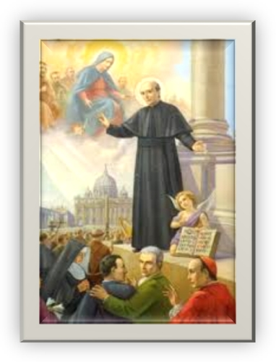
Let Us Pray….
Not the goods of the world, but God. Not riches, but God. Not honors, but God. Not distinction, but God. Not dignities, but God. Not advancement, but God. God always and in everything. - Saint Vincent Pallotti

