Slide 1
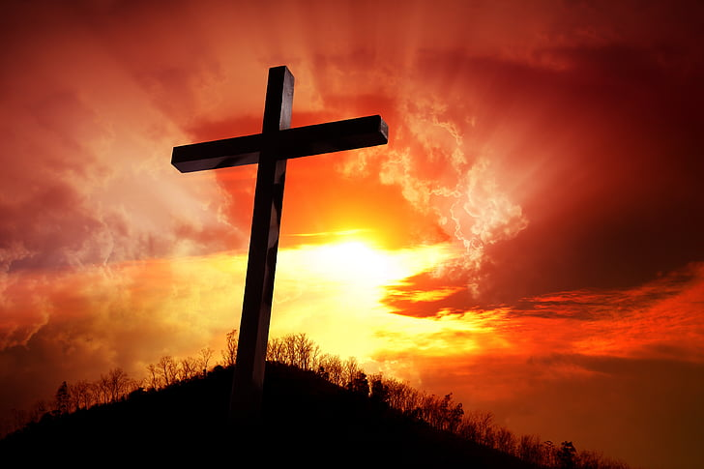
The Cross

Slide 2
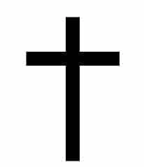
Latin Cross
This is the most famous cross, we also know it as the crucifix.
It reminds us the crucifixion of Jesus Christ and is a symbol of Christian religion.
The defining feature of this Cross is its more extended arm at the bottom.

Slide 3
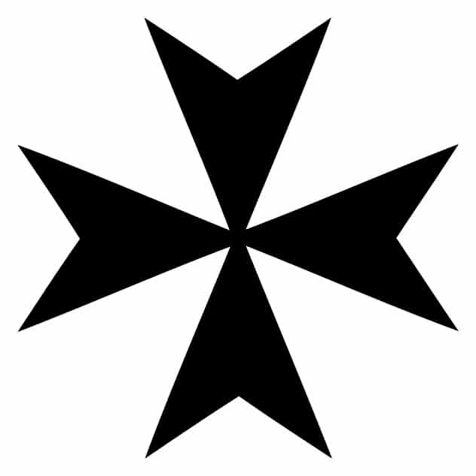
Eight pointed Cross (Maltese Cross)
Each of the 4 main sections of this cross represents the 4 cardinal values Prudence, Justice, Temperance, Fortitude.
Each of the 8 points reminds us of the 8 Beatitudes - truth, faith, repentance, humility, justice, charity, sincerity and resistance to persecution
This Cross is also known as the Maltese Cross. Or a cross of St John.
This cross is a symbol associated with Malta because of the Knights of St John who fought to protect Malta during the religious crusades.

Slide 4
Celtic cross
The Celtic cross is similar to a Latin cross but with a circle surrounding the centre of the four arms.
It has the same Christian meaning as the Latin cross
This cross is most commonly found in Ireland and Great Britain
It was also found in France during the 9th to 12th centuries.

Slide 5
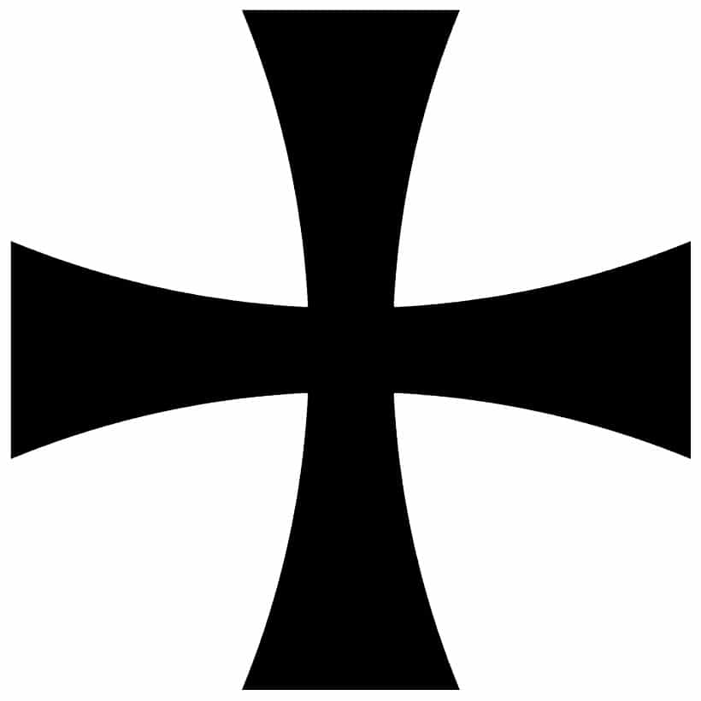
Templar Cross
Knights from Jerusalem, who were called the Templar Knights, wore the Templar Cross on their armour.
They believed that this cross symbolized their martyrdom – which means suffering and dying for something you believe in.
They believed believed that if they died in battle, this would help them go to Heaven.

Slide 6
Papal Cross
The Papal cross is the symbol of the Pope. Currently, Pope Francis is the leader of the Roman Catholic order.
It is a Latin cross with three horizontal lines of increasing length, instead of just one.
The three lines represent The Holy Trinity – the Father, the Son and the Holy Spirit.
It also represents the Pope’s authority around Heaven, Earth, and the Church.

Slide 7
Byzantine Cross
This cross is also referred to as the Eastern Cross because it is usually used by Orthodox Christians who primarily exist in the East.
While Roman Catholics believe that Jesus is just God in human form, the Byzantines believed that Jesus was both human and God.
Byzantine crosses originated during the reign of the Byzantine Empire.
The Ukrainians are incredibly attached to the Byzantine cross out of all the types of crosses.

Slide 8
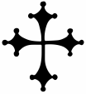
Cross Pisana
This cross is also known as the Pisan Cross. It was once the coat-of-arms of the people of Pisa.
Historically, it was granted by Pope Benedict VIII (8) to the Pisans during their wars with Saracens in Sardinia, Italy, around 1017.
Some people describe the cross as having paws or keys because of the three circles at the end of each arm.
The true meaning behind the Pisan Cross is unknown. However, some people believe the circles represent the twelve apostles of Christ surrounding him.
Modern Pisa uses the Cross Pisana as a town symbol.

