Slide 1
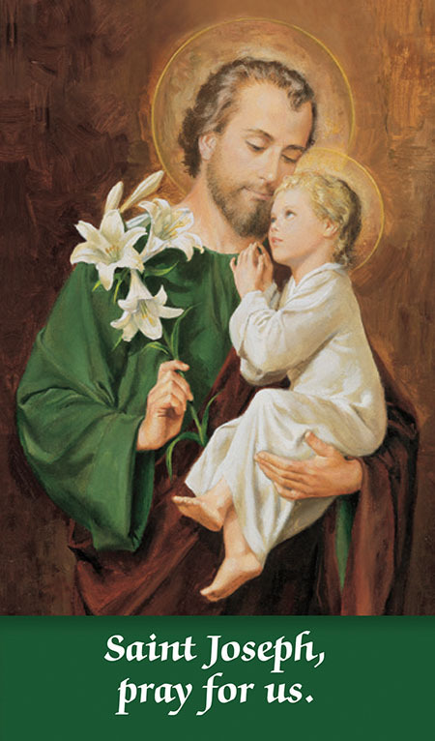
St Joseph
Feast Day
19th March

Slide 2
St Joseph – 19th March
St Joseph was the husband of Mary, the mother of Jesus. According to the earliest Christian traditions he was a carpenter or woodworker.
  The Gospel of Matthew calls him a ‘righteous man’ meaning he was an observant Jew who obeyed God’s Laws.

Slide 3
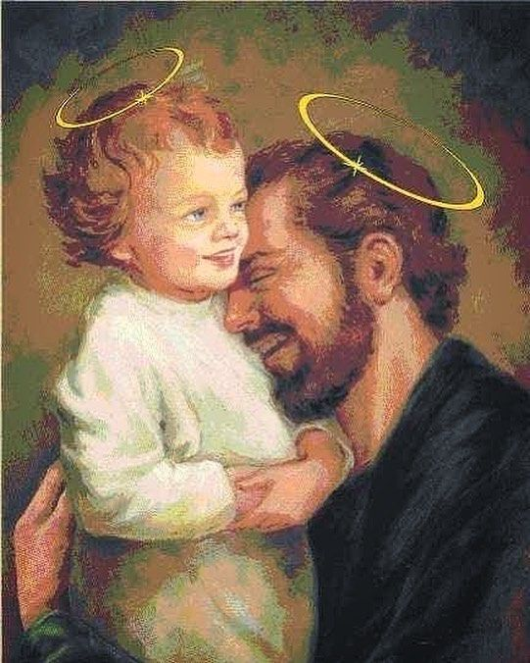
St Joseph is usually depicted holding Jesus, whom he loved very much.

Slide 4
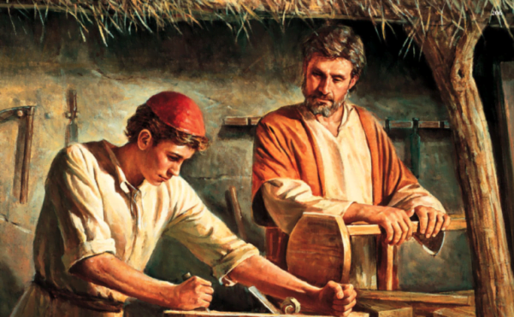
Joseph taught Jesus the skills of carpentry and made sure that he was kept safe when he was a child.

Slide 5
Let us pray……
Hail Guardian of the redeemer,
Spouse of the Blessed Virgin Mary.
To you God entrusted his only Son;
In you Mary placed her trust;
With you Christ became man.
Blessed Joseph, to us too,
Show yourself a father and guide us in the path of life.
Obtain for us grace, mercy, and courage, and defend us from every evil.
Amen

